Slide 1
Reaction Rate Laws
Mrs. Nielsen
Honors Chemistry

Slide 2
Expressing reaction rate
For the equation: A → B,
the rate at which A forms B can be expressed as the change in A (or ΔA) with time, where the beginning concentration A₁ is at time t₁, and concentration A₂ is at a later time t₂
Rate = ΔA = concentration A₂ – concentration A₁
Δt t₂-t₁

Slide 3
Expressing reaction rate
Since A is decreasing, its concentration is smaller at a later time than initially, so ΔA is negative
The negative sign is needed to make the rate positive, as all rates must be.
The rate of disappearance of A is proportional to concentration of A:
ΔA
Δt
-
α [A]

Slide 4
Rate Laws
ΔA
Δt
This equation, called a rate law, is an expression for the rate of a reaction in terms of the concentration of reactants
Rate = -
= k [A]

Slide 5
The Rate constant
The specific rate constant (k) for a reaction is a proportionality constant relating the concentrations of reactants to the rate of reaction
The value k is large if the products form quickly
The value k is small if the products form slowly

Slide 6
Reactant order
The order of a reactant is the power to which the concentration of a reactant must be raised to give the experimentally observed relationship between concentration and rate
For the equation: aA + bB → cC + dD,
Rate = k[A]^{n}[B]^{m}
Note: The exponents n and m in the rate law MUST be determined experimentally. The coefficients in the equation will not always correspond to the exponents in the rate law expression

Slide 7
Reactant order
Example:
Rate = k[A]²[B]³
The exponent of A is 2, so we say the reaction is 2nd order with respect to A
The exponent of B is 3, so we say the reaction is 3rd order with respect to B
The overall reaction order is the SUM of the orders of each reactant. The overall reaction order is 5.

Slide 8
Rate Laws
Rate = k[A]^{n}[B]^{m}
The rate law determines the speed of a chemical reaction and is based on THREE things:
The concentration (molarity) of each of the reactants
The exponent (order) to which each of these reactants is raised
The value of k (the rate constant), which is unique to each chemical reaction
Factors that affect k include:
Temperature
Presence of a catalyst

Slide 9
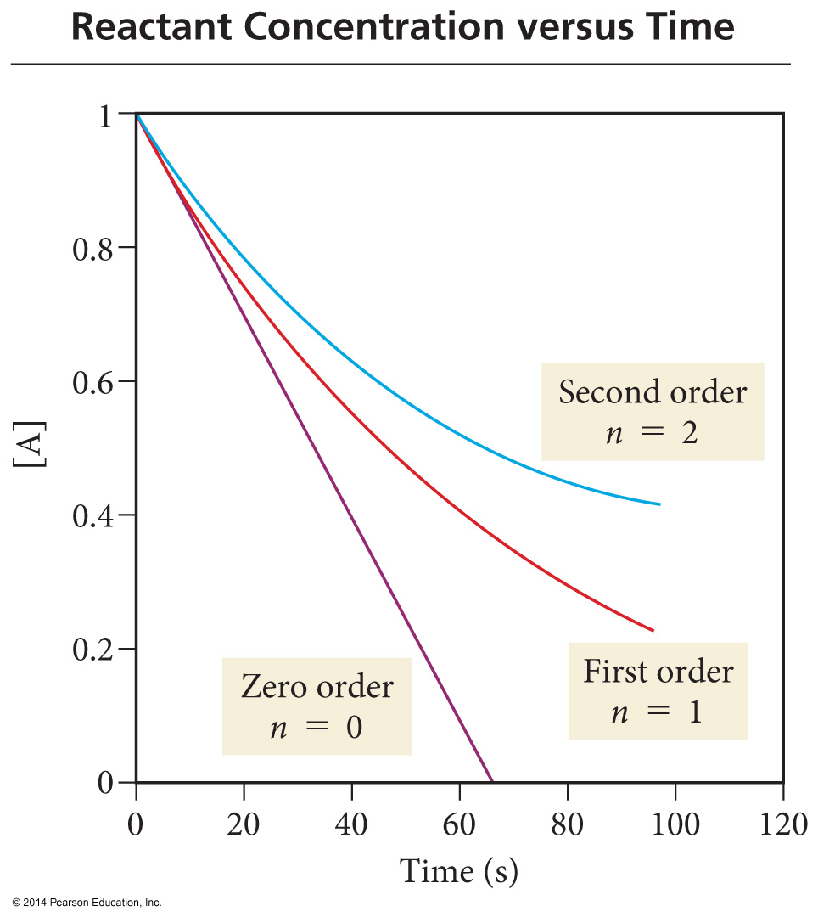
Reactant concentration vs. time A → Products
0 order: Reaction rate is independent of reactant concentration. The slope of the line is constant and the reaction proceeds at the same rate regardless of reactant concentration
1st order: Reaction rate slows down with time (the line becomes less steep)
2nd order: Reaction rate is even more sensitive to reactant concentration

Slide 10
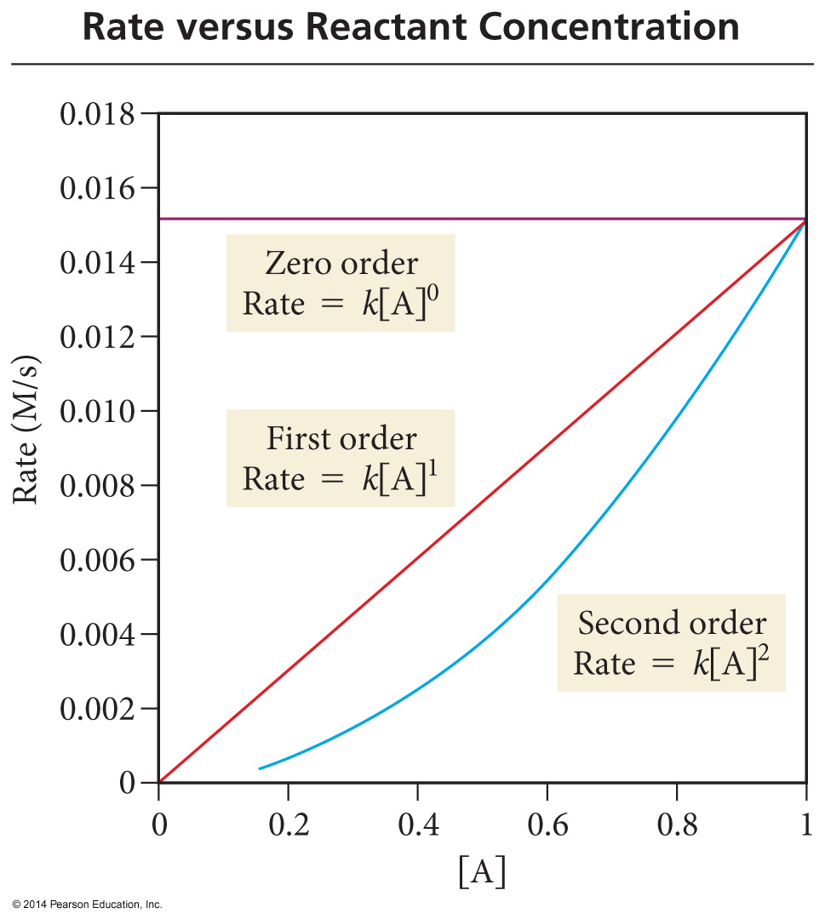
Rate vs. Reactant concentration A → Products
0 order: Reaction rate is independent of reactant concentration.
1st order: Linear relationship - reaction rate is directly proportional to reactant concentration
2nd order: Exponential relationship – reaction rate is proportional to the square of the concentration

