Slide 1
Warm Up Electron Configurations, Trends and Oxidation #s
Draw the orbital notations for Cr and Cu
Indicate the most stable electron configurations for the following ions
Cr ⁺¹
Cr ⁺³
Cr⁺⁶
Cu⁺¹
Cu⁺²
Find the Z_{eff} for Sc and K. Use this to justify the relative atomic radius and ionization energy of the two atoms.

Slide 2
What is a Trend?
A predictable change in a particular direction
Food for thought:
What “trends” do you see at Mira Costa High School?

Slide 3
A Key to the Trends
Decreasing Down
Increasing right
Increasing Down
Decreasing right

Slide 4
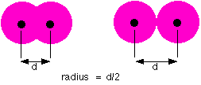
Atomic Radius:
The distance from the center of an atom's nucleus to its outermost electron.
The Atomic Radius is measured by finding ½ the distance between the nuclei of two identical atoms next to together (pm = picometers = 1x10⁻¹²m)

Slide 5
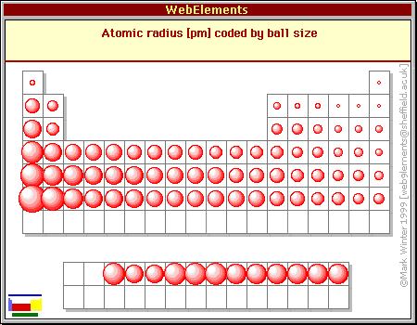

Slide 6
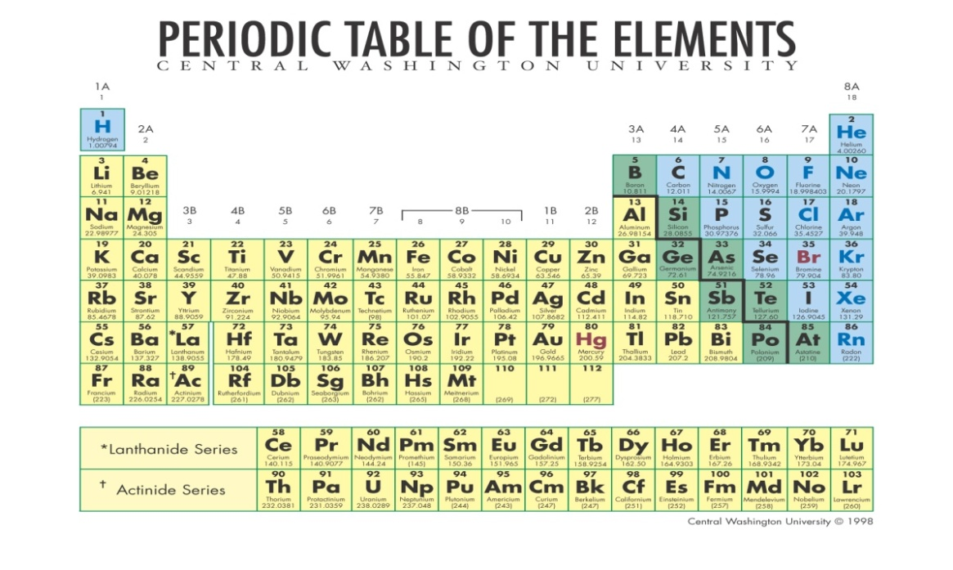
Atomic Radius:
The distance from the center of an atom's nucleus to its outermost electron.
Across a period:
Increased positive charge in the nucleus and increased Z_{eff}→ decreases atomic radius.
-
Down a group:
Valence electrons exist in higher energy levels (farther from the nucleus) → increasing atomic radius
+

Slide 7
Atomic Radius Practice
Which has a smaller Atomic Radius? Justify your answer using Z_{eff}
Argon or Chlorine?
Argon. Argon has a greater Z_{eff}, drawing its valence electrons closer to the nucleus. Both atoms have ten core electrons shielding their nuclei, but argon has one more protons than chlorine resulting in the greater Z_{eff}.

Slide 8
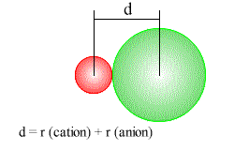
Ionic Radius: An estimate of the size of an ion in an ionic compound; found from the internuclear distance.

Slide 9
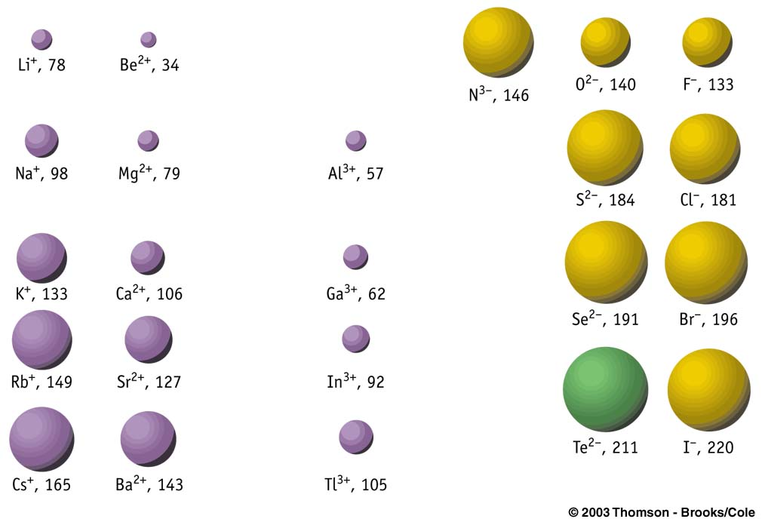
Ionic Radius

Slide 10
Ionic Radius
Cation=
positively charged ion
Anion =
negatively charged ion
10 e-
2 e-
3 p+
8 p+
ex) Lithium → Li⁺
ex) Oxygen → O⁻²
Cations will have a SMALLER atomic radius than the neutral atom.
Anions will have a LARGER atomic radius than the neutral atom.

Slide 11
Ionic Radius Practice
Which has a greater Ionic Radius?
N or N⁻³?
Mg or Mg⁺²?
S or S⁻²?
N⁻³
Mg
S⁻²

Slide 12
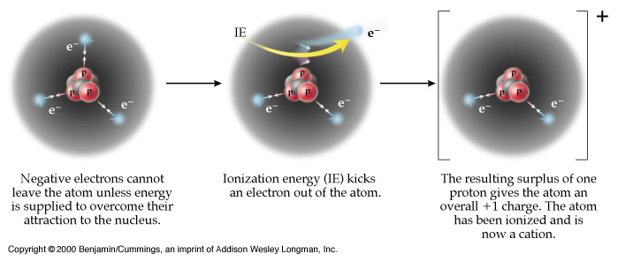
Ionization Energy (kJ/mol):
The amount of energy required to remove 1 electron from the valence shell of an atom.

Slide 13
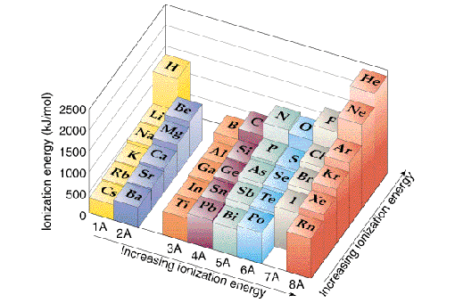

Slide 14
Ionization Energy (kJ/mol):
The amount of energy required to remove 1 electron from the valence shell of an atom.
Ion:
Atom or group of bonded atoms that have a + or – charge.
Across a period:
Increased positive charge in the nucleus and increased Z_{eff} holds electrons more tightly→ more difficult to remove the valence electrons
-
Ionization:
Process that forms an ion.
ex) Na → Na⁺ + 1 e⁻
Down a group:
Electrons exist in higher energy levels → valence e- further away from the nucleus AND more shielding by core electrons makes it easier to remove valence e-.
Ionization Energy
+

Slide 15
Ionization Energy Practice
Which has a greater Ionization Energy?
Aluminum or Chlorine?
Fluorine or Bromine?
Francium or Helium?
Chlorine (greater Z_{eff})
Fluorine (less shielding)
Helium (less shielding)

Slide 16
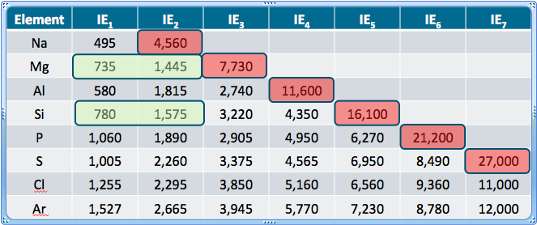
Ionization Energies can be used to Predict Oxidation States
Ionization Energies: 1st > 2nd > 3rd
Each successive electron is more difficult to remove due to stronger attraction to the nucleus

Slide 17
Electronegativity The ability of an atom in a chemical compound to attract electrons
I am soooo electronegative…
Wow, he is one attractive element…

Slide 18
Electronegativity: The ability of an atom in a chemical compound to attract electrons
Across a period:
Increasing positive nuclear charge “pulls” electrons in more
-
Down a group:
Electrons exist in higher energy levels → force of attraction decreases with distance (Coulomb’s Law)
+
FONClBrISCH

Slide 19
Electronegativity Practice
Which has a greater Electronegativity?
Potassium or Chlorine?
Fluorine or Bromine?
Francium or Sulfur?
Chlorine
Fluorine
Sulfur

