Slide 1
Naming Ionic Compounds
Mrs. Nielsen
Honors Chemistry

Slide 2
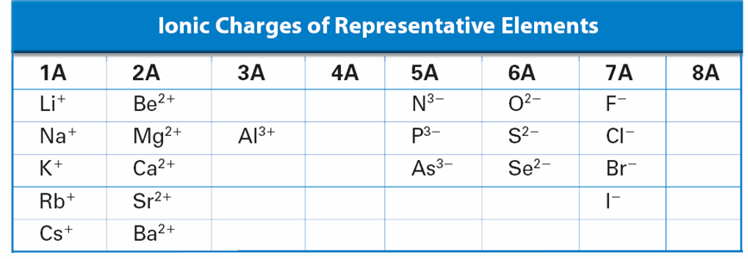
Monoatomic Ion
= A single atom with a charge
Common Ions Based on Groups

Slide 3
Monoatomic Ions
Oxidation number is the charge of a monatomic ion
Oxidation state is usually the same as the oxidation number (charge) and equals the number of electrons transferred.
Ex: oxidation state of Na : +1 Cl: -1
Main Group elements (s & p block) generally have 1 oxidation state
Transition metals can have more than 1 oxidation state (a.k.a. “the funky d block”)

Slide 4
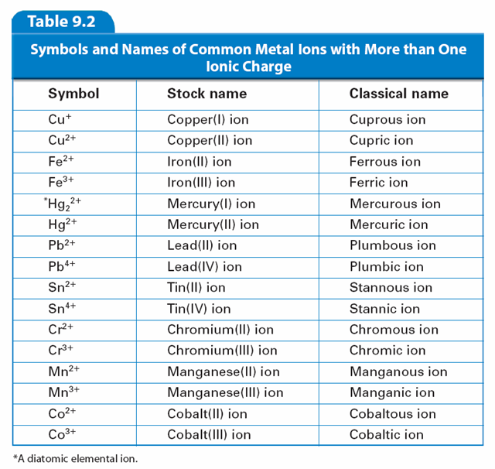
Naming “The Funky d Block”
When naming transition metals, the oxidation state is indicated by roman numerals (stock) or by a suffix (classical)
Exceptions: Ag⁺¹, Zn⁺²

Slide 5
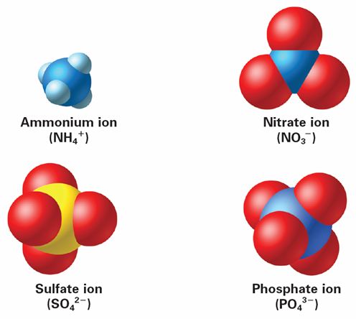
Polyatomic Ions
= Groups of atoms with a charge
The charge given to a polyatomic ion applies to the entire group of atoms because it acts as a unit.
The names of most polyatomic anions end in -ite or –ate
Most are oxyanions
* See Polyatomic Ions Handout

Slide 6
-ates vs. -ites
Oxyanion – polyatomic ion bonded to one or more oxygen atoms
Ex: NO₃⁻ (nitrate) SO₄⁻² (sulfate)
NO₂⁻ (nitrite) SO₃⁻² (sulfite)
ClO₃⁻ (chlorate) PO₄⁻³ (phosphate)
ClO₂⁻ (chlorite) PO₃⁻³ (phosphite)
What’s the difference between “-ates” and “-ites”?

Slide 7
Now we can finally Name Ionic Compounds
1. Monatomic cations use the element name.
ex: Cs⁺ = Cesium
2. Monatomic anions use the root of their element name plus the suffix –ide.
ex: Br⁻ = Bromide
You Try it!
Name the cation first and the anion second
NaCl CsBr K₂S

Slide 8
Naming Ionic Compounds continued...
* For Transition Metals with more than one oxidation number, roman numerals are required to indicate the charge on the ion
ex: FeO = iron (II) oxide
Fe₂O₃ = iron (III) oxide
* If a compound contains a polyatomic ion, simply name the ion
ex: NaOH = sodium hydroxide
(NH₄)₂S = ammonium sulfide

