Slide 1
Introduction to Photoelectron Spectroscopy (PES)

Slide 2
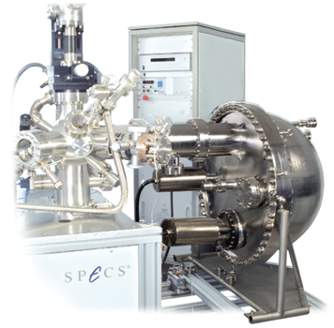
Why a webcast on PES?
Chemists rely heavily on various methods of spectroscopy to understand the structure of atoms and molecules that are too small to see directly
Photoelectron Spectroscopy (PES) is a powerful instrumental tool for probing the electronic structure of any of the naturally-occurring elements, as well as materials that contain mixtures of these elements
Image Source: SPECS GmbH
Notes:
Many people have asked why the redesign of the course includes photoelectron spectroscopy at all. Spectroscopy, in general, is a really powerful tool that chemists use to understand the structure of matter. Since the pieces of matter are too small for us to see directly, we rely heavily on various methods of instrumentation, including spectroscopy, to understand structure of atoms and molecules, the particles that are responsible for all of chemistry and the chemistry that we study on the macroscopic level.
Photoelectron spectroscopy can be used to probe the electronic structure of atoms, as well as mixtures of those atoms. And since PES data provides a direct link between electron arrangements and their energy, the Redesign Commission felt that it was an important data source to include in the new course.

Slide 3
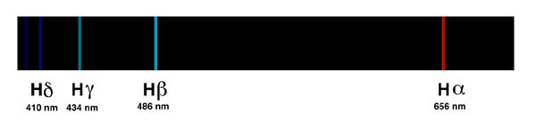
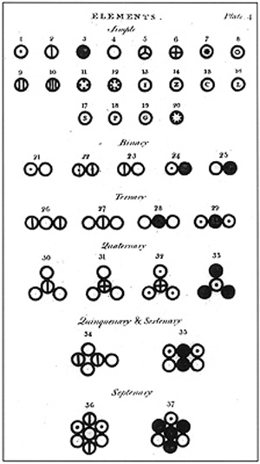
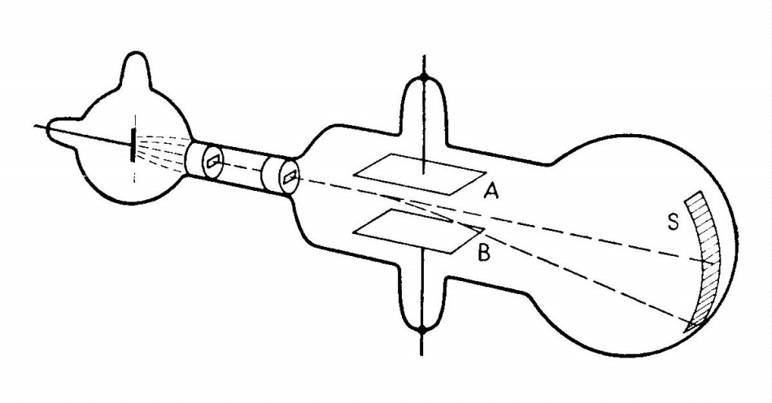
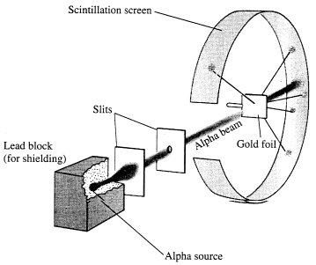
Various Models of the Atom
+
+
-
+
-
-
-
+
-
+
-
+
+
+
+
+
+
-
+
-
+
-
-
+
+
+
+
+
+
+
+
-
-
-
-
+
+
+
-
-
-
Dalton
Thomson
Rutherford
Bohr
Image sources:
http://library.thinkquest.org/13394/angielsk/athompd.html
http://abyss.uoregon.edu/~js/21st_century_science/lectures/lec11.html
http://mail.colonial.net/~hkaiter/astronomyimages1011/hydrogen_emis_spect.jpg
http://upload.wikimedia.org/wikipedia/commons/9/97/A_New_System_of_Chemical_Philosophy_fp.jpg
Notes:
In one of your preliminary questions, you were asked to identify the experimental evidence that led to the development of the atomic models.
Dalton built on the work of other scientists to derive that atoms must combine in whole-number ratios. And that there is nothing smaller than an atom.
Thompson then experimented with the cathode ray tubes and magnetic fields, and determined that charged particles must exist within the atoms themselves, giving evidence that we had electrons, a smaller piece to the atom itself.
Later on Rutherford, who is actually Thompson's former student, conducted the gold foil experiment in attempts to verify Thompson's plum pudding model. But instead, he derived that there must be a dense positive nucleus surrounded by negative charge within the atom.
And then Bohr used atom emission spectrum of hydrogen specifically to determine that there were quantized energy levels within the electron cloud.

Slide 4
Further refinements to these models have occurred with new experimental results
7s
5f
6p
1s
2s 2p
3s 3p 3d
4s 4p 4d 4f
5s 5p 5d 5f
6s 6p 6d
7s 7p
8s
5d
6s
4f
5p
4d
5s
4p
3d
4s
3p
3s
2p
2s
1s
Notes:
As we build the model of the atom further from these classic experiments, we often give students the sequence of electron filling, which many of them memorize, but do we ever really let them know how we came to this understanding of electron orbital filling?
This is actually an incredibly abstract concept. And one that the concrete operational thinkers in our classrooms will actually have a pretty hard time grasping. Students can often correctly generate electron configurations using these sort of memory tricks in these mnemonic devices, but does this really help them understand how we know that electron configurations are accurate descriptions of the electron distributions within an atom?

Slide 5
But not all elements ‘follow the rules’
1s
1s
[Ar]4s¹3d⁵
[Ar]4s¹3d¹⁰
2s
2p
3s
3p
4s
3d
4p
5s
4d
5p
6s
5d
6p
7s
6d
7p
4f
5f
Notes:
Now, hopefully we go further and show students how electron configurations align to our current Periodic Table. But then we eventually get into this predicament of explaining that elements like chromium and copper don't really follow the rule that are outlined by the Aufbau filling principle. But how do scientists actually know that these two elements and others in the Periodic Table don't actually follow the Aufbau filling rules?
If we're going train our students to think like scientists, then they need to be able to use data to make conclusions. So what are the data that support a shell and a subshell model of the atom?

Slide 6
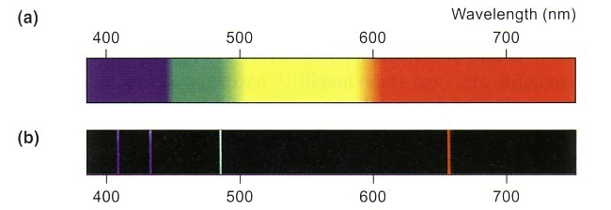
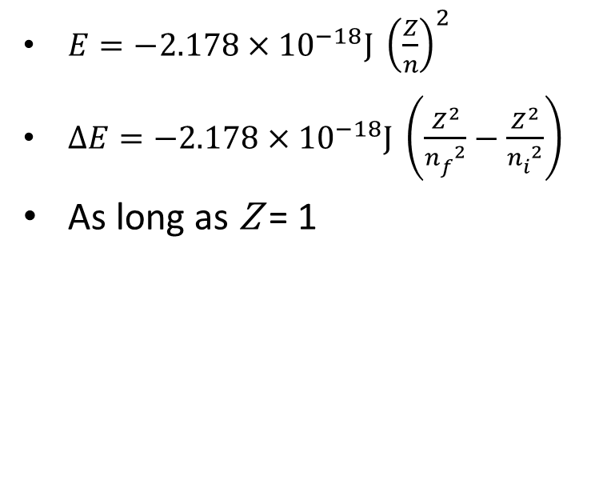
How do we know?
hν
-
hν
-
+
Notes:
Scientists use data to make conclusions. So what data do we have to support our shell and subshell model of the atom? Classically, we can start with the atomic emission spectrum of hydrogen to build the shell model of the atom, much in the way that Bohr did.
Electrons receive energy from electricity, from heat or incident photons. They can be promoted to higher energy levels in the atom. The electron will not stay in this excited state forever. So when the electron relaxes back to a lower energy level, it emits a photon of light.
We can record this photon's wavelength or frequency using a spectrometer. We can then even use Bohr's equation to determine the energy levels that the electron must have transitioned through to generate the visible light portion of the hydrogen emission spectrum.
This equation works great for hydrogen, but it falls down as soon as you try to use any of the other 100 or so elements. So the Bohr Model gives us an important feature of the atom that electron energy is quantized. But further refinements to this model are needed.

Slide 7
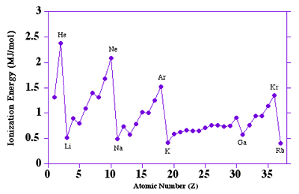
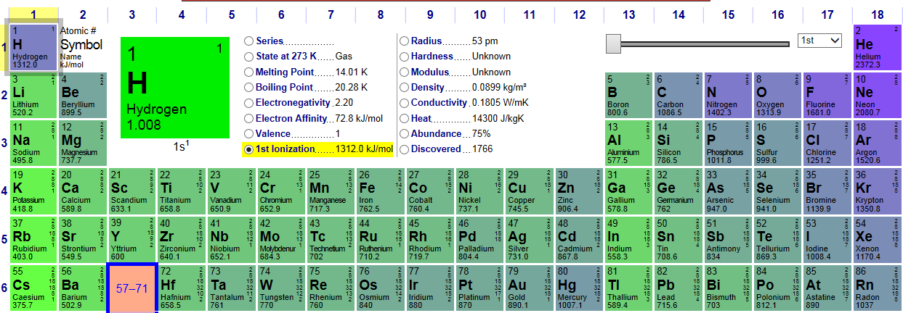
Ionization Energy
Image source: http://chemistry.beloit.edu/stars/images/IEexpand.gif
Image source: Dayah, Michael. “Dynamic Periodic Table.” Accessed Sept. 5, 2013. http://ptable.com/#Property/Ionization
Notes:
So we can analyze other data sources to get a more complete model of the atom. First, ionization energy data gives us a lot of information about nuclear charge and columbic effects, as well as some rational for the chemical behavior or elements within a column of the Periodic Table.
This data is commonly presented in textbooks, but where does this data come from? Textbooks often don't give the data source, or they say that the method for this data collection is too complex to discuss at this level.
This doesn't do much to help students understand the nature of science, nor does it make chemistry seem any less mysterious.

Slide 8
Ionization Energy
Element | IE₁ | IE₂ | IE₃ | IE₄ | IE₅ | IE₆ | IE₇
Na | 495 | 4,560
Mg | 735 | 1,445 | 7,730
Al | 580 | 1,815 | 2,740 | 11,600
Si | 780 | 1,575 | 3,220 | 4,350 | 16,100
P | 1,060 | 1,890 | 2,905 | 4,950 | 6,270 | 21,200
S | 1,005 | 2,260 | 3,375 | 4,565 | 6,950 | 8,490 | 27,000
Cl | 1,255 | 2,295 | 3,850 | 5,160 | 6,560 | 9,360 | 11,000
Ar | 1,527 | 2,665 | 3,945 | 5,770 | 7,230 | 8,780 | 12,000
LO 1.5 - The student is able to explain the distribution of electrons in an atom or ion based upon data.
LO 1.6 - The student is able to analyze data relating to electron energies for patterns or relationships.
Notes:
We can take the ionization energy concept deeper, and we further build the concept of electron shells and valence electrons by showing tables of successive ionization energy. But again, we often never tell the students where this data comes from. Now, before we get into where this data originates, though, let's take a moment to examine the data in front of us and answer some questions.
It appears that removing the second electron from an atom, regardless if it's from the 2S orbital or if it's from the 2P orbital, the second electron always requires more energy to remove than the first electron does. Why is this the case? If you try to pull an electron away from an ion that is already positively charged, more energy is required. The more positively charged the atom or the ion that you pull from, the harder it is to remove the electron.
So to remove two electrons from an atom, you need to achieve both the first and the second ionization energies. This ties into one of the pre-activity questions that you answered about magnesium. To remove two electrons from a mole of neutral gaseous magnesium atoms, you must put in 735 kilojoules per mole of energy to remove the first valence electron. And then an additional 1,445 kilojoules per mole to remove the second. Totally 2,180 kilojoules per mole overall.
By the way, there are two learning objectives in the curriculum framework that align to this type of activity. LO 1.5 says that a student should be able to explain the distribution of electrons in an atom or ion based on data. Ionization energy and successive ionization energy data are great ones to use. And then also, the student is able to analyze data relating to electron energies for patterns or relationships.
So you can look at successive ionization energy to figure out which column an electron or an atom should fall in based on when you start stripping core versus valence electrons.
So, so far we've been looking only at the valence electrons, but what would happen if you wanted to probe further into the atom to look at core electrons?
You can see from the successive ionization energy table that the core electrons require substantially more energy to remove than the valance electrons do.

Slide 9

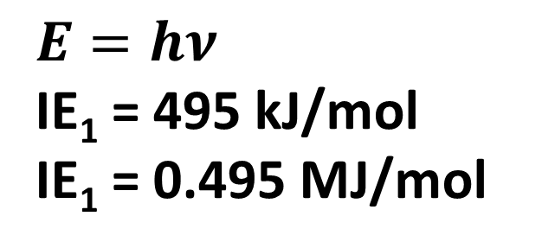
How do we probe further into the atom?
$$E=hν$$
Radiation Type | ν | E | Aspects Probed
Microwaves | 10⁹ – 10¹¹ Hz | 10⁻⁷ – 10⁻⁴ MJ/mol | Molecular rotations
Infrared (IR) | 10¹¹ – 10¹⁴ Hz | 10⁻⁴ – 10⁻¹ MJ/mol | Molecular vibrations
Visible (ROYGBV) | 4x10¹⁴ – 7.5x10¹⁴ Hz | 0.2 - 0.3 MJ/mol | Valence electron transitions in atoms and molecules
Ultraviolet (UV) | 10¹⁴ – 10¹⁶ Hz | 0.3 – 100 MJ/mol | Valence electron transitions in atoms and molecules
X-ray | 10¹⁶ – 10¹⁹ Hz | 10² – 10⁵ MJ/mol | Core electron transitions in atoms
hν
-
$$E=hν$$
IE₁ = 495 kJ/mol
IE₁ = 0.495 MJ/mol
-
-
-
-
11+
-
hν
-
-
-
-
-
Notes:
Based on what we saw on the Bohr experiment, electrons have to absorb energy to reach excited states. So we're going to need an energy source in order to move electrons around inside of the atom.
Light or electromagnetic radiation is a valuable probe for parts of atoms in molecules. Planck's Equation communicates that light with higher frequency has higher energy. So if you want to have enough energy to remove multiple electrons or core electrons, then we're simply going to need electromagnetic radiation of higher frequency.
If you look at the distribution of frequencies within the electromagnetic spectrum, you can see that different frequencies correspond to different energy transitions of atoms and molecules.
If you want to remove a valence electron from an atom, say of sodium, how much energy would we have to add to that electron to remove it? If we look at Planck's Equation and substitute in values, you can see the amount of energy to remove the first electron, what we would consider to be the ionization energy, falls within the ultraviolent realm. So visible and ultraviolent light are tuned to the removal of valance electrons.
And you can see from the first ionization energy data that was on the previous slide that a lot of atoms correspond to visible and ultraviolet light electron transitions for their valence shell. But what would happen if we wanted to inject an electron from a core part of the atom, one of the inner electron shells? What if we wanted to remove an electron from the first energy level? What type of light would be needed to remove that electron?

Slide 10
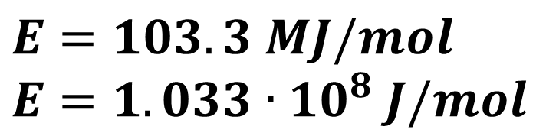
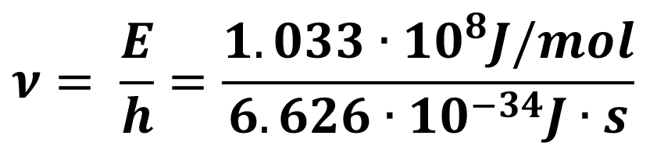

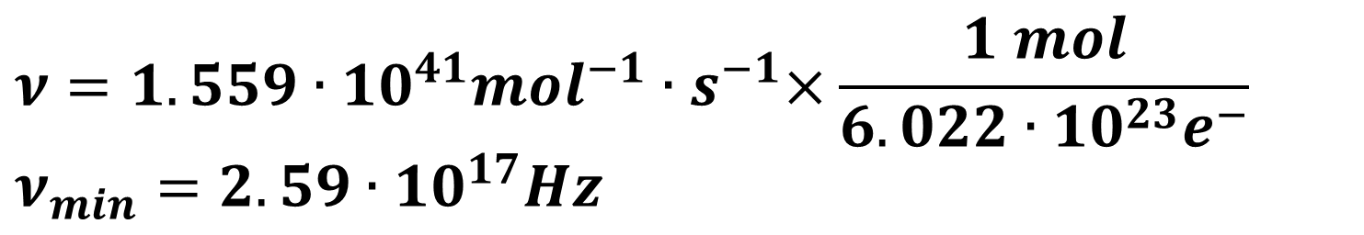
Removing Core Electrons
-
$$E=103.3 MJ/mol$$
$$E=1.033∙{10}^{8} J/mol$$
-
-
-
-
11+
-
hν
-
-
-
$$ν= \frac{E}{h}=\frac{1.033∙{10}^{8}J/mol}{6.626∙{10}^{−34}J∙s}$$
-
-
$$ν=1.559∙{10}^{41}{mol}^{−1}{∙s}^{−1}$$
$$ν=1.559∙{10}^{41}{mol}^{−1}{∙s}^{−1}×\frac{1 mol}{6.022∙{10}^{23}e^{−}}$$
$$ν_{min}=2.59∙{10}^{17}Hz$$
Radiation Type | ν | E | Aspects Probed
X-ray | 10¹⁶ – 10¹⁹ Hz | 10² – 10⁵ MJ/mol | Core electron transitions in atoms
Notes:
So let's look specifically at the first energy level. In order to remove electrons from the first energy level of sodium atoms, over 100 mega joules of energy are required. If we use Planck's Equation, then we can determine the frequency of that light needed to inject this electron.
And if we follow the math through, we can see that the type of light that's needed to remove this electron corresponds to x-rays. So x-ray radiation would be one good choice to use if we want to try to study things further inside of the atom than just the valance shell.

Slide 11


Removing Core Electrons
hν
-
-
-
$$E_{1st}=103.3 MJ/mol$$
-
-
11+
-
hν
$$E_{2nd}=3−6 MJ/mol$$
-
-
-
-
-
Any frequency of light that is sufficient to remove electrons from the 1st shell can remove electrons from any of the other shells.
$hν$ = IE + KE
Notes:
Now, if we use x-rays to remove electrons from the first energy level, it's important to know that the amount of energy required to remove electrons from the first shell is going to be much greater than the amount of energy required to remove electrons from the second shell.
So the x-ray that is energetic enough to remove first energy level electrons is also going to remove second energy electrons as well. The difference is that the second energy level electrons, because they are easier to remove, are going to exit the electron cloud with much greater kinetic energy.
This fact is really important to photoelectron spectroscopy because if electrons from further energy levels leave with greater kinetic energy and if we can measure that kinetic energy that the electrons have, then we can figure out how much energy must have been required to remove that specific electron from the atom itself.

Slide 12
PES Instrument
Image Source: SPECS GmbH, http://www.specs.de/cms/front_content.php?idart=267
Notes:
So we're going to look next at how the PES instrument can generate a spectrum of electron energies for atoms within an element. You see a picture here of a PES instrument, which doesn't give you much insight into what's happening inside any more than looking at the outside of a spectrophotometer lets you know how the machine operates.
But if you look here to the left, you can see where the samples are analyzed. And this has to be done under ultra-high vacuum conditions. The radiation source here causes the electrons to be ejected from the sample, and the free photoelectrons travel through the hemispheric analyzer here where the amount of kinetic energy that they possess can be measured and recorded.

Slide 13
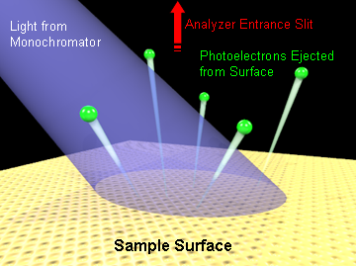
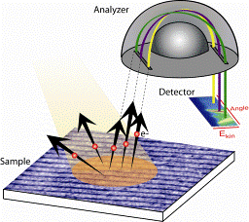
Supporting Resources (cont.)
Image Source: Shen Laboratory, Stanford University and SLAC National Accelerator Laboratory
http://arpes.stanford.edu/facilities_ssrl.html
Image source: Inna M Vishik
http://www.stanford.edu/~ivishik/inna_vishik_files/Page452.htm
Notes:
I hope that after this webcast, you now feel that you have a greater understanding of how the PES instrument collects data about electron energies by ejecting electrons and then collecting data on their kinetic energies.

Slide 14
X-ray or UV
Source
Kinetic Energy Analyzer
Kinetic Energy Analyzer
6.26
0.52
Binding Energy (MJ/mol)
3+
3+
3+
3+
3+
3+
3+
3+
3+
3+
3+
3+
3+
3+
3+
3+
3+
3+
3+
3+
3+
3+
3+
3+
3+
3+
3+
3+
3+
3+
3+
3+
3+
3+
3+
3+
3+
3+
3+
3+
3+
3+
3+
3+
3+
3+
3+
3+
3+
3+
3+
3+
3+
Notes:
We have here a sample of several atoms of the same element. And if you watch what happens during the radiation process, you can use this model to envision how the spectrum from PES is established. In order for a spectrum to be generated, though, you need a large sample of atoms so that electrons from all energy levels can be analyzed.
So let's take a moment to look at the atomic level model. Pay careful attention to how electrons from the first energy level are different than electrons from the second energy level.
So if you look at the irradiation, you can see it causes electrons to be ejected, and then the kinetic energy analyzer measures the energy of the electrons that pass through it. And so if we look at now our valance electron, you can see the valance electron has a different binding energy than the core electrons.
So core electrons seem to build up to peak at about 6.26, and then that core electron amplifies that peak even further. If you look at this valance electron, you can see the peak at 0.52 binding energy seems to be amplified for the valance electrons. So one more core electron you can see the binding energy of 6.26 mega joules per mole gets amplified.
And so we see clearly for this atom -- I'm obviously looking at lithium here. For this atom, the binding energy of the core electrons is significantly higher than the binding energy of the valance electrons.
Now, remember back to what we said earlier, that the electrons that have less binding energy that are less attracted to the nucleus, those valance electrons or external electrons, they're going to eject from the atom with much greater kinetic energy.
So let's look at how that kinetic energy analyzer can actually measure the kinetic energy of the electrons after they've been ejected from the atom.

Slide 15
X-ray or UV
Source
Kinetic Energy Analyzer
Kinetic Energy Analyzer
Li
6.26
0.52
Binding Energy (MJ/mol)
Boron
19.3
1.36
0.80
Binding Energy (MJ/mol)
5+
3+
5+
3+
5+
5+
5+
3+
5+
3+
3+
3+
3+
5+
3+
5+
3+
3+
3+
3+
5+
3+
3+
3+
5+
3+
3+
5+
3+
5+
3+
3+
5+
3+
3+
3+
5+
3+
3+
5+
3+
3+
5+
3+
3+
3+
5+
3+
3+
5+
3+
3+
5+
Notes:
So we're going to look at a different system now. We clearly have a different atom here. Think first what you would expect the spectrum for this atom to look like based on what you saw for lithium. So would you expect two peaks, one you expect one peak, would you expect three, would you expect them all to have the same energy, different energies? Just take a moment to think through it, and then I'll run the animation. And we'll sort of see what happens as the spectrum builds up.
So is there anything that looks different about this spectrum compared to what we saw last time with lithium? We still definitely see a splitting of energy between the first energy and the second energy level. But if you look to the right-hand side of the spectrum, we have an additional peak that we didn't see before.
So clearly, there is something different about boron than what we saw with lithium. And if we compare the spectrum side by side, you can see a couple of things. First of all, we still see one peak bigger than the other, so there's more electrons on that first energy level than there were in the valance shell or the outer most subshell for boron. But we also see a couple of things.
There's something in boron about the second energy level that lithium didn't have. So now we have an experimental observation, some actual data that we can put in front of our students to start to build the idea that even within the second energy level there are further refinements to our model that we now need to introduce the idea of subshells.
So you can use this data to introduce the idea of S, P, and D sublevels and the varying electron energy that is there. PES provides direct evidence that the Bohr Model does not fully describe the electron shells. And our subshell model provides a further refinement to his first model presented.
This addresses rather neatly learning objective 1.12 or 1.12 that a student should be able to explain why given sets of data suggest or do not suggest the need to refine the atomic model from a classical shell model to the quantum mechanical model.
So photoelectron spectroscopy inches us closer to the quantum mechanical model of the atom in a way that's data driven and a little bit more concrete than just presenting students with a list of orbital filling diagrams or asking them to memorize a set of quantum numbers or a sort of tangential reference to the Schrodinger equation. Which students at this level would be very unlikely to understand the mathematics and the computations and trying to resolve that equation are simply too complex.
I do want to point out one limitation of this model that I've presented in front of you and that I've built with this animation. I've presented a set of atoms that are stationary and this is indicative of the solid phase and photoelectron spectroscopy is often done with solid-phase elements. But this does provide one complication to the data analysis.
So if you're familiar with the photoelectron effect, then you know that there is a work function involved with removing electrons from bound atoms in the solid state because some of the electrons are tied up in bonding orbitals, and this adds one just additional level of energy that has to be overcome.
PES can be run on individual gaseous atoms as well. And this eliminates the need for the work function since atoms are individualized in the gas phase, whereas in the solid phase, they're clearly all stuck together.
Attempting to illustrate that gas phase version of photoelectron spectroscopy would have just been too complex, and I wanted to keep the animation as clear as possible for my students.
So for your own knowledge, I think it's important to know that there are limitations on the model that I presented with you here. I don't think that students need to know that particular limitation. The simulated spectra that we'll be using on the following slides usually are collected from gaseous atoms not bonded in the solid state, are meant to represent gaseous atoms.
But many of the published spectra that you're going to find on photoelectron spectroscopy will commonly be for solid-state atoms and compounds. So just be aware that both methods of data collection are possible, but the gaseous systems are much easier to analyze and provide much cleaner data for analysis.

Slide 16
Analyzing Data from PES Experiments
Notes:
Now that you know how the data are collected within the PES instrument, let's look at how we can analyze data from photoelectron spectroscopy experiments that are run on various samples. The following questions will be available to you in the resources section that accompany this presentation.

Slide 17
Analyzing data from PES
2p
2.0
1s
2s
Relative Number of Electrons
84.0
4.7
+
90 80 70 60 50 40 30 20 10 0
Binding Energy (MJ/mol)
Which of the following elements might this spectrum represent?
  He
  N
  Ne
  Ar
Notes:
Before we get into the question that accompanies this data, let me point out a couple of features of this simulated spectrum. This spectrum is idealized, so a lot of the background noise and the other transitions within the atom have been removed so that students can focus just on the peaks that are important for establishing the subshell model.
If you look at the X axis here, you'll notice that it is in descending order. And we've reversed the X axis on purpose. This is a convention that the Test Development Committee chose to use since students can imagine that the nucleus would lie at the left-hand side of the axis right at the origin. And then if they move further to the right, then they can see that the orbitals, on average, are further from the nucleus and have less energy required to remove electrons from those orbital.
The 1S orbital then would be closest to the origin since it requires the most energy to remove and is closest to the nucleus, on average. Then we've got the 2S orbital further away, and then the 2P orbital, which requires even less energy to remove than the 2S.
Now, when we look at average distance, this is not a true direct relationship because there are greater penetrating ability of the S orbital compared to the P, but you can at least imagine first energy level, second energy level, and third. And reason out the best based on the energy.
So looking at this energy diagram, which of the following elements are most likely represented by this spectrum?
So if you look at the relative number of electrons on these peaks, you can see the amount in the 1S orbital and the 2S orbital are about the same. And then the 2P orbital appears to have about three times more electrons than the 2S orbital does. So this would be indicative of neon if we were to try to sign the electron configuration based on the data that was collected here.

Slide 18
Analyzing data from PES
2p⁶
7.9
1s²
2s²
3s²
3p¹
Relative Number of Electrons
151
12.1
1.09
0.58
100 10 1
Binding Energy (MJ/mol)
Given the spectrum above, identify the element and its electron configuration:
  B
  Al
  Si
  Na
Notes:
Looking at the spectrum, could you assign an electron configuration for this element and identify the element as well? You could present this either as a free response question or as a multiple choice question, but we'll treat it as a multiple choice question here.
So looking at these four choices, if you go through the spectrum and analyze which sublevels are present, you can assign the number of electrons based on peak height. Doing all of that, if we look at the electron arrangements and break down these primary energy levels into the sublevels that are present and if we look at peak height and reason out proportionality of heights to number of electrons, we should be able to arrive at the electron configuration of aluminum.
Now, one note here about the axes. When you run a pure sample, the peak heights -- or really it's the area under the curve -- is proportionate to the number of electrons that have that particular binding energy. So if you look at spectra online and in published books and activities, you may see them label the axes as relative number of electrons, as I've done here.
And that's because the signal intensity is proportionate, for the most part, to the number of electrons as long as you're dealing with a pure sample. The only thing that will change the relative number of electrons is the number of electrons within each sublevel of that atom. But again, this only really works for pure samples. It does not work on mixtures.

Slide 19
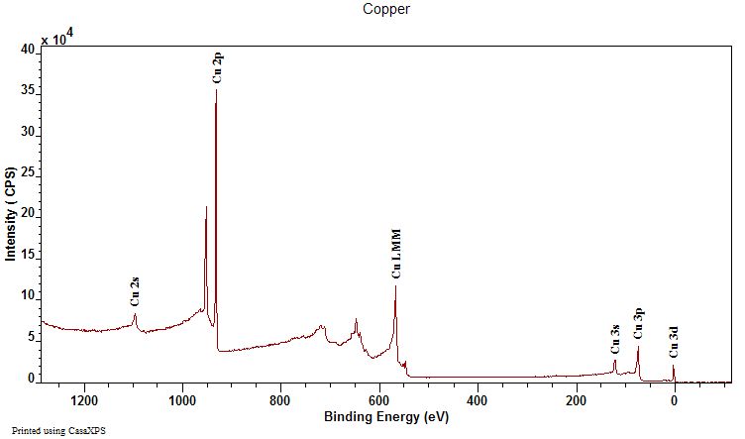
Real Spectrum
Notes:
So let's take a look at an actual spectrum that comes from a PES instrument. You can find these spectra online if you search for things like ‘XPS’ or ‘photoelectron spectra’ or ‘ESCA spectroscopy’. If you look at the spectrum, though, you'll see that there's a lot more noise and detail on this spectrum than in the idealized spectrum that I presented earlier.
But there are still some things that can be learned from the spectrum. One of the major factors that contributes to some of these background peaks that you're seeing are Auger transitions. What we're doing right now is going to go a bit beyond anything that we would ever cover on the AP exam, but I think that if you're going to use real spectra, I think it is worth being able to explain to students what they're seeing.

Slide 20
Auger Transitions
-
-
-
-
-
hν
11+
-
hν
-
-
-
-
-
Notes:
Auger transitions occur commonly in the solid state because once an electron is ejected from an inner sublevel, rather than new electrons coming from the bulk of the material, sometimes outer electrons fall into the spaces vacated. This releases another photon, and this photon can cause ejections of other electrons elsewhere in the bulk of the material.
However, if you look at the dominant peaks in the spectrum and compare them against reference values, you can still make use of real spectra by comparing the relative positions on the X axis of various peaks.

Slide 21
Real Spectrum
4
3.5
3
2.5
2
1.5
1
.5
0
Intensity (x10⁵ counts/s)
Notes:
So if we go back to the spectrum of copper that we looked at earlier, you can still see the areas that are related to each orbital. And they're labeled on this particular spectrum. You'll notice that in the sublevels, the 4s orbital is absent. If we use x-rays as the radiation source, then valance electrons are not easily resolved, especially in solids.
So if you remember back to the beginning of this session, you'll remember we mentioned that copper is one of the exceptions to the alpha Aufbau filling rules. And PES provides evidence that 4s1 and 3d10 is an appropriate ground state electron configuration for copper.
X-ray photoelectron spectroscopy only pairs appropriately with the energy of inner subshells that are completely filled. Since copper has a filled 3d sublevel, we can see it showing up in the PES spectrum here.

Slide 22
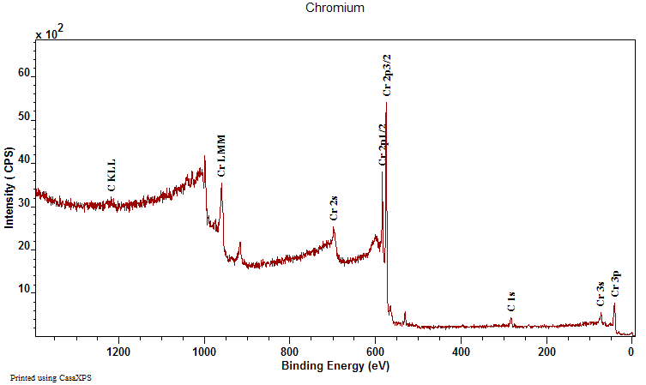
Copper vs. Chromium
6
5
4
3
2
1
0
Intensity (x10³ counts/s)
Notes:
And as a point of comparison, if we look at the spectrum for chromium, our other exception to the Aufbau filing rules, we can see that chromium doesn't display a 3d peak, indicating that it's not completely filled. And so chromium often loses electrons from both the 3d and the 4s sublevel when it makes ions.
There's another part of the spectrum that I'd like to point out to you. If you look at the 2p region here, you'll see that there is some splitting, a dual peak for the 2p in chromium. Depending on how far into the quantum mechanical model you want to go with your student, you can use this evidence to bring up the idea of electron and nuclear spin.
You get some combinations of quantum numbers that give you a one-half value in the p sublevel and fewer combinations can give you a three halves value. The p splitting is always in a 2:1 ratio, indicating the possible combinations of the quantum numbers for electrons in the p sublevel.
Likewise, the d sublevel is often split into five halves and three halves. Now everything I've just mentioned is well beyond the scope of the AP exam, but I wanted to make sure that if you were going to use real spectra, that you can interpret what you see. For any spectra that we're going to use on the AP exam will be sufficiently zoomed out and at a lower resolution such that such splitting is not going to show up in any of the spectra that we'll be using for a test question.
But also, to help you with interpreting spectra and creating your own simulated spectra, in the reference section that accompanies this presentation, I've included a table of the reference peaks for all of the inner orbitals of the first 80 elements in the supplemental material. It's in a document labeled PES Peaks Compiled. And so you've got an Excel spreadsheet there that has all the data available.
You can use this to find approximate orbitals and positioning on the X axis or the binding energy for each orbital. And you can generate your own simulated spectra. Keep in mind that if you're interpreting real data that the local environment of the atom can shift the peaks left or right from the reference value, depending on which atom the other atom has bonded to. But generally, the spacing between sublevels is pretty far and far enough that you can pretty easily still tell which orbital peak you're examining.

Slide 23
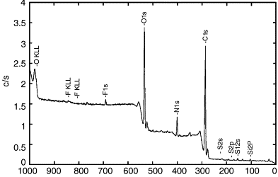
Mixtures of Elements
4
3.5
3
2.5
2
1.5
1
0.5
Intensity (x10⁵ counts/s)
100 90 80 70 60 50 40 30 20 10 0
Binding Energy (MJ/mol)
Notes:
Now, if you're going to look at mixtures of elements, things can get a little bit more complicated. And if you give a mixture spectrum to your students, you'll want to label the peaks for them. You'll notice on the Y axis that intensity is used as the label here, which is the usual label that's used in the literature. This is also important because the varying peak heights here for mixture can be from different elemental abundances and not necessarily from the number of electrons in the orbital.
For example, if both of these peaks represent a 2s orbital or 2s electrons, then why would one peak be four times larger than the other? There's no way that one element could have four electrons in his 2s orbital and the other one have only one electron there. However, it's completely plausible that one element makes up more of the sample, say, 80% abundance, and the other element may be only 20%.
So if you look at these two peaks, if each represents the 2s orbital of their respective atoms, could you predict which element has the greater atomic number?
So the electrons that require more energy to remove must be being pulled away from a nucleus with greater positive charge. So in the case here, we have oxygen with one more proton than nitrogen. And if you want to look at the other elements in the sample, you can see a general trend between the nuclear charge of the atom and the binding energy for the 2s electrons. The greater the nuclear charge, the more energy it takes to remove the electron away from that nucleus.

Slide 24
PES Sample Questions
Notes:
So let’s look through some of the questions that you can ask with PES spectra. For each question, I will give you about 15 to 20 seconds of silence to read and think through each question before I provide an analysis of the item.

Slide 25
Sample Question #1
Which element could be represented by the complete PES spectrum below?
(A) Li (B) B (C) N (D) Ne
Notes:
So if you look at the data here, you can see that there's clearly two energy levels and that the second energy level is split into sublevels. And that you've got, basically, a ratio of 2:3 between the s and the p sublevel. And so this one clearly corresponds to a nitrogen atomic spectrum.

Slide 26
Sample Question #2
Which of the following best explains the relative positioning and intensity of the 2s peaks in the following spectra?
Intensity
Li
14 12 10 8 6 4 2 0
Binding Energy (MJ/mol)
Intensity
Be
14 12 10 8 6 4 2 0
Binding Energy (MJ/mol)
Be has a greater nuclear charge than Li and more electrons in the 2s orbital
Be electrons experience greater electron-electron repulsions than Li electrons
Li has a greater pull from the nucleus on the 2s electrons, so they are harder to remove
Li has greater electron shielding by the 1s orbital, so the 2s electrons are easier to remove
Notes:
So if we look at the two spectra here, you can see that this is one way you can compare one atom to another by just putting the spectra right on top of each other and having students compare relative positioning. And then if you look at peak intensity, you can see one has a greater intensity than the other. And then it might correspond to a greater number of electrons.
So beryllium being further to the left means the electrons are more attracted. And the higher peak means that there's more electrons in the 2s orbital for beryllium than there are for lithium.

Slide 27
Sample Question #3
Given the photoelectron spectra above for phosphorus, P, and sulfur, S, which of the following best explains why the 2p peak for S is further to the left than the 2p peak for P, but the 3p peak for S is further to the right than the 3p peak for P?
Binding Energy
(A) S has a greater effective nuclear charge than P, and the 3p sublevel in S has greater electron repulsions than in P.
(B) S has a greater effective nuclear charge than P, and the 3p sublevel is more heavily shielded in S than in P.
(C) S has a greater number of electrons than P, so the third energy level is further from the nucleus in S than in P.
(D) S has a greater number of electrons than P, so the Coulombic attraction between the electron cloud and the nucleus is greater in S than in P.
Notes:
So if you look at the spectrum here, I've labeled each peak with the binding energy, and you might want to do this for your students if you have especially complex or very small differences between two spectra as we see here for phosphorus and sulfur.
So if you look at the binding energy for phosphorus, for the 3p orbital, you can see it's only 1.06. But sulfur requires even less energy. It's a very slight difference, but even less energy to remove 1.00 mega joules per mole. But if we go further in and we look at the 2p peak, we can see that the sulfur 2p electrons are more attracted to the nucleus than the phosphorus are.
So putting those two together, we can reason through why this difference might occur between the 2p versus the 3p peaks for these two elements. And since sulfur has more protons in its nucleus, that 2p electron or those 2p electrons will be more attracted to the sulfur; therefore, having higher binding energy.
But because the 3p sublevel for sulfur has some electron-electron repulsions, it's a little bit easier to remove electrons there because when you remove that one electron, you're alleviating that electron-electron repulsion.

Slide 28
Sample Question #4
Looking at the complete spectra for Na and K below, which of the following would best explain the relative positioning of the 3s electrons?
Intensity (c/s)
Na
130 105 90 75 60 45 30 15 0
Binding Energy (MJ/mol)
Intensity (c/s)
K
400 350 300 250 200 150 100 50 0
Binding Energy (MJ/mol)
Notes:
Now, if we look at the full spectrum for these things, it can be really difficult to see the details of certain parts of the spectrum. And so I'm going to zoom in on just the 3s peaks for these two elements, and I'm going to put them on the exact same slide.

Slide 29
Sample Question #4a
Looking at the spectra for Na and K below, which of the following would best explain the difference in binding energy for the 3s electrons?
K-3s
Na-3s
Intensity (c/s)
4 3.5 3 2.5 2 1.5 1 0.5 0
Binding Energy (MJ/mol)
K has a greater nuclear charge than Na
K has more electron-electron repulsions than Na
Na has one valence electron in the 3s sublevel
Na has less electron shielding than K
Notes:
And so if we look at them on the same axis relative to each other, could we look at the difference in binding energy between potassium and sodium and explain the difference in binding energy between these two elements?
So because potassium has more protons and we're talking about an inner core cell of electrons for the potassium atom here, they are much more tightly bound to the nucleus than the 3s electrons for sodium are. And in sodium, 3s is a valance electron.
Now, this does raise another interesting question we can ask because we could also ask about peak height here rather than ask about positioning on the X axis.

Slide 30
Sample Question #4b
Looking at the spectra for Na and K below, which of the following would best explain the difference in signal intensity for the 3s electrons?
K-3s
Na-3s
Intensity (c/s)
4 3.5 3 2.5 2 1.5 1 0.5 0
Binding Energy (MJ/mol)
K has a greater nuclear charge than Na
K has more electron-electron repulsions than Na
Na has one valence electron in the 3s sublevel
Na has less electron shielding than K
Notes:
So if we look at the same spectrum and we try to explain the difference in signal intensity, what might give rise to the sodium peak not being as high as the potassium peak?
So since sodium only has one valance electron in the 3s sublevel, then its peak would be lower than potassium's since for potassium, 3s is completely filled.

Slide 31
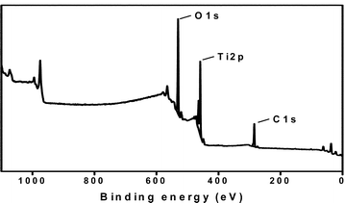
Sample Question #5
Given the photoelectron spectrum below, which of the following best explains the relative positioning of the peaks on the horizontal axis?
Intensity (counts/s)
Image source: http://www.rsc.org/ej/JM/2010/b925409a/b925409a-f2.gif
(A) O has more valence electrons than Ti or C, so more energy is required to remove them
(B) O has more electron-electron repulsions in the 2p sublevel than Ti and C
(C) Ti atoms are present in a greater quantity than O can C in the mixture.
(D) Ti has a greater nuclear charge, but the 2p sublevel experiences greater shielding than the 1s sublevel.
Notes:
So here we have a mixture of elements, and we'll look at the relative positioning between different orbitals within the atom.
So because titanium is comparing an outer electron shell and we're looking at just the most inner shell core of electrons of oxygen and carbon, we can see that the greater nuclear charge of titanium pulls even the outer most shells or more outer shells further in than even the first energy level. And has much greater force of attraction for the 2p s than even carbon has for its 1s electrons.

Slide 32
Sample Question #6
Given the photoelectron spectrum of scandium below, which of the following best explains why Scandium commonly makes a 3+ ion as opposed to a 2+ ion?
0.63
Intensity (c/s)
0.77
500 400 300 50 40 30 10 9 8 7 6 5 4 3 2 1 0
Binding Energy (MJ/mol)
(A) Removing 3 electrons releases more energy than removing 2 electrons.
(B) Scandium is in Group 3, and atoms only lose the number of electrons that will result in a noble gas electron configuration
(C) The amount of energy required to remove an electron from the 3d sublevel is close to that for the 4s sublevel, but significantly more energy is needed to remove electrons from the 3p sublevel.
(D) Removing 2 electrons alleviates the spin-pairing repulsions in the 4s sublevel, so it is not as energetically favorable as emptying the 4s sublevel completely.
Notes:
One issue you run into with our spectra are that the spacing between peaks is often very large, and so there's a couple of ways you can abbreviate the spread of the X axis. One thing you've seen me do already is to use a logarithmic scale, but you can also do what I've done in the graphic here and put a break within the spectrum to sort of bring only the relevant parts of the spectrum a little bit closer together.
So either a logarithmic scale or only zooming on certain parts of the spectrum and introducing axes breaks can help you to fit the spectrum onto one page. But go ahead and take a moment to examine this data and see if you can answer the question here.
Now, if you look further onto the right-hand side, you can see that those peaks are really, really close. So I'm going to go ahead and label those peaks for you so you can differentiate their energies a little bit better since they're almost right on top of each other.
And so you can see you've got one peak at 0.77 and one peak at 0.63, and the 0.63 peak is just a little bit higher than 0.77. So the peak that has more electrons is actually a little bit easier to pull the electrons away from. And if you think about the electron configuration for scandium, we can see that they would have 4s2, 3d1 and that one of the reasons that scandium often makes that 3-plus ion is that it's a very small amount of energy to remove the electrons from both the 4s and the 3d sublevel. But if you try to pick off anything from the 3p sublevel, a huge much, much greater amount of energy, I mean almost ten times greater amount of energy is required to start pulling those electrons away.

Slide 33

Quick Check – Can You Now Translate Between These Representations of Mg?
Intensity
100 10 1
Binding Energy (MJ/mol)
4s
-
-
-
Mg
-
3p
-
-
12+
3s
-
-
-
-
-
2p
-
2s
1s² 2s² 2p⁶ 3s²
1s
Notes:
So to check your own understanding, do you now have enough information to translate between these various models of the atom from magnesium?
You should hopefully feel very comfortable at representing knowledge about the electron arrangement of magnesium in a variety of ways. And knowing that these models have been refined and replaced and improved as new data has come alone. And photoelectron spectroscopy is one of those places where we've gotten data to directly support our subshell model of the atom and our ideas about electron configurations.

Slide 34
PES – Data that Shells are Divided into Subshells
2p⁶
7.9
1s²
2s²
3s²
3p¹
Relative Number of Electrons
151
12.1
1.09
0.58
100 10 1
Binding Energy (MJ/mol)
Element | IE₁ | IE₂ | IE₃ | IE₄ | IE₅ | IE₆ | IE₇
Na | 495 | 4560
Mg | 735 | 1445 | 7730
Al | 580 | 1815 | 2740 | 11,600
Si | 780 | 1575 | 3220 | 4350 | 16,100
P | 1060 | 1890 | 2905 | 4950 | 6270 | 21,200
S | 1005 | 2260 | 3375 | 4565 | 6950 | 8490 | 27,000
Cl | 1255 | 2295 | 3850 | 5160 | 6560 | 9360 | 11,000
Ar | 1527 | 2665 | 3945 | 5770 | 7230 | 8780 | 12,000
Notes:
And then if we go further into PES, it gives further refinement to Bohr's energy shells. And that those shells are divided further into subshells. And if we look at things like successive ionization energy data, then we can also start to build the idea of electron spin and spin pairing of electrons.

Slide 35
Supporting Resources (cont.)
Arizona simulated photoelectron spectra
  http://www.chem.arizona.edu/chemt/Flash/photoelectron.html
Guided inquiry activities on PES
  John Gelder (Oklahoma State University)
  Moog and Farrell, Chemistry: A Guided Inquiry
  POGIL
Books on PES technical specs
  Van der Heide, Paul. X-Ray Photoelectron Spectroscopy: An Introduction to Principles and Practices. New Jersey: John Wiley & Sons, Inc, 2012.
  Ellis, Andrew M., Miklos Feher, and Timothy Wright. Electronic and Photoelectron Spectroscopy: Fundamentals and Case Studies. New York: Cambridge University Press, 2005.
Notes:
There are some resources that I want to point you toward as you work to incorporate PES into your classroom. Links to these resources are included in the supplemental material in a file called the in-class activity file. And the Arizona website on photoelectron spectroscopy has simulated spectra that you can compare side by side for two of any of the first twenty-one elements on the Periodic Table.
John Gelder from Oklahoma State University has also generated a guided inquiry activity on photoelectron spectroscopy that you can use with students in your class. There are many activities related to photoelectron spectroscopy in the Moog and Farrell Book "Chemistry: A Guided Inquiry". And if you go onto the AP Chemistry Teacher Community, you can actually get one of his activities on photoelectron spectroscopy as a download.
There also is the -- the POGIL Project is going to release a new book related to the AP Chemistry curriculum, and they're also in that book going to have an activity on photoelectron spectroscopy.
If you really want to get into the technical specs of how the instrument works, there's a couple of books, but be aware that these go well beyond what is expected on the AP exam. But the two books listed here give a really comprehensive review of how the photoelectron spectroscopy instrument works, and also how you can interpret and make useful, meaningful data and conclusions out of the spectra that the instrument provides.

Slide 36
Take Away
You should now feel confident
Explaining how data informs our understanding of the atom
Using PES and experimental evidence to build mental models of atomic structure
Explaining how a PES instrument collects data and how to analyze spectra
Notes:
I hope that after finishing this online event, you will now feel confident in explaining to your students how data informs our understanding of the atom. And I also hope that you'll feel comfortable using PES and experimental evidence to build a robust mental model of the structure of the atom for your students to carry with them and to use to analyze new situations.
And I also hope that you'll feel comfortable explaining how a PES instrument collects data and how to analyze the produced spectra, both simulated and real, to answer questions related to atomic and electronic structure.

