Slide 1
AP Chem Equilibrium Practice FRQ with Solutions

Slide 2
Equilibrium Expression and Calculation
Using the reaction: bR#1 + aR#2 → cP
K_{eq}= [products]^{c}
[reactant #1 ]^{b} [reactant #2]ª
K eq | Favors this side of reaction
Keq>>>1
Keq<<<1
Products
Reactants

Slide 3
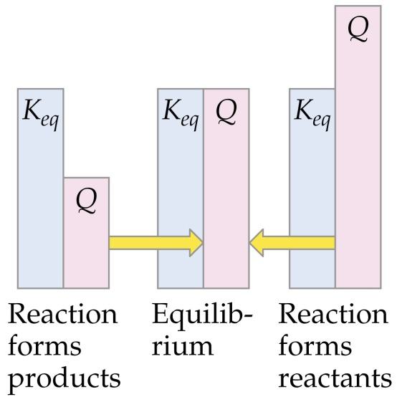
Reaction Quotient
The reaction quotient, Q is similar to the equilibrium constant, but describes where the reaction is at a point in time.
When Q > K_{eq}:
not at equilibrium, too many products
reaction will move to the left, products will form reactants
When Q < K_{eq}:
not at equilibrium, too many reactants
reaction will move to the right, reactants will form products
When Q = K_{eq}: system at equilibrium

Slide 4
Additional Info:
*In heterogeneous equilibrium, we DON’T include solids and liquids in calculating Keq. Why?
*If temperature is constant, then partial pressure of a gas directly related to the concentration (mol/L)
*K_{p} = K_{c} (RT)^{Δn}
where R = Univ. gas constant (0.08206 L.atm/K.mol)
Δn = moles of gas products – moles of gas reactants

Slide 5
Calculating concentrations at equilibrium → ICE Method (see pg. 604-606 for steps and example)
Ex. Calculate concentrations at equilibrium if you have 1 M of each reactant in this reaction:
Step 1: A + B 2AB
ICE | A | B | 2AB
INITIAL (M)
CHANGE (M)
EQUILIBRIUM (M)
1
1
0
-x
-x
+2x
1-x
1-x
0+2x

Slide 6
Calculating concentrations at equilibrium → ICE Method (see Ch. 14 for steps and examples)
Step 2: Based on your ICE chart, set up your Keq
Step 3: Solve for X → you might have to use the quadratic equation
Step 4: Evaluate x-values (you will have 2→ one will follow the parameters set in the problem)
Step 5: Plug in x-value to solve for concentrations at equilibrium

Slide 7
AP Chem: Practice FR #1
CO_{2(g)} + H_{2(g)} →H₂O_{(g)} + CO_{(g)}
When H₂(g) is mixed with CO₂(g) at 2,000 K, equilibrium is achieved according to the equation above. In one experiment, the following equilibrium concentrations were measured.
[H₂] = 0.20 mol/L
[CO₂] = 0.30 mol/L
[H₂O] = [CO] = 0.55 mol/L
(a) What is the mole fraction of CO(g) in the equilibrium mixture?
(b) Using the equilibrium concentrations given above, calculate the value of Kc, the equilibrium constant for the reaction.
(c) Determine Kp in terms of Kc for this system.
(d) When the system is cooled from 2,000 K to a lower temperature, 30.0 percent of the CO(g) is converted back to CO₂(g). Calculate the value of Kc at this lower temperature.
(e) In a different experiment, 0.50 mole of H₂(g) is mixed with 0.50 mole of CO₂(g) in a 3.0-liter reaction vessel at 2,000 K. Calculate the equilibrium concentration, in moles per liter, of CO(g) at this temperature.

Slide 8
AP Chem: Practice FR #1 Solution
(a) CO = = 0.34
(b) Kc = = 5.04
(c) Since Δn = 0, Kc = Kp
(d) [CO] = 0.55 - 30.0% = 0.55 - 0.165 = 0.385 M
[H2O] = 0.55 - 0.165 = 0.385 M
[H2] = 0.20 + 0.165 = 0.365 M
[CO2] = 0.30 + 0.165 = 0.465 M
K = (0.385)²/(0.365 X 0.465) = 0.87
(e) let X = Δ[H2] to reach equilibrium
[H2] = 0.50 mol/3.0L - X = 0.167 - X
[CO2] = 0.50 mol/3.0L - X = 0.167 - X
[CO] = +X ; [H2O] = +X
K = X²/(0.167 - X)² = 5.04 ; X = [CO] = 0.12 M

Slide 9
AP Chem: Practice FR #2
MgF_{2(s)} ↔ Mg²⁺_{(aq)} + 2 F⁻_{(aq)}
#2.) In a saturated solution of MgF₂ at 18°C, the concentration of Mg²⁺ is 1.21X10⁻³ M and F⁻ is 2.42X10⁻³ M. The equilibrium is represented by the equation above.
(a) Write the expression for the solubility-product constant, K_{sp}, and calculate its value at 18°C.
(b) Calculate the equilibrium concentration of Mg²⁺ in 1.000 liter of saturated MgF₂ solution at 18°C to which 0.100 mole of solid KF has been added. The KF dissolves completely. Assume the volume change is negligible.

Slide 10
AP Chem: Practice FR #2 Solution
(a) K_{sp} = [Mg²⁺][F⁻]² = (1.21X10⁻³)(2.42X10⁻³)²= 7.09X10⁻⁹
(b) X = concentration loss by Mg²⁺ ion
2X = concentration loss by F⁻ ion
[Mg²⁺] = (1.21X10⁻³ - X) M
[F⁻] = (0.100 + 2.42X10⁻³ - 2X) M
since X is a small number then (0.100 + 2.42X10⁻³ - 2X) ≈ 0.100
K_{sp} = 7.09X10⁻⁹ = (1.21X10⁻³ - X)(0.100)²
X = 1.2092914X10⁻³
[Mg²⁺]= 1.21X10⁻³-1.2092X´10⁻³ = 7.09X10⁻⁷M

Slide 11
AP Chem: Practice FR #3
C(s) + H₂O(g) ↔ CO(g) + H₂(g) ΔHº = +131kJ
#2. A rigid container holds a mixture of graphite pellets (C(s)), H₂O(g), CO(g), and H₂(g) at equilibrium. State whether the number of moles of CO(g) in the container will increase, decrease, or remain the same after each of the following disturbances is applied to the original mixture. For each case, assume that all other variables remain constant except for the given disturbance. Explain each answer with a short statement.
(a)Additional H₂(g) is added to the equilibrium mixture at
constant volume.
(b)The temperature of the equilibrium mixture is increased
at constant volume.
(c)The volume of the container is decreased at constant
temperature.
(d) The graphite pellets are pulverized.

Slide 12
AP Chem: Practice FR #3 Solution
(a) CO will decrease. An increase of hydrogen gas molecule will increase the rate of the reverse reaction which consumes CO. A LeChatelier Principle shift to the left.
(b) CO will increase. Since the forward reaction is endothermic (a ΔH > 0) an increase in temperature will cause the forward reaction to increase its rate and produce more CO. A Le Chatelier Principle shift to the right.
(c) CO will decrease. A decrease in volume will result in an increase in pressure, the equilibrium will shift to the side with fewer gas molecules to decrease the pressure, , a shift to the left.
(d) CO will remain the same. Once at equilibrium, the size of the solid will affect neither the reaction rates nor the equilibrium nor the concentrations of reactants or products.

Slide 13
AP Chem FR Practice #4
REMINDERS: Solids and liquids are not counted/ Partial pressure is proportional to # moles
NH₄Cl(s) ↔ NH₃(g) + HCl(g) ΔH = +42.1 kilocalories
Suppose the substances in the reaction above are at equilibrium at 600K in volume V and at pressure P. State whether the partial pressure of NH₃(g) will have increased, decreased, or remained the same when equilibrium is reestablished after each of the following disturbances of the original system. Some solid NH₄Cl remains in the flask at all times. Justify each answer with a one-or-two sentence explanation.
(a) A small quantity of NH₄Cl is added.
(b) The temperature of the system is increased.
(c) The volume of the system is increased.
(d) A quantity of gaseous HCl is added.
(e) A quantity of gaseous NH₃ is added.

Slide 14
AP Chem FR Practice 4: ANSWER
Answer:
(a) P_{NH3} does not change. Since NH₄Cl(s) has constant concentration (a = 1), equilibrium does not shift.
(b) P_{NH3} increases. Since the reaction is endothermic, increasing the temperature shifts the equilibrium to the right and more NH₃ is present.
(c) P_{NH3} does not change. As V increases, some solid NH₄Cl decomposes to produce more NH₃. But as the volume increases, P_{NH3} remains constant due to the additional decomposition.
(d) P_{NH3} decreases. Some NH₃ reacts with the added HCl to relieve the stress from the HCl addition.
(e) P_{NH3} increases. Some of the added NH₃ reacts with HCl to relieve the stress, but only a part of the added NH₃ reacts, so P_{NH3} increases.

