Slide 1
Chemical Equilibrium
Honors Chemistry
Mrs. Nielsen

Slide 2
Reversible Reactions
Forward and reverse reactions that occur simultaneously
*almost all reactions are reversible to some extent
Forward: 2SO_{2(g)} + O_{2(g)} → 2SO_{3(g)}
Reverse: 2SO_{2(g)} + O_{2(g)} ← 2SO_{3(g)}
2SO_{2(g)} + O_{2(g)} ↔ 2SO_{3(g)}

Slide 3
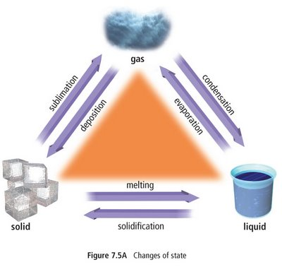
Equilibrium
A dynamic condition in which two opposing changes occur at equal rates in a closed system
IN MOTION!
MATTER CANNOT ENTER OR LEAVE, BUT ENERGY CAN

Slide 4
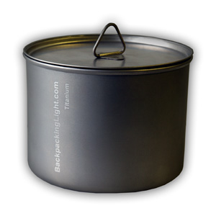
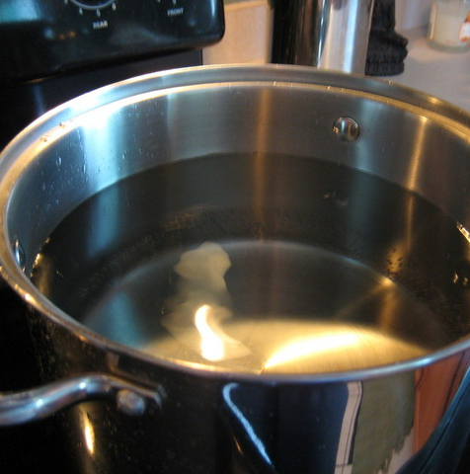
WHICH PICTURE REPRESENTS A CLOSED SYSTEM?
YES!
NO!

Slide 5
CLOSED SYSTEM at EQUILIBRIUM
Example: In a pot of boiling water with a lid,
RATE of vaporization = RATE of condensation
X
the AMOUNT of liquid
=
the AMOUNT of gas

Slide 6
Chemical Equilibrium
Though the rate_{forward} = rate_{reverse}, the concentrations of components on both sides may not be equal
A B or A B
1% 99% 99% 1%

Slide 7
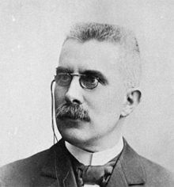
Le Chatelier’s Principle
When a system at equilibrium is disturbed by application of a stress, it attains a new equilibrium position that relieves the stress
A STRESS is usually a change in concentration [ ], pressure, or temperature
Affects gases only!
French chemist
Henri Le Chatelier (1850-1936)

Slide 8
Le Chatelier’s Principle
Pressure changes will only affect gases
Increasing the pressure will favor the direction that has fewer gas molecules
Example:
N_{2(g)} + 3H_{2(g)} ↔ 2NH_{3(g)}
Increasing Pressure will cause a shift to the right
Decreasing VOLUME will ALSO cause a
shift to the right
* Recall that Volume and Pressure are inversely proportional

Slide 9
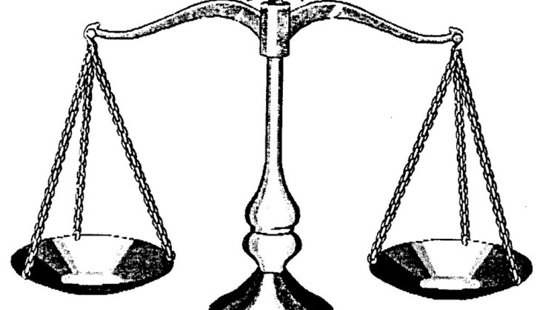
Ex) @ 25°C: H₂O_{(l)} + HEAT H₂O_{(g)}
Temperature changes:
* Increasing temp favors the endothermic rxn
* Decreasing temp favors the exothermic reaction
@ 50°C: SHIFT RIGHT
Increase rate of evaporation until new equilibrium is reached
= [H₂O_{(g)}]
FORWARD REACTION IS FAVORED
@ 5°C: SHIFT LEFT
Increase rate of condensation until new equilibrium is reached
= [H₂O_{(l)}]
REVERSE REACTION IS FAVORED

Slide 10
Equilibrium Constants: K_{eq}
Quantifies equilibrium position
Example:
wA + xB  yC + zD
REACTANTS
PRODUCTS
[C]^{y} x [D]^{z}
[A]^{w} x [B]^{x}
K_{eq} =
Note: * Do not include (s) or (l) in the K_{eq} expression
* K_{eq} has NO UNITS because it is a ratio
* [ ] = molarity concentration

