Slide 1
Chemical Bonds
Mrs. Nielsen
Honors Chemistry

Slide 2
Chemical Bonds
Valence electrons are lost, gained or shared
Attractive Forces between opposing charges that hold two atoms together.
Positive nucleus and negative electrons
Cation (+) to Anion (-)

Slide 3
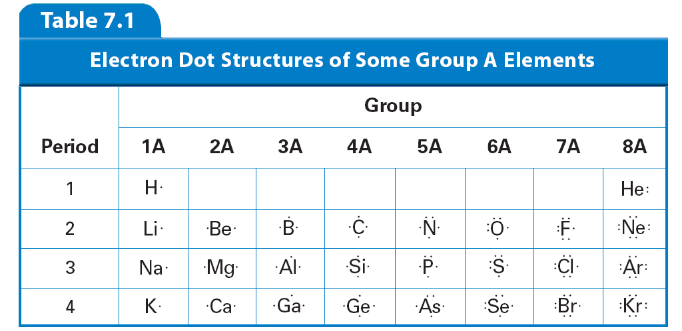
Valence Electrons
Lewis Dot Structures show valence electrons as dots.

Slide 4
Duet vs. Octet Rule
Duet rule: (H, He, Li, Be)
Atoms will gain or lose or share electrons until the 1s is the valence shell and contains 2 electrons
Octet Rule: (all other elements)
Atoms will gain or lose or share electrons until the valence shell contains 8 electrons.
* “Boron the Moron”: 6 valence electrons

Slide 5
Types of Chemical Bonds
Ionic Bond = Metal + Non-metal
Metal TRANSFERS one or more electrons to the non-metal.
The oppositely charged ions are attracted each other by electrostatic forces.
Covalent Bonds = Non-metal + non-metal
Electrons are SHARED creating a very strong bond
Bonded atoms have lower potential energy than single atoms
Metallic Bonds = Metal + Metal
Delocalized valence electrons: A “sea of electrons” shared among all atoms

Slide 6
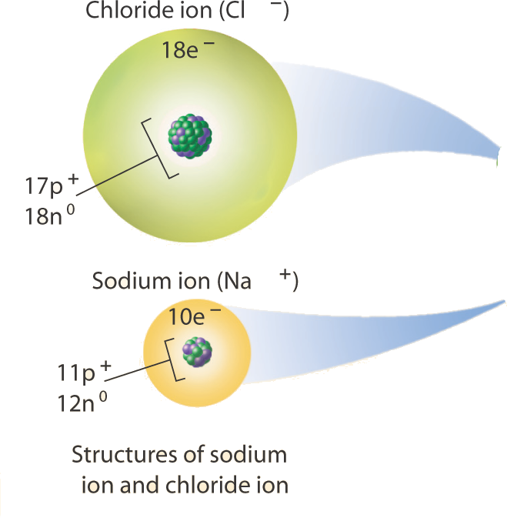
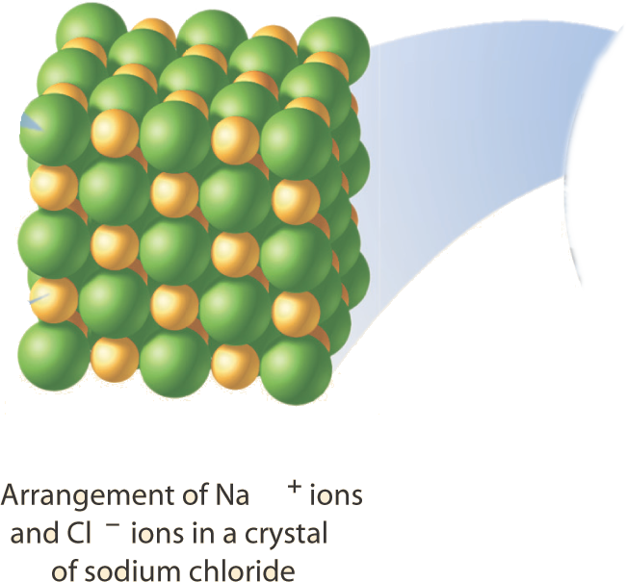
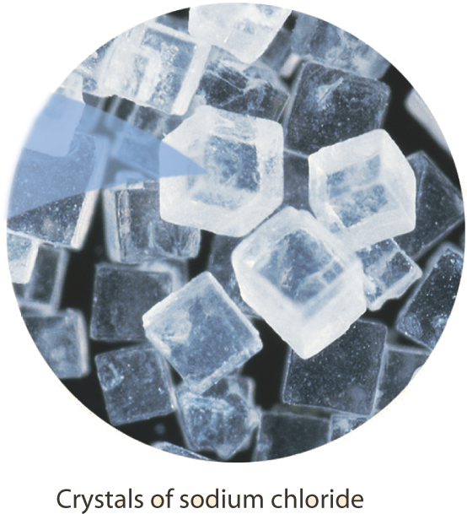
Properties: Crystalline solids at room temperature, hard, rigid, and high melting points + boiling points, conduct electricity
Ionic Bond
Ex) NaCl

Slide 7
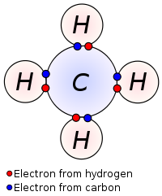
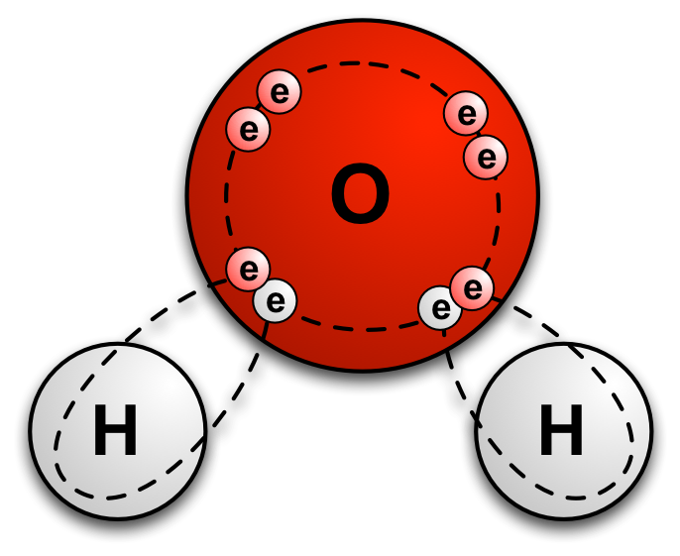
Covalent Bonds (form molecules) Ex) CH₄, H₂O

Slide 8
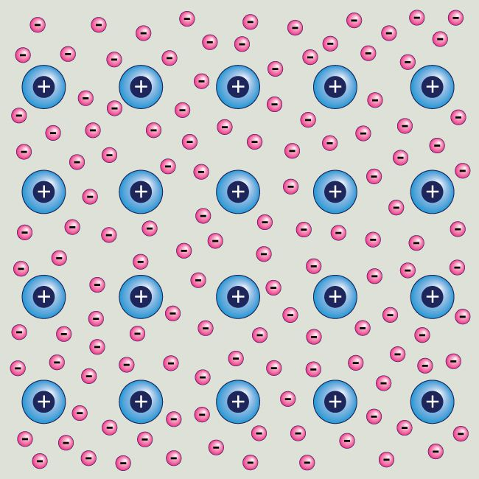
Metallic Bond Ex) Iron, Copper
Sea of Delocalized Electrons

Slide 9
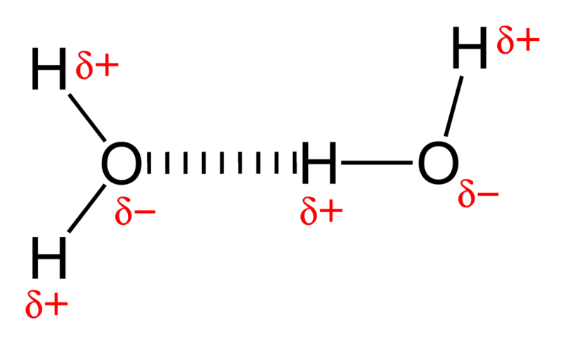
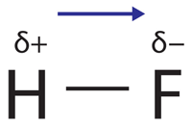
Polarity
Polar bonds = an UNEVEN distribution of electrons
Partial positive pole and a partial negative pole in a compound
Degree of polarity depends on the electronegativity difference between the two bonding atoms
0 – 0.5: non-polar covalent
0.5 – 1.7: polar covalent
1.7 – 3.5 ionic

Slide 10
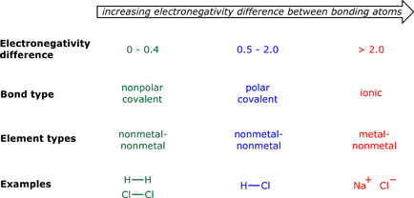
Summary of Bond Types

