Slide 1
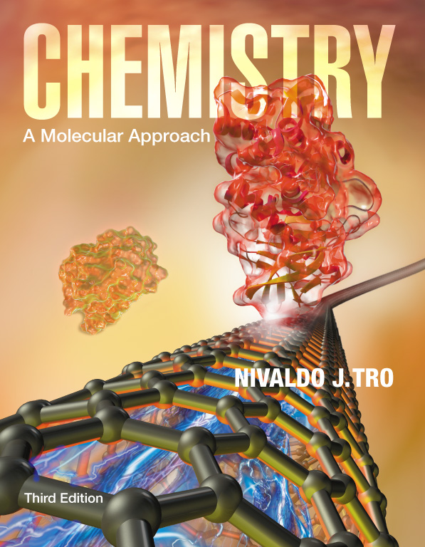
Lecture Presentation
Chapter 3 Molecules, Compounds, and Chemical Equations
Christian Madu, Ph.D.
Collin College

Slide 2
How Many Different Substances Exist?
Elements combine with each other to form compounds.
The great diversity of substances that we find in nature is a direct result of the ability of elements to form compounds.

Slide 3
Hydrogen, Oxygen, and Water
The dramatic difference between the elements hydrogen and oxygen and the compound water is typical of the differences between elements and the compounds that they form.
When two or more elements combine to form a compound, an entirely new substance results.

Slide 4
Hydrogen, Oxygen, and Water

Slide 5
Definite Proportion
A hydrogen–oxygen mixture can have any proportions of hydrogen and oxygen gas.
Water, by contrast, is composed of water molecules that always contain two hydrogen atoms to every one oxygen atom.
Water has a definite proportion of hydrogen to oxygen.

Slide 6
Definite Proportion

Slide 7
Chemical Bonds
Compounds are composed of atoms held together by chemical bonds.
Chemical bonds result from the attractions between the charged particles (the electrons and protons) that compose atoms.
Chemical bonds are classified into two types:
Ionic
Covalent

Slide 8
Ionic Bonds
Ionic bonds—which occur between metals and nonmetals—involve the transfer of electrons from one atom to another.
When a metal interacts with a nonmetal, it can transfer one or more of its electrons to the nonmetal.
The metal atom then becomes a cation.
The nonmetal atom becomes an anion.

Slide 9
Ionic Bonds
These oppositely charged ions attract one another by electrostatic forces and form an ionic bond.
The result is an ionic compound, which in the solid phase is composed of a lattice—a regular three-dimensional array—of alternating cations and anions.

Slide 10
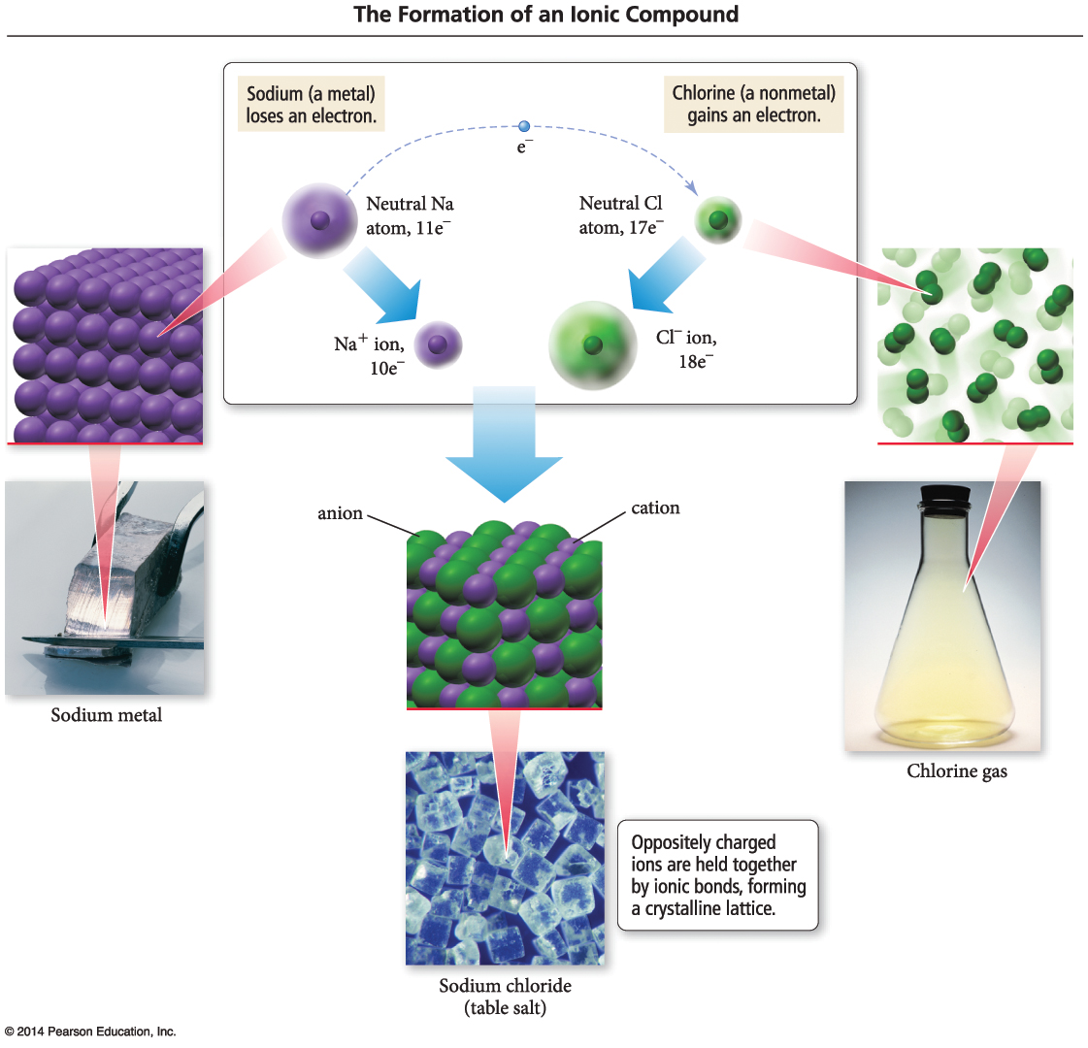
Ionic Bonds

Slide 11
Covalent Bonds
Covalent bonds—which occur between two or more nonmetals—involve the sharing of electrons between two atoms.
When a nonmetal bonds with another nonmetal, neither atom transfers its electron to the other. Instead the bonding atoms share some of their electrons.
The covalently bound atoms compose a molecule.
Hence, we call covalently bonded compounds molecular compounds.

Slide 12
Representing Compounds: Chemical Formulas and Molecular Models
A compound is represented with its chemical formula.
Chemical formula indicates the elements present in the compound and the relative number of atoms or ions of each.
Water is represented as H₂O.
Carbon dioxide is represented as CO₂.
Sodium Chloride is represented as NaCl.
Carbon tetrachloride is represented as CCl₄.

Slide 13
Types of Chemical Formulas
Chemical formulas can generally be categorized into three different types:
Empirical formula
Molecular formula
Structural formula

Slide 14
Types of Chemical Formulas
An empirical formula gives the relative number of atoms of each element in a compound.
A molecular formula gives the actual number of atoms of each element in a molecule of a compound.
(a) For C₄H₈, the greatest common factor is 4. The empirical formula is therefore CH₂.
(b) For B₂H₆, the greatest common factor is 2. The empirical formula is therefore BH₃.
(c) For CCl₄, the only common factor is 1, so the empirical formula and the molecular formula are identical.

Slide 15
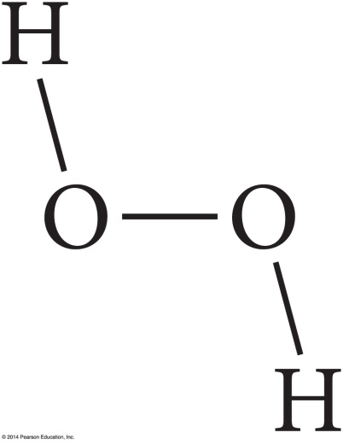
Types of Chemical Formulas
A structural formula uses lines to represent covalent bonds and shows how atoms in a molecule are connected or bonded to each other. The structural formula for H₂O₂ is shown below:

Slide 16
Types of Chemical Formulas
The type of formula we use depends on how much we know about the compound and how much we want to communicate.
A structural formula communicates the most information,
while an empirical formula communicates the least.

Slide 17
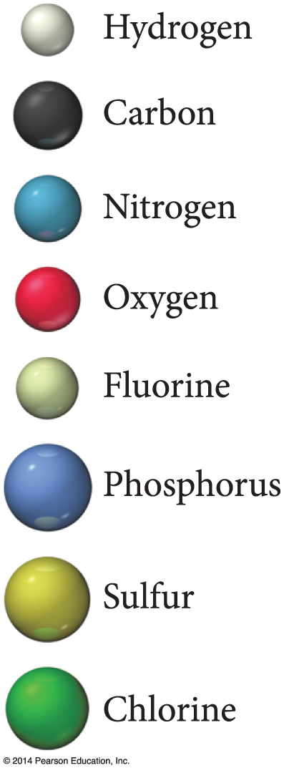
Molecular Models
A molecular model is a more accurate and complete way to specify a compound.
A ball-and-stick molecular model represents atoms as balls and chemical bonds as sticks; how the two connect reflects a molecule’s shape.
The balls are typically color-coded to specific elements.

Slide 18
Molecular Models
In a space-filling molecular model, atoms fill the space between each other to more closely represent our best estimates for how a molecule might appear if scaled to visible size.

Slide 19
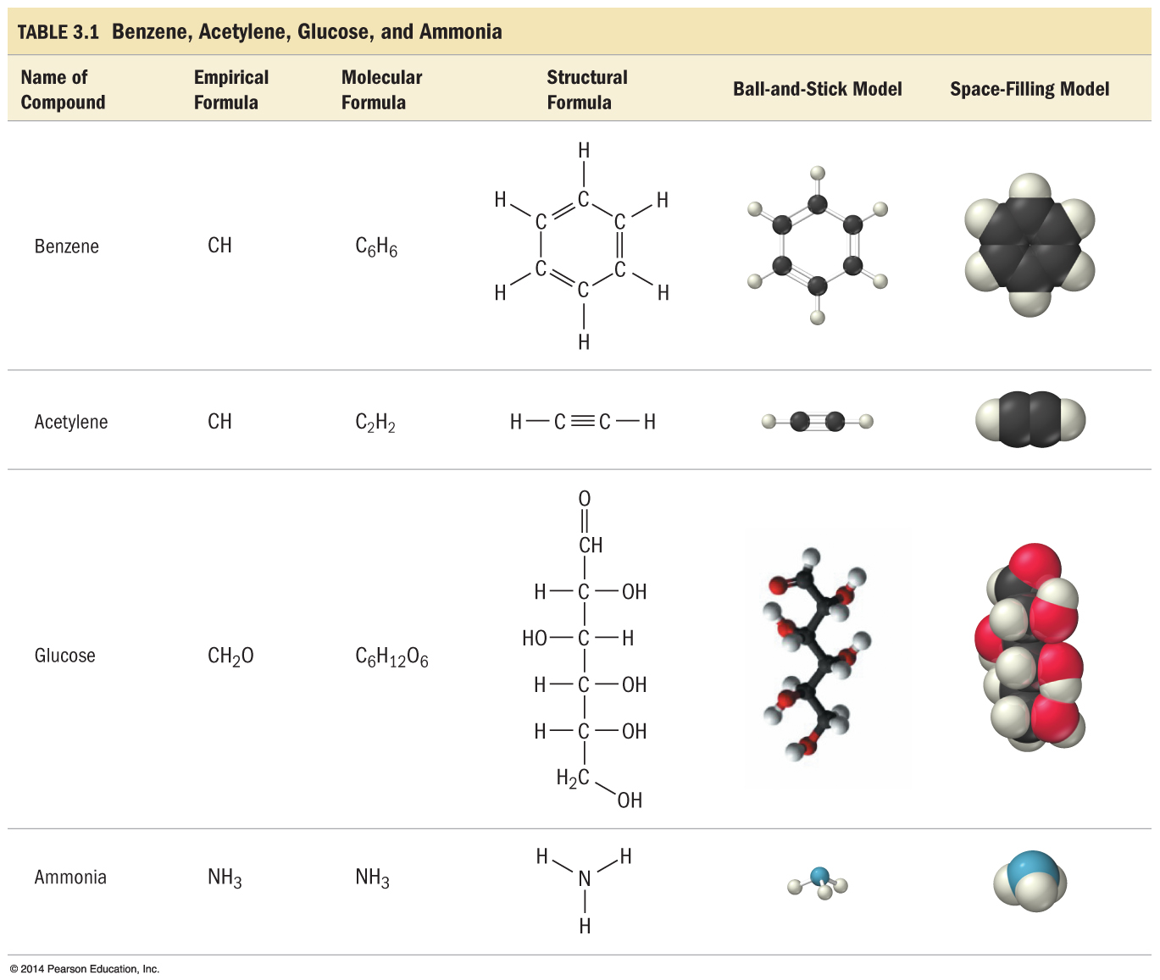
Ways of Representing a Compound

Slide 20
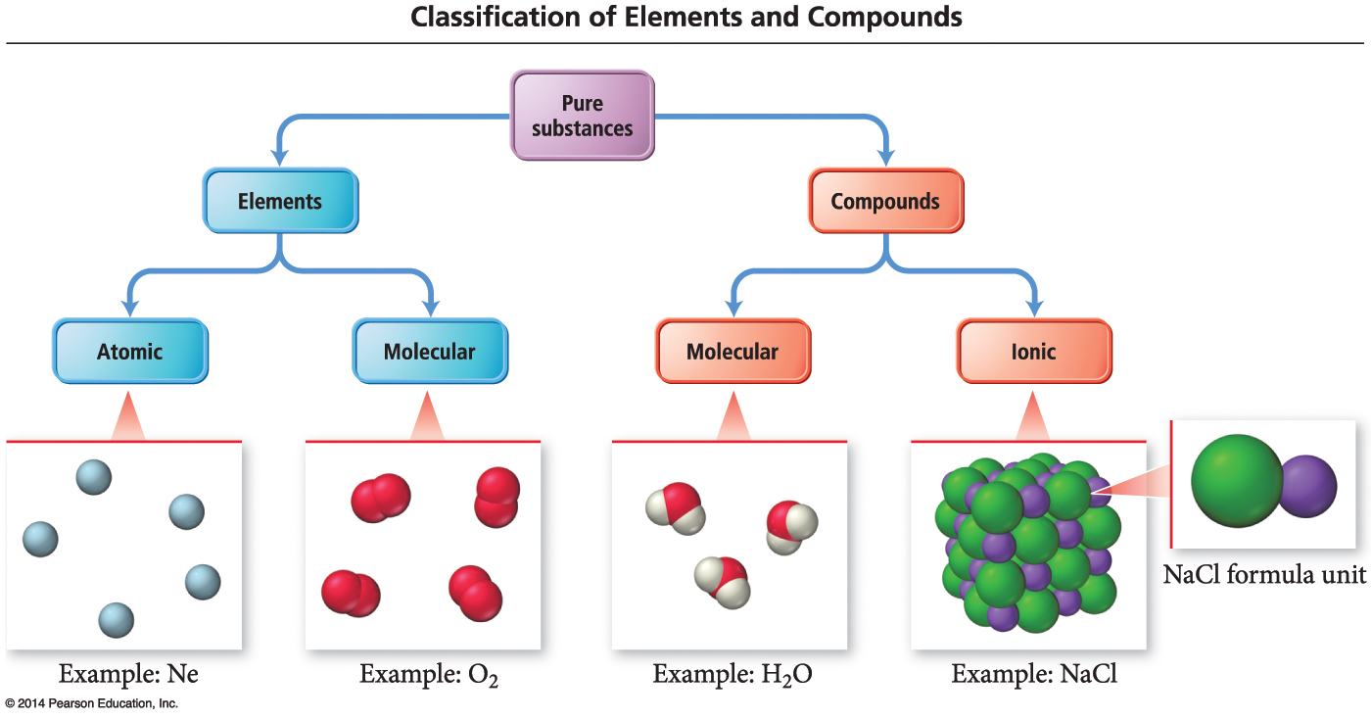
An Atomic-Level View of Elements and Compounds
Elements may be either atomic or molecular. Compounds may be either molecular or ionic.

Slide 21
View of Elements and Compounds
Atomic elements exist in nature with single atoms as their basic units. Most elements fall into this category.
Examples are Na, Ne, C, K, Mg, etc.
Molecular elements do not normally exist in nature with single atoms as their basic units; instead, they exist as molecules—two or more atoms of the element bonded together.
There only seven diatomic elements and they are H₂, N₂, O₂, F₂, Cl₂, Br₂, and I₂.
Also, P₄ and S₈ are polyatomic elements.

Slide 22
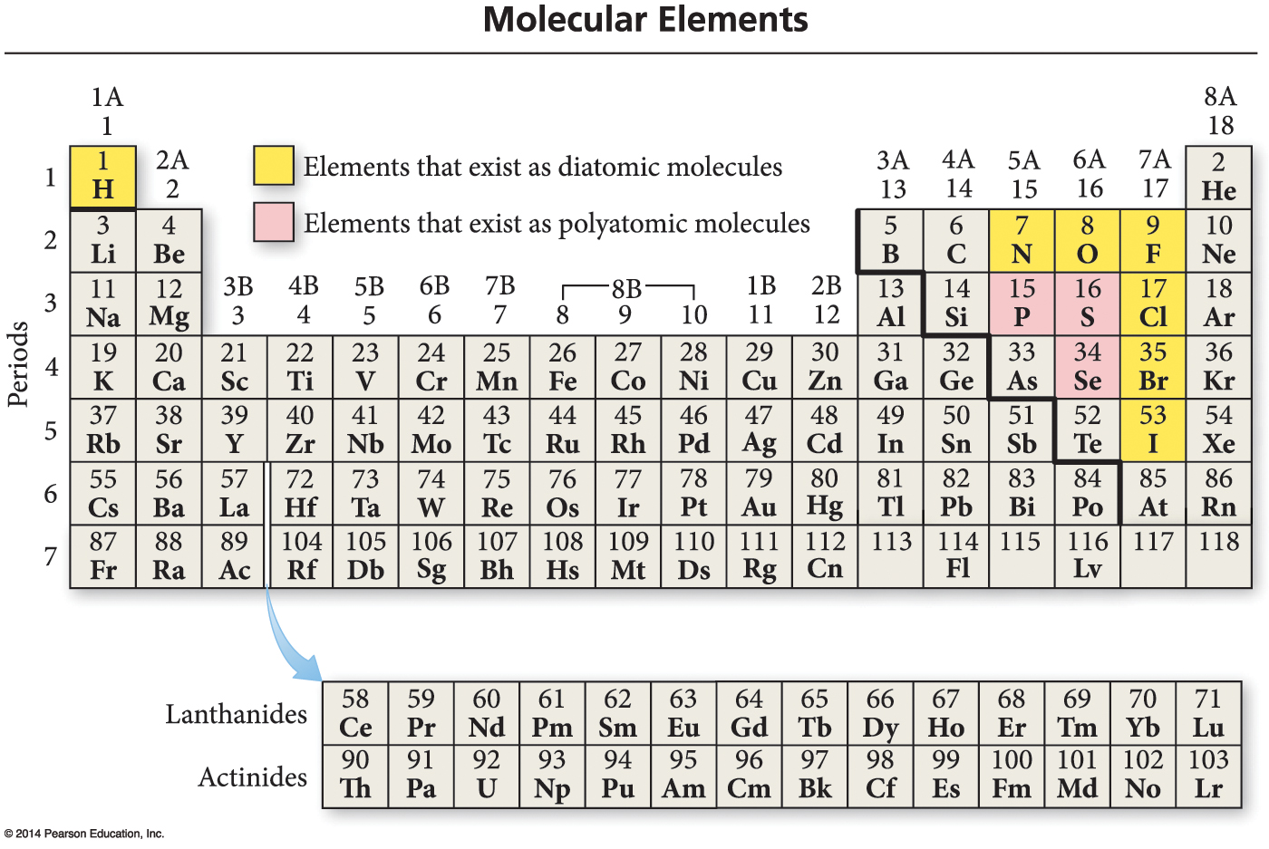
Molecular Elements

Slide 23
Molecular Compounds
Molecular compounds are usually composed of two or more covalently bonded nonmetals.
The basic units of molecular compounds are molecules composed of the constituent atoms.
Water is composed of H₂O molecules.
Dry ice is composed of CO₂ molecules.
Propane (often used as a fuel for grills) is composed of C₃H₈ molecules.

Slide 24
Ionic Compounds
Ionic compounds are composed of cations (usually a metal) and anions (usually one or more nonmetals) bound together by ionic bonds.
The basic unit of an ionic compound is the formula unit, the smallest, electrically neutral collection of ions.
The ionic compound table salt, with the formula unit NaCl, is composed of Na⁺ and Cl– ions in a one-to-one ratio.

Slide 25
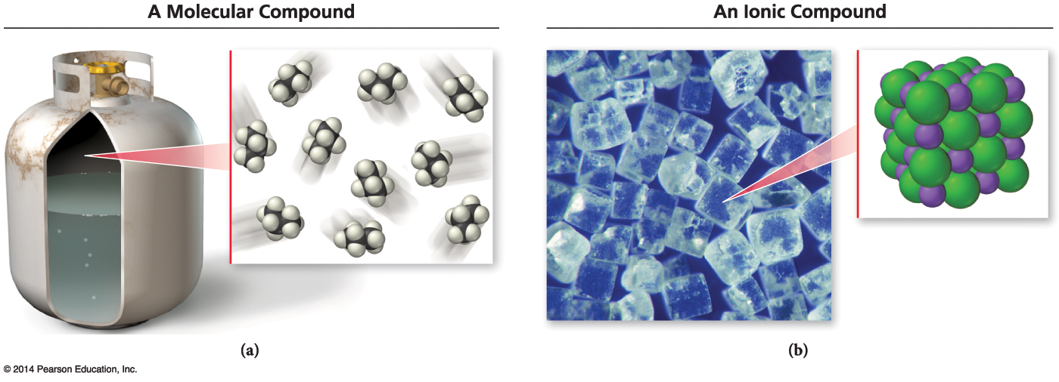
Molecular and Ionic Compounds

Slide 26
Polyatomic Ion
Many common ionic compounds contain ions that are themselves composed of a group of covalently bonded atoms with an overall charge.
This group of charged species is called polyatomic ions.
NaNO₃ contains Na⁺ and NO₃–.
CaCO₃ contains Ca²⁺ and CO₃^{2–}.
KClO Contains K⁺ and ClO–.

Slide 27
Ionic Compounds: Formulas and Names
Summarizing Ionic Compound Formulas:
Ionic compounds always contain positive and negative ions.
In a chemical formula, the sum of the charges of the positive ions (cations) must equal the sum of the charges of the negative ions (anions).
The formula of an ionic compound reflects the smallest whole-number ratio of ions.

Slide 28
Ionic Compounds: Formulas and Names
The charges of the representative elements can be predicted from their group numbers.
The representative elements forms only one type of charge.
Transition metals tend to form multiple types of charges.
Hence, their charge cannot be predicted as in the case of most representative elements.

Slide 29
Naming Ionic Compounds
Ionic compounds are usually composed of metals and nonmetals.
Anytime you see a metal and one or more nonmetals together in a chemical formula, assume that you have an ionic compound.
NaBr, Al₂(CO₃)₃, CaHPO₄, and MgSO₄ are some examples of ionic compounds.

Slide 30
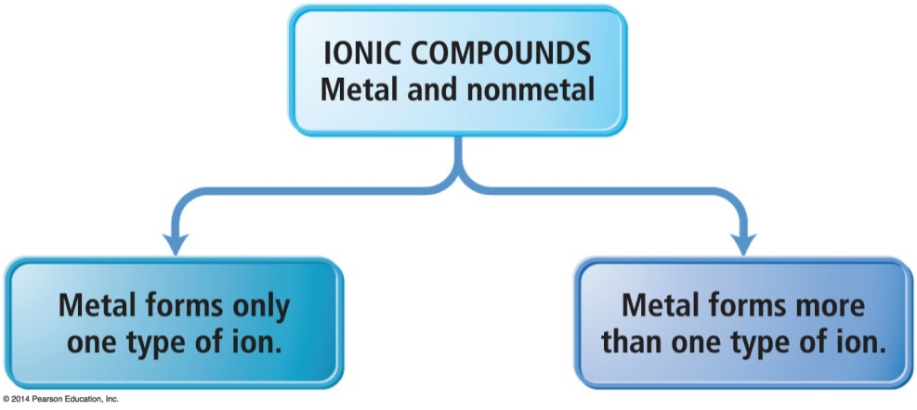
Naming Ionic Compounds
Ionic compounds can be categorized into two types, depending on the metal in the compound.
The first type contains a metal whose charge is invariant from one compound to another.
Whenever the metal in this first type of compound forms an ion, the ion always has the same charge.

Slide 31
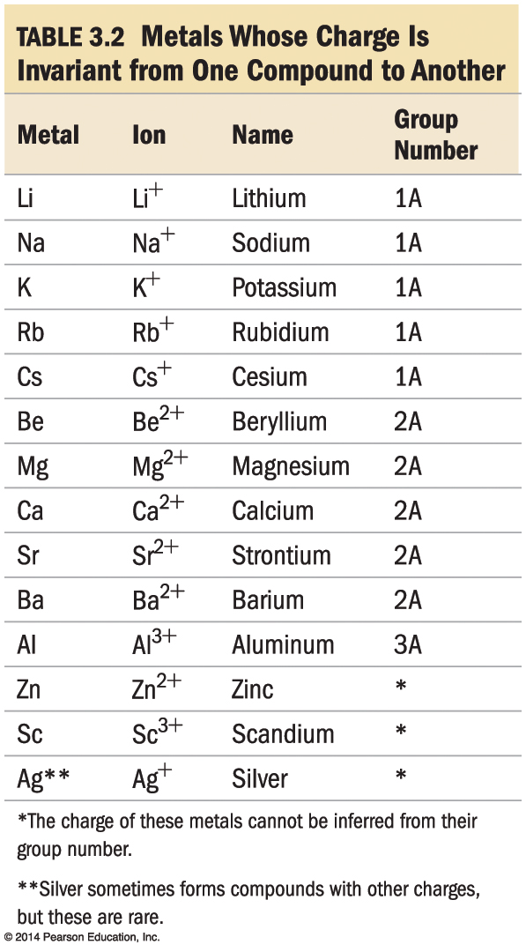
Naming Type I Ionic Compounds

Slide 32
Naming Type II Ionic Compounds
The second type of ionic compound contains a metal with a charge that can differ in different compounds.
The metals in this second type of ionic compound can form more than one kind of cation (depending on the compound).
Its charge must therefore be specified for a given compound.

Slide 33
Type II Ionic Compounds
Iron, for instance, forms a 2+ cation in some of its compounds and a 3+ cation in others.
Metals of this type are often transition metals.
FeSO₄ Here iron is +2 cation (Fe²⁺).
Fe₂(SO₄)₃ Here iron is +3 cation (Fe³⁺).
Cu₂O Here copper is +1 cation (Cu⁺).
CuO Here copper is +2 cation (Cu²⁺).
Some main group metals, such as Pb, Tl, and Sn, form more than one type of cation.

Slide 34
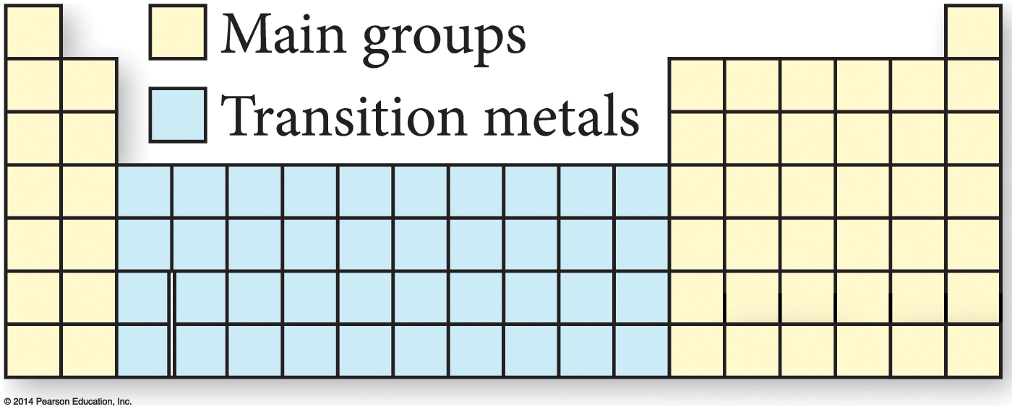
Type II Ionic Compounds

Slide 35
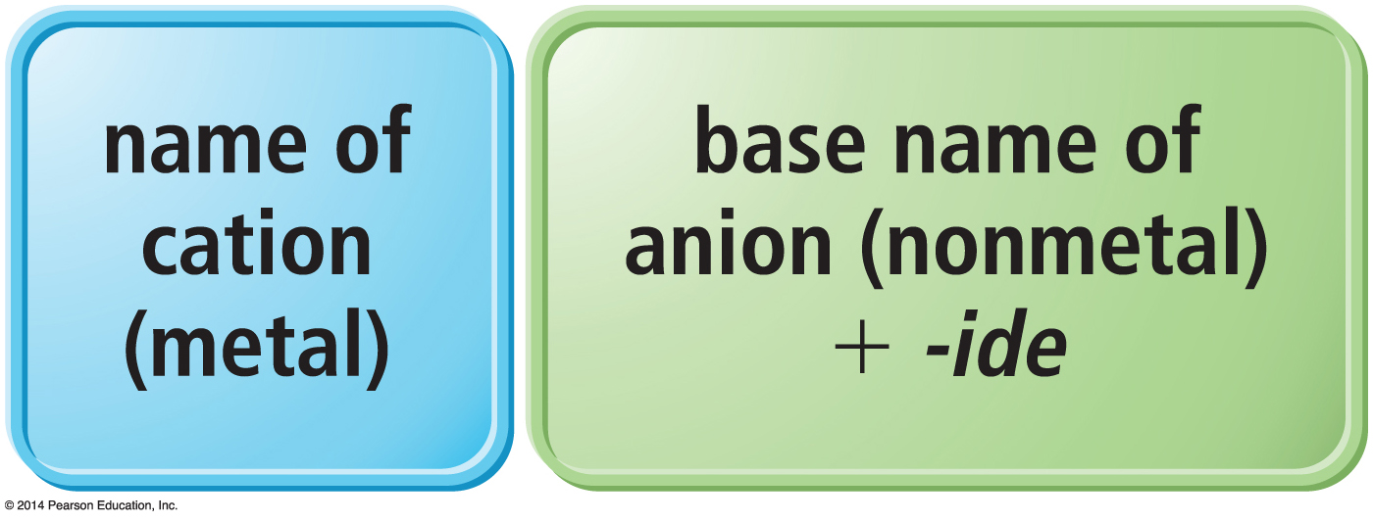
Naming Binary Ionic Compounds of Type I Cations
Binary compounds contain only two different elements. The names of binary ionic compounds take the following form:

Slide 36
Naming Type I Binary Ionic Compounds
For example, the name for KCl consists of the name of the cation, potassium, followed by the base name of the anion, chlor, with the ending -ide.
KCl is potassium chloride.
The name for CaO consists of the name of the cation, calcium, followed by the base name of the anion, ox, with the ending -ide.
CaO is calcium oxide.

Slide 37
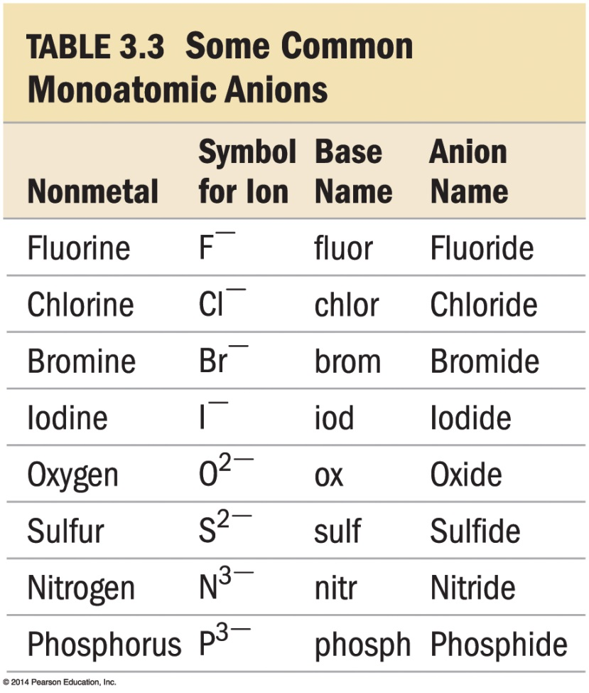
Base Names of Monoatomic Anions
The base names of some nonmetals, and their most common charges in ionic compounds, are shown in Table 3.3.

Slide 38
Naming Type II Binary Ionic Compounds
For these types of metals, the name of the cation is followed by a roman numeral (in parentheses) that indicates the charge of the metal in that particular compound.
For example, we distinguish between Fe²⁺ and Fe³⁺ as follows:
Fe²⁺ Iron(II)
Fe³⁺ Iron(III)

Slide 39
Naming Type II Binary Ionic Compounds
The full names for compounds containing metals that form more than one kind of cation have the following form:
The charge of the metal cation can be determined by inference from the sum of the charges of the nonmetal.

Slide 40
Naming Type II Binary Ionic Compounds
For example, to name CrBr₃ determine the charge on the chromium.
Total charge on cation + total anion charge = 0.
Cr charge + 3(Br– charge) = 0.
Since each Br has a –1 charge, then
Cr charge + 3(–1) = 0
Cr charge –3 = 0
Cr = +3
Hence, the cation Cr³⁺ is called chromium(III), while Br– is called bromide.
Therefore, CrBr₃ is chromium(III) bromide.

Slide 41
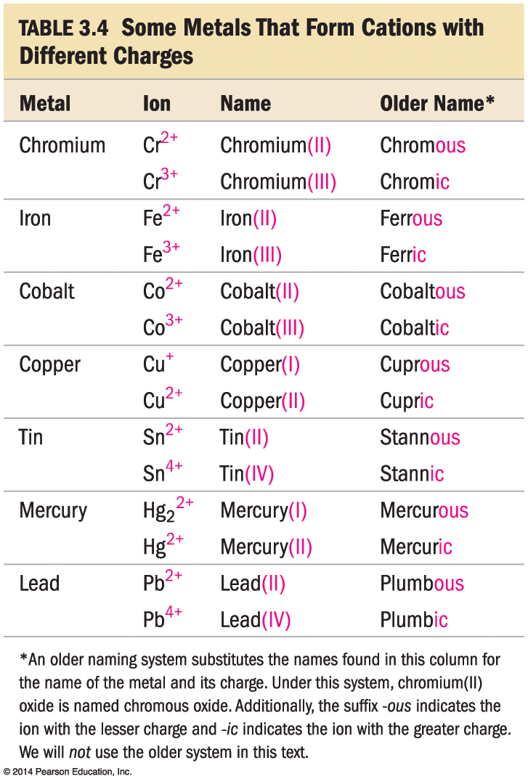
Type II Cation

Slide 42
Naming Ionic Compounds Containing Polyatomic Ions
We name ionic compounds that contain a polyatomic ion in the same way as other ionic compounds, except that we use the name of the polyatomic ion whenever it occurs.
For example, NaNO₂ is named according to
its cation, Na⁺, sodium, and
its polyatomic anion, NO₂–, nitrite.
Hence, NaNO₂ is sodium nitrite.

Slide 43
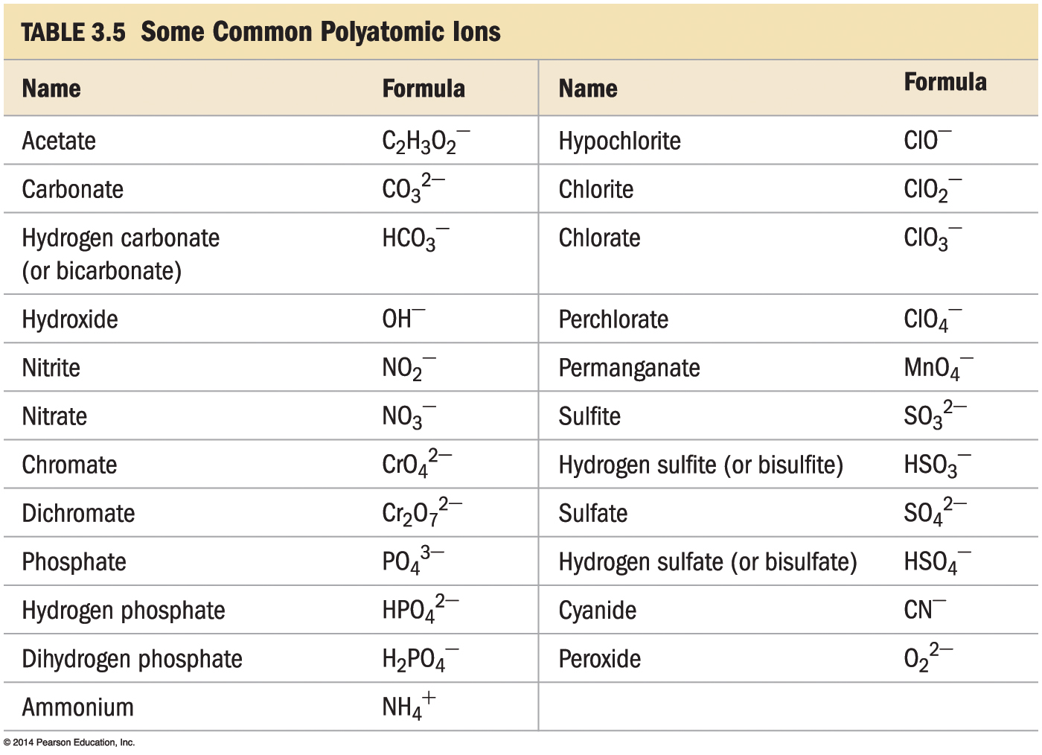
Common Polyatomic Ions

Slide 44
Oxyanions
Most polyatomic ions are oxyanions, anions containing oxygen and another element.
Notice that when a series of oxyanions contains different numbers of oxygen atoms, they are named according to the number of oxygen atoms in the ion.
If there are two ions in the series,
the one with more oxygen atoms has the ending -ate, and
the one with fewer has the ending -ite.
For example,
NO₃– is nitrate SO₄^{2–} is sulfate
NO₂– is nitrite SO₃^{2–} is sulfite

Slide 45
Oxyanions
If there are more than two ions in the series then the prefixes hypo-, meaning less than, and per-, meaning more than, are used.
ClO– hypochlorite BrO– hypobromite
ClO₂– chlorite BrO₂– bromite
ClO₃– chlorate BrO₃– bromate
ClO₄– perchlorate BrO₄– perbromate

Slide 46
Hydrated Ionic Compounds
Hydrates are ionic compounds containing a specific number of water molecules associated with each formula unit.
For example, the formula for epsom salts is MgSO₄ • 7H₂O.
Its systematic name is magnesium sulfate heptahydrate.
CoCl₂ • 6H₂O is cobalt(II)chloride hexahydrate.

Slide 47
Hydrates
Common hydrate prefixes
hemi = ½
mono = 1
di = 2
tri = 3
tetra = 4
penta = 5
hexa = 6
hepta = 7
octa = 8
Other common hydrated ionic compounds and their names are as follows:
CaSO₄ • 1/2H₂O is called calcium sulfate hemihydrate.
BaCl₂ • 6H₂O is called barium chloride hexahydrate.
CuSO₄ • 6H₂O is called copper sulfate hexahydrate.

Slide 48
Molecular Compounds: Formulas and Names
The formula for a molecular compound cannot readily be determined from its constituent elements because the same combination of elements may form many different molecular compounds, each with a different formula.
Nitrogen and oxygen form all of the following unique molecular compounds: NO, NO₂, N₂O, N₂O₃, N₂O₄, and N₂O₅.

Slide 49
Molecular Compounds
Molecular compounds are composed of two or more nonmetals.
Generally, write the name of the element with the smallest group number first.
If the two elements lie in the same group, then write the element with the greatest row number first.
The prefixes given to each element indicate the number of atoms present.

Slide 50
Binary Molecular Compounds
These prefixes are the same as those used in naming hydrates:
mono = 1 hexa = 6 di = 2 hepta = 7 tri = 3 octa = 8 tetra = 4 nona = 9 penta = 5 deca = 10
If there is only one atom of the first element in the formula, the prefix mono- is normally omitted.

Slide 51
Acids
Acids are molecular compounds that release hydrogen ions (H⁺) when dissolved in water.
Acids are composed of hydrogen, usually written first in their formula, and one or more nonmetals, written second.
HCl is a molecular compound that, when dissolved in water, forms H⁺_{(aq)} and Cl–_{(aq)} ions, where aqueous (aq) means dissolved in water.

Slide 52
Acids
Acids are molecular compounds that form H⁺ when dissolved in water.
To indicate the compound is dissolved in water (aq) is written after the formula.
A compound is not considered an acid if it does not dissolve in water.
Sour taste
Dissolve many metals
such as Zn, Fe, Mg; but not Au, Ag, Pt
Formula generally starts with H
e.g., HCl, H₂SO₄

Slide 53
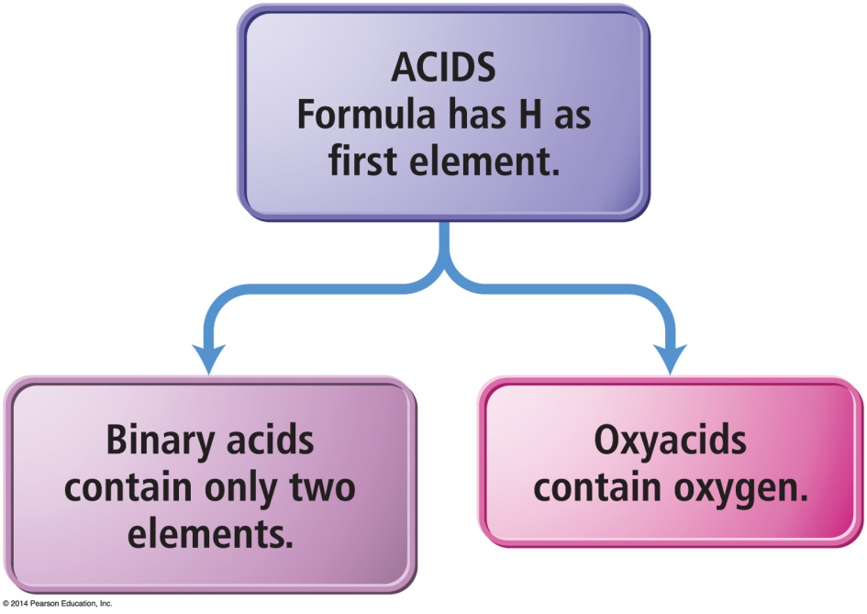
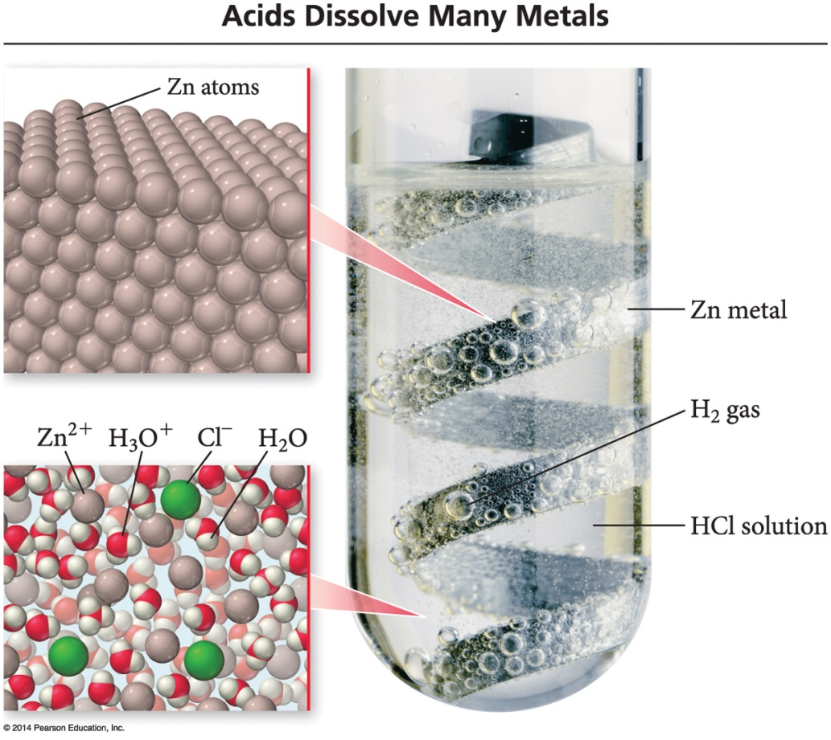
Acids
Binary acids have H⁺¹ cation and nonmetal anion.
Oxyacids have H⁺ cation and polyatomic anion.

Slide 54
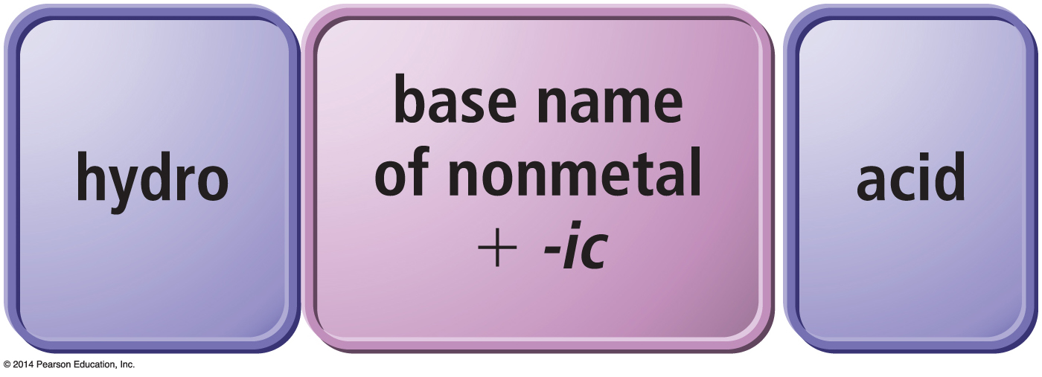
Naming Binary Acids
Write a hydro- prefix.
Follow with the nonmetal name.
Change ending on nonmetal name to –ic.
Write the word acid at the end of the name.

Slide 55
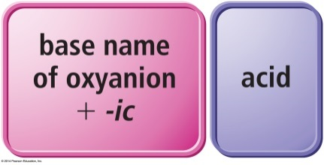
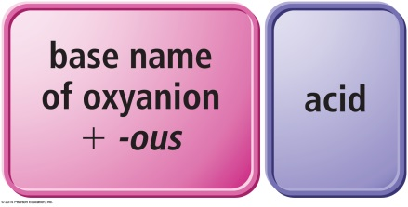
Naming Oxyacids
If polyatomic ion name ends in –ate, then change ending to –ic suffix.
If polyatomic ion name ends in –ite, then change ending to –ous suffix.
Write word acid at the end of all names.
oxyanions ending with -ate
oxyanions ending with -ite

Slide 56
Name the Following
1. H₂S
2. HClO₃
3. HC₂H₃O₂

Slide 57
Name the Following
1. H₂S
2. HClO₃
3. HC₂H₃O₂
hydrosulfuric acid
chloric acid
acetic acid
Notes:
57

Slide 58
Writing Formulas for Acids
When name ends in acid, formulas starts with H.
Write formulas as if ionic, even though it is molecular.
Hydro- prefix means it is binary acid; no prefix means it is an oxyacid.
For oxyacid
if ending is –ic, polyatomic ion ends in –ate.
if ending is –ous, polyatomic ion ends in –ous.

Slide 59
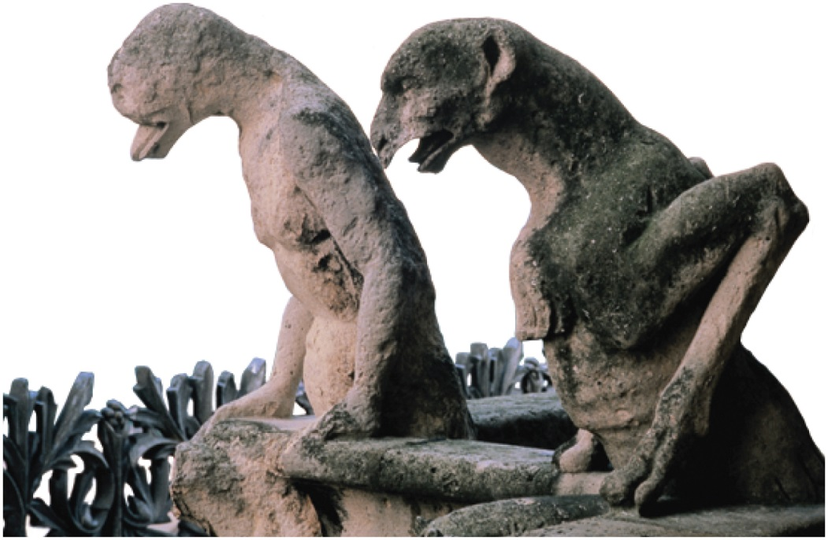
Acid Rain
Certain pollutants—such as NO, NO₂, SO₂, SO₃—form acids when mixed with water, resulting in acidic rainwater.
Acid rain can fall or flow into lakes and streams, making these bodies of water more acidic.

Slide 60
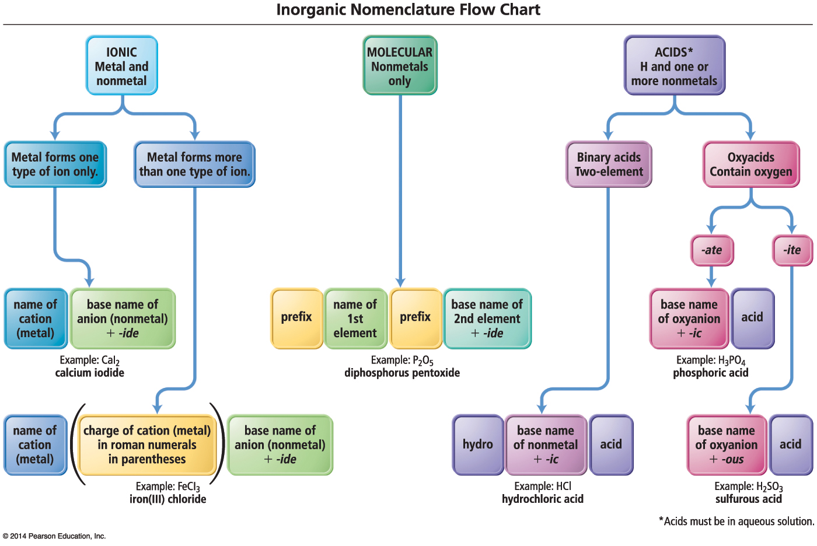
Inorganic Nomenclature Flow Chart

