Slide 1
Problems with Lewis Theory
Lewis theory generally predicts trends in properties, but does not give good numerical predictions.
For example, bond strength and bond length
Lewis theory gives good first approximations of the bond angles in molecules, but usually cannot be used to get the actual angle.
Lewis theory cannot write one correct structure for many molecules where resonance is important.
Lewis theory often does not predict the correct magnetic behavior of molecules.
For example, O₂ is paramagnetic, although the Lewis structure predicts it is diamagnetic.

Slide 2
Valence Bond Theory
Linus Pauling and others applied the principles of quantum mechanics to molecules.
They reasoned that bonds between atoms would occur when the orbitals on those atoms interacted to make a bond.
The kind of interaction depends on whether the orbitals align along the axis between the nuclei, or outside the axis.
Notes:
2

Slide 3
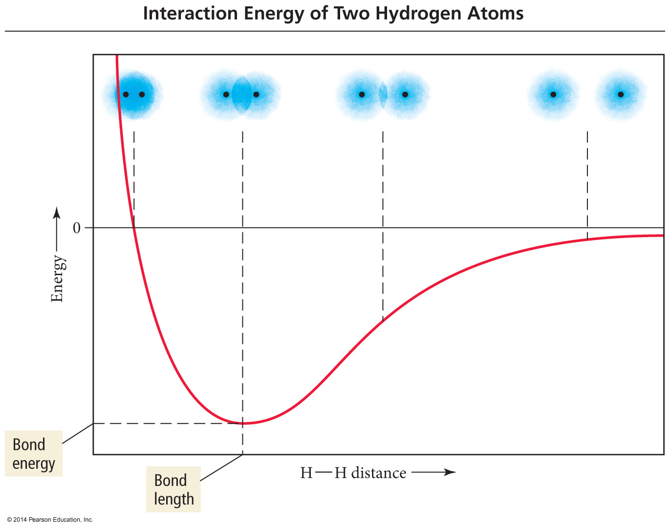

Slide 4
Orbital Interaction
As two atoms approached, the half–filled valence atomic orbitals on each atom would interact to form molecular orbitals.
Molecular orbitals are regions of high probability of finding the shared electrons in the molecule.
The molecular orbitals would be more stable than the separate atomic orbitals because they would contain paired electrons shared by both atoms.
The potential energy is lowered when the molecular orbitals contain a total of two paired electrons compared to separate one electron atomic orbitals.

Slide 5
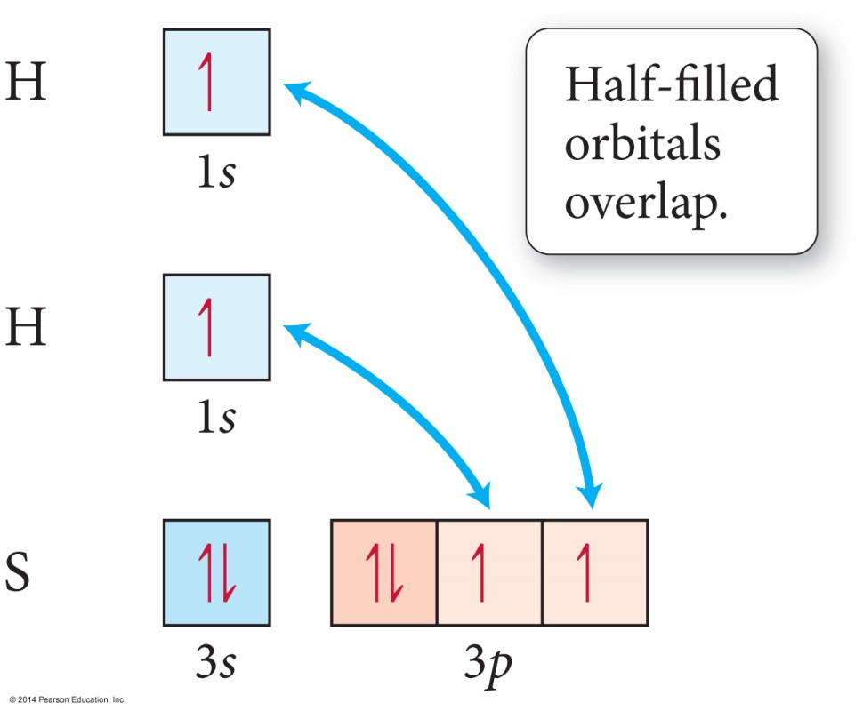
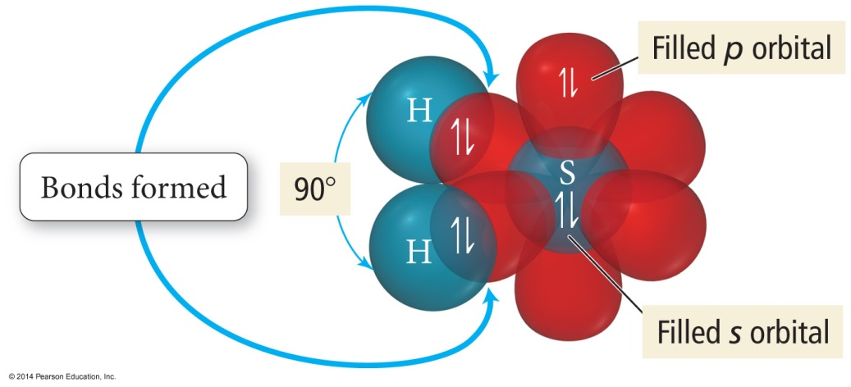
Orbital Diagram for the Formation of H₂S
Predicts bond angle = 90°
Actual bond angle = 92°

Slide 6
Valence Bond Theory – Hybridization
One of the issues that arises is that the number of partially filled or empty atomic orbitals did not predict the number of bonds or orientation of bonds.
C = 2s²2p_{x}¹2p_{y}¹2p_{z}⁰ would predict two or three bonds that are 90° apart, rather than four bonds that are 109.5 ° apart.
To adjust for these inconsistencies, it was postulated that the valence atomic orbitals could hybridize before bonding took place.
One hybridization of C is to mix all the 2s and 2p orbitals to get four orbitals that point at the corners of a tetrahedron.

Slide 7
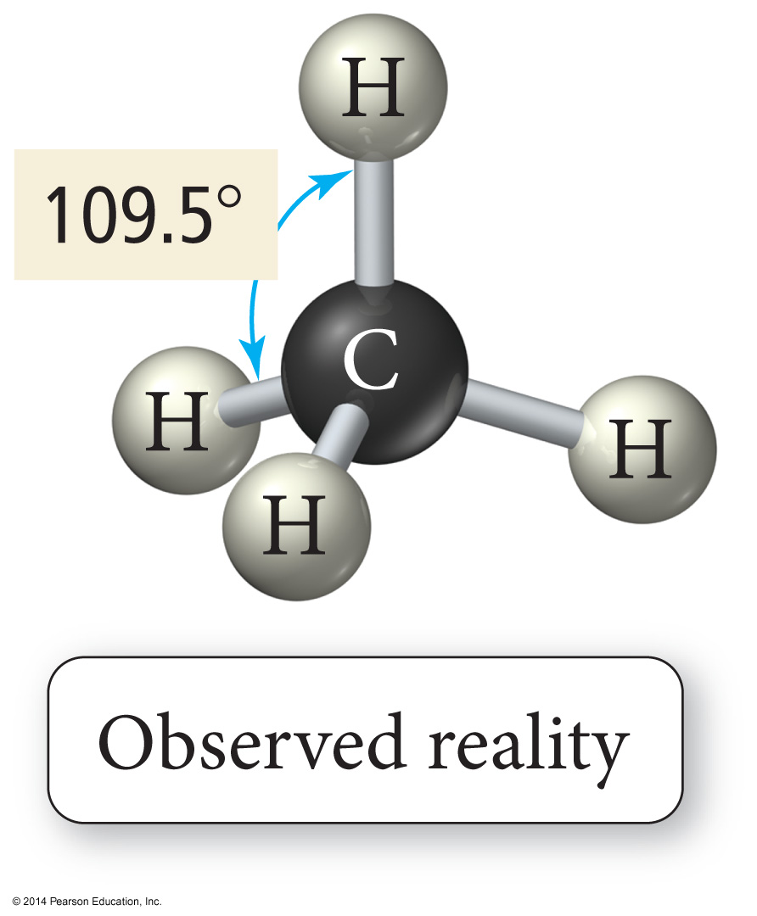
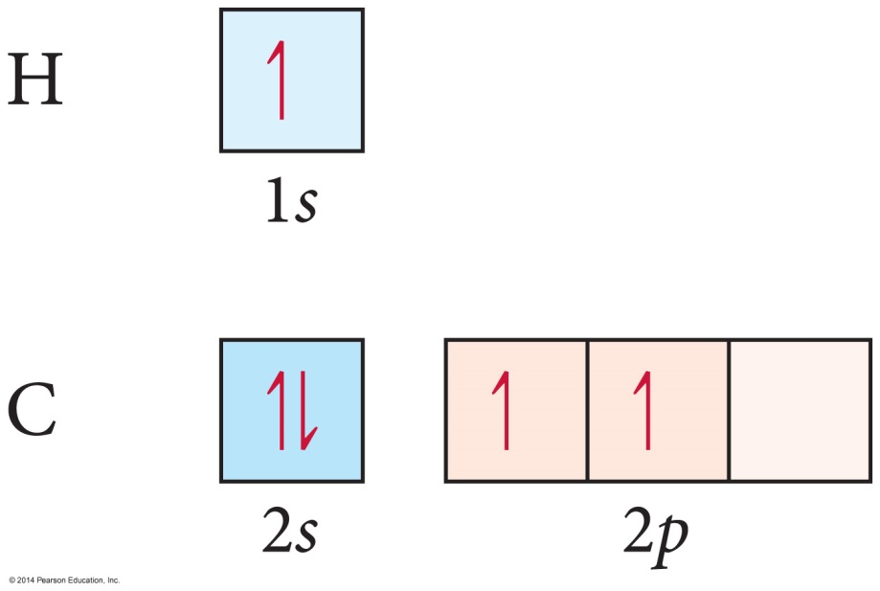
Unhybridized C Orbitals Predict the Wrong Bonding and Geometry

Slide 8
Valence Bond Theory: Main Concepts
The valence electrons of the atoms in a molecule reside in quantum-mechanical atomic orbitals. The orbitals can be the standard s, p, d, and f orbitals, or they may be hybrid combinations of these.
A chemical bond results when these atomic orbitals interact and there is a total of two electrons in the new molecular orbital.
The electrons must be spin paired.
The shape of the molecule is determined by the geometry of the interacting orbitals.

Slide 9
Hybridization
Some atoms hybridize their orbitals to maximize bonding.
More bonds = more full orbitals = more stability
Hybridizing is mixing different types of orbitals in the valence shell to make a new set of degenerate orbitals.
sp, sp², sp³, sp³d, sp³d²
Same type of atom can have different types of hybridization.
C = sp, sp², sp³

Slide 10
Hybrid Orbitals
The number of standard atomic orbitals combined = the number of hybrid orbitals formed.
Combining a 2s with a 2p gives two 2sp hybrid orbitals.
H cannot hybridize!
Its valence shell only has one orbital.
The number and type of standard atomic orbitals combined determines the shape of the hybrid orbitals.
The particular kind of hybridization that occurs is the one that yields the lowest overall energy for the molecule.

Slide 11
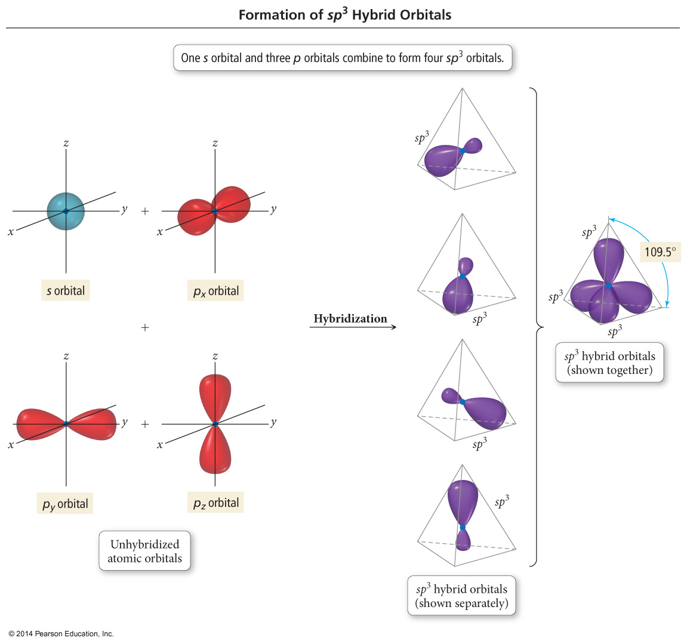

Slide 12
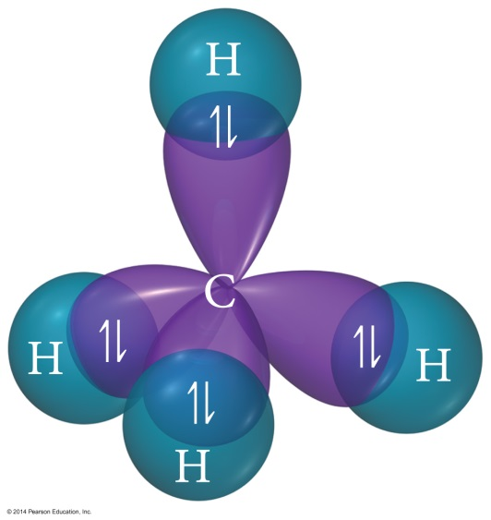
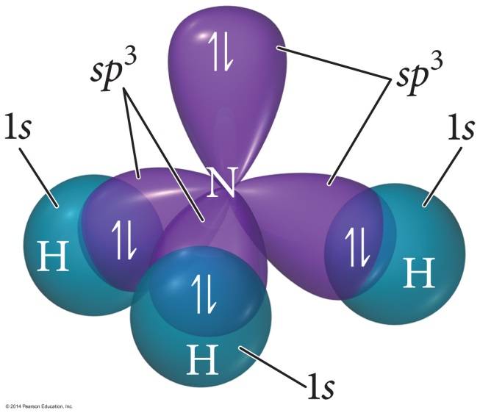
sp³ Hybridization
Atom with four electron groups around it
Tetrahedral geometry
109.5° angles between hybrid orbitals
Atom uses hybrid orbitals for all bonds and lone pairs

Slide 13
Orbital Diagram of the sp³ Hybridization of C

Slide 14
Bonding with Valence Bond Theory
According to valence bond theory, bonding takes place between atoms when their atomic or hybrid orbitals interact.
“Overlap”
To interact, the orbitals must either
be aligned along the axis between the atoms, or
be parallel to each other and perpendicular to the interatomic axis.

Slide 15
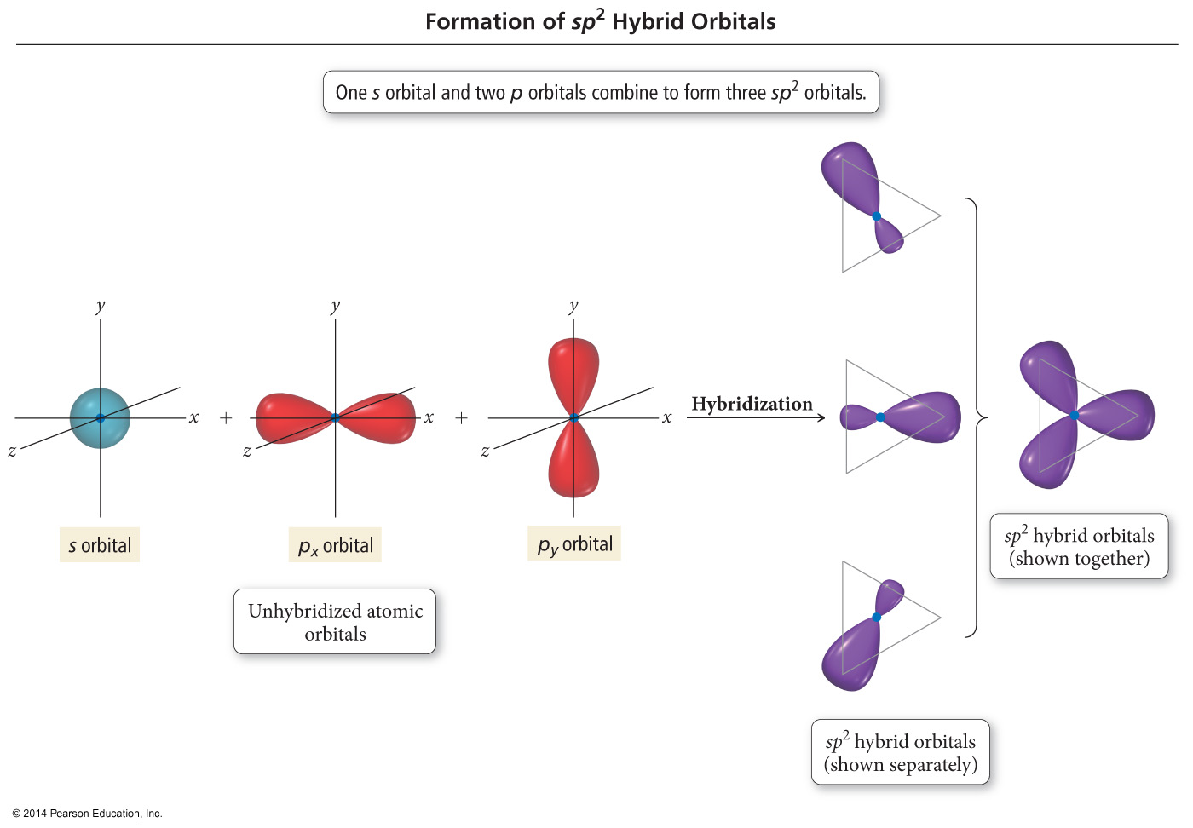

Slide 16
sp²
Atom with three electron groups around it
Trigonal planar system
C = trigonal planar
N = trigonal bent
O = “linear”
120° bond angles
Flat
Atom uses hybrid orbitals for σ bonds and lone pairs, and uses nonhybridized p orbital for π bond

Slide 17
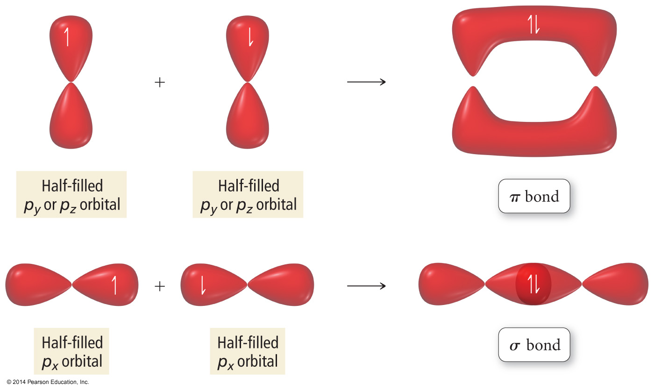

Slide 18
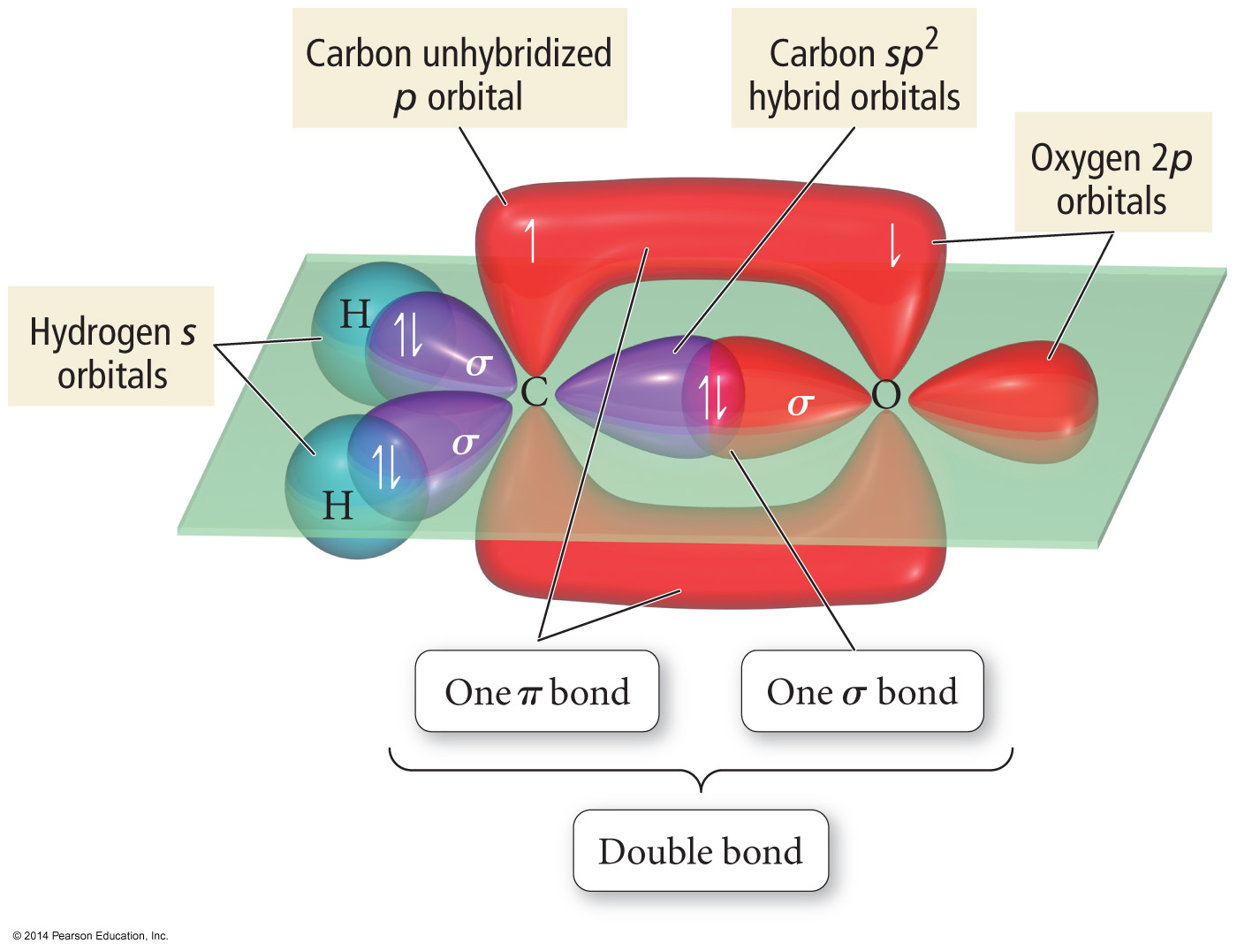

Slide 19
Types of Bonds
A sigma (σ) bond results when the interacting atomic orbitals point along the axis connecting the two bonding nuclei.
Either standard atomic orbitals or hybrids
s to s, p to p, hybrid to hybrid, s to hybrid, etc.
A pi (π) bond results when the bonding atomic orbitals are parallel to each other and perpendicular to the axis connecting the two bonding nuclei.
Between unhybridized parallel p orbitals
The interaction between parallel orbitals is not as strong as between orbitals that point at each other; therefore, σ bonds are stronger than π bonds.

Slide 20
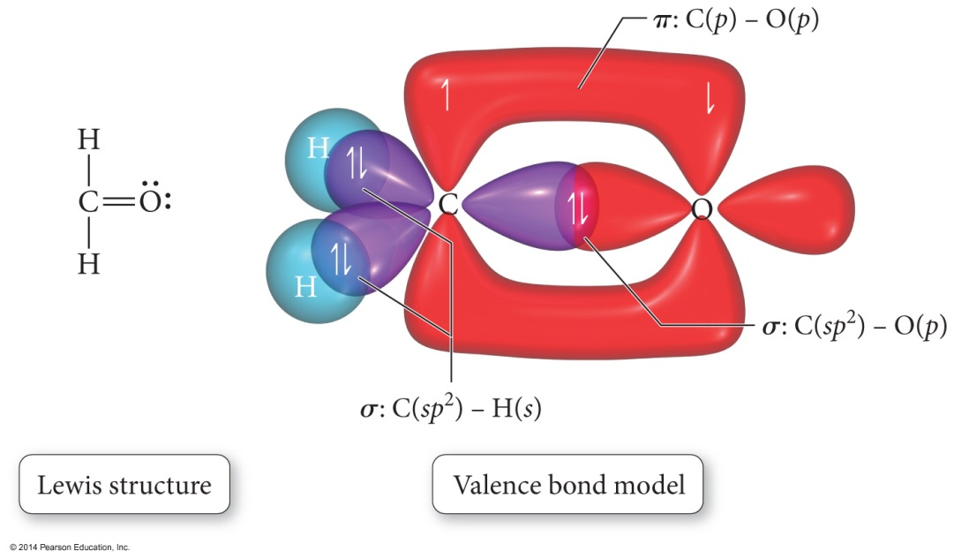
Orbital Diagrams of Bonding
“Overlap” between a hybrid orbital on one atom with a hybrid or nonhybridized orbital on another atom results in a σ bond.
“Overlap” between unhybridized p orbitals on bonded atoms results in a π bond.

Slide 21
Orbital Diagrams of Bonding cont.
Hybrid orbitals overlap to form a σ bond. Unhybridized p orbitals overlap to form a π bond.

Slide 22
Bond Rotation
Because the orbitals that form the σ bond point along the internuclear axis, rotation around that bond does not require breaking the interaction between the orbitals.
But the orbitals that form the π bond interact above and below the internuclear axis, so rotation around the axis requires the breaking of the interaction between the orbitals.

Slide 23
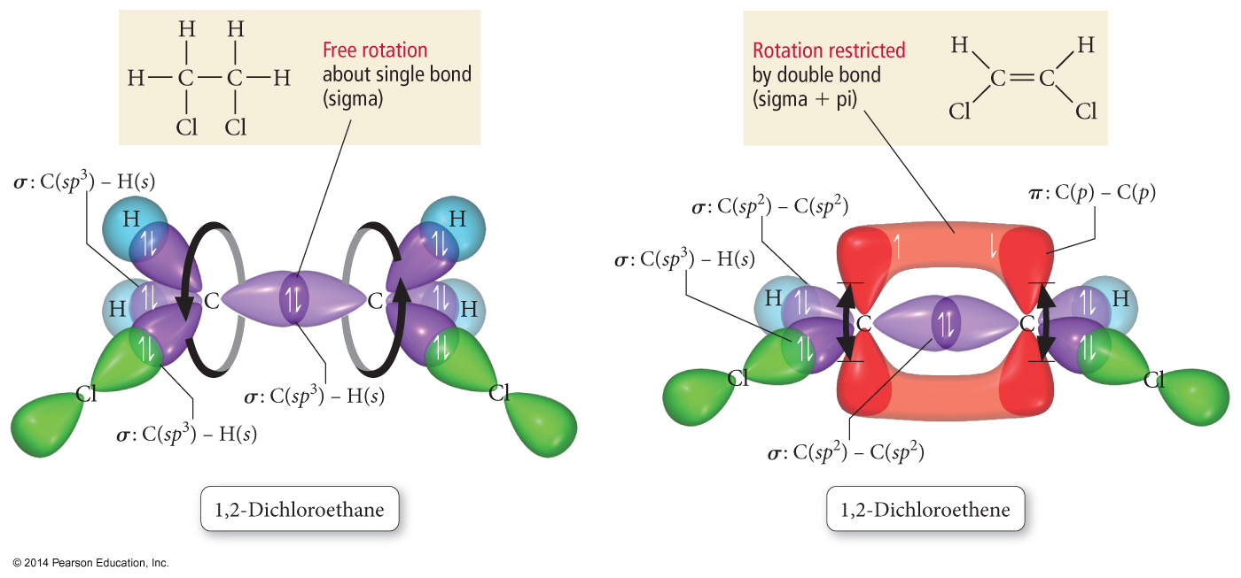
Bond Rotation

Slide 24
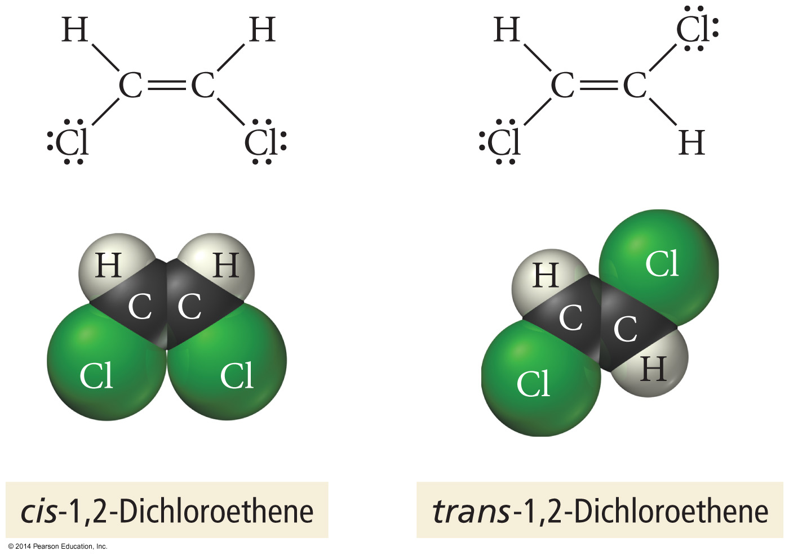

Slide 25
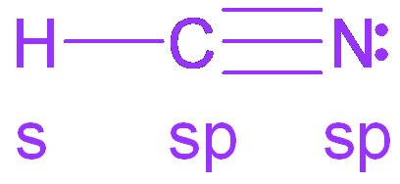
sp
Atom with two electron groups
Linear shape
180° bond angle
Atom uses hybrid orbitals for σ bonds or lone pairs, and uses nonhybridized p orbitals for π bonds
π
σ
π

Slide 27
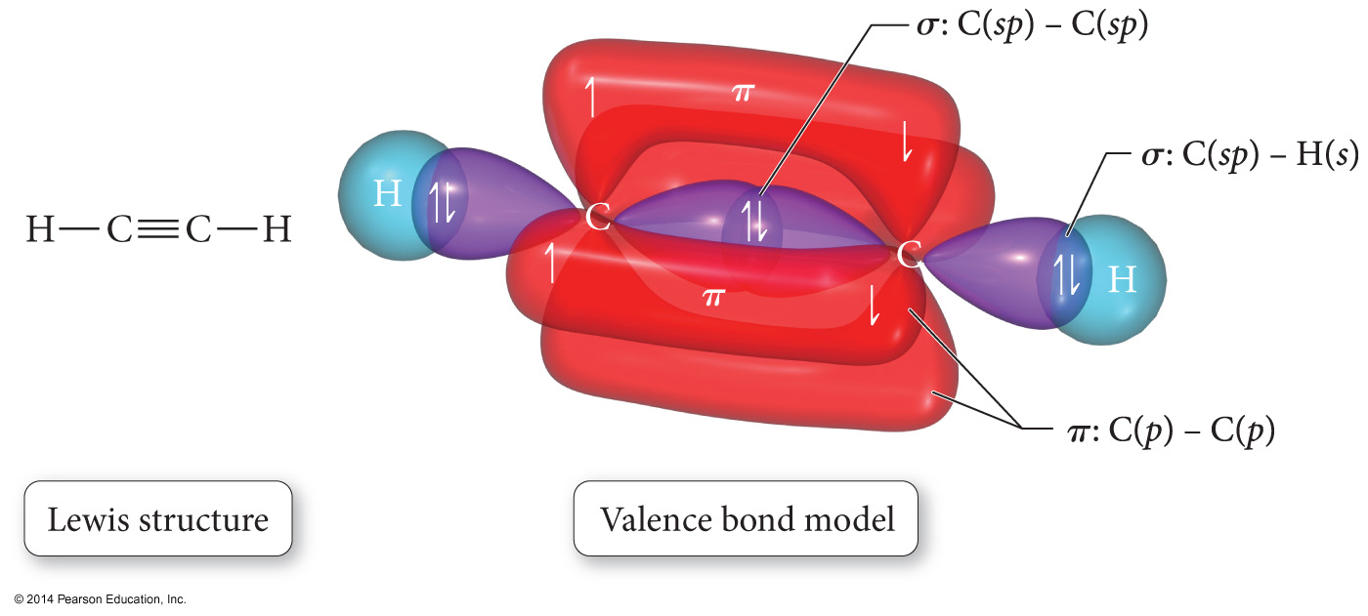

Slide 28
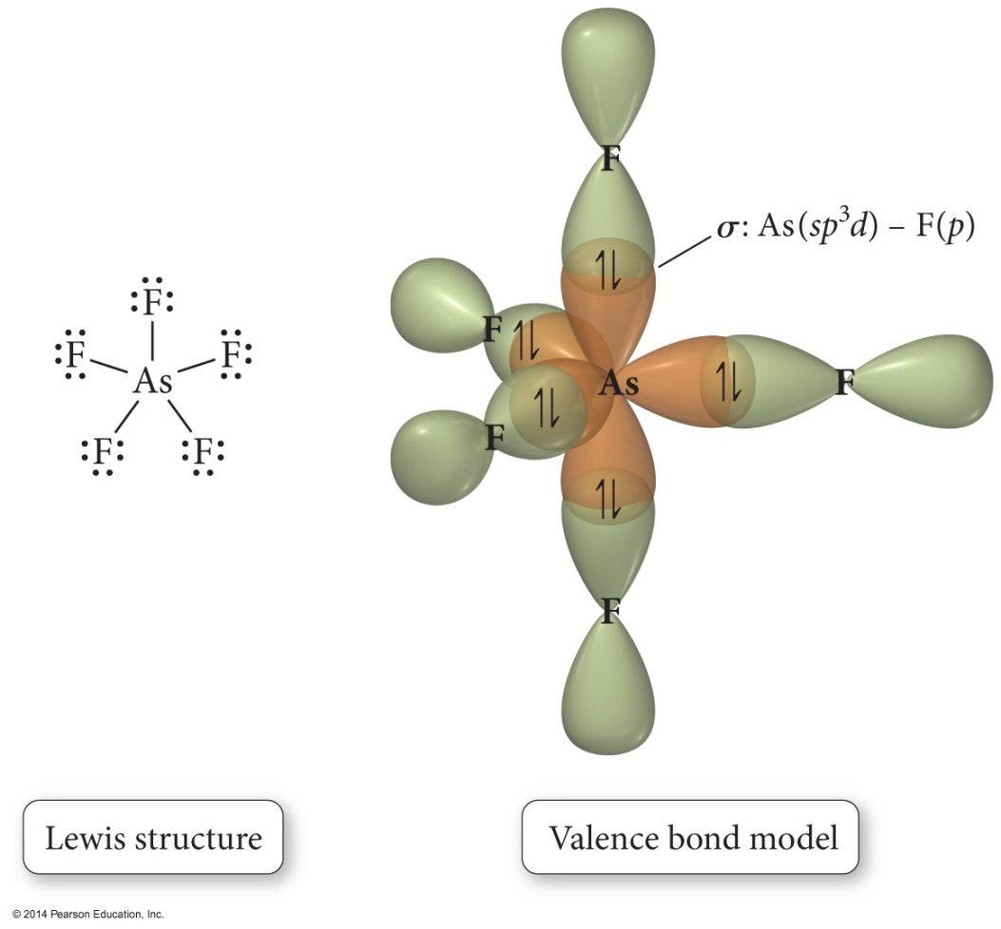
sp³d
Atom with five electron groups around it
Trigonal bipyramid electron geometry
Seesaw, T–shape, linear
120° and 90 ° bond angles
Use empty d orbitals from valence shell
d orbitals – used to make π bonds

Slide 29
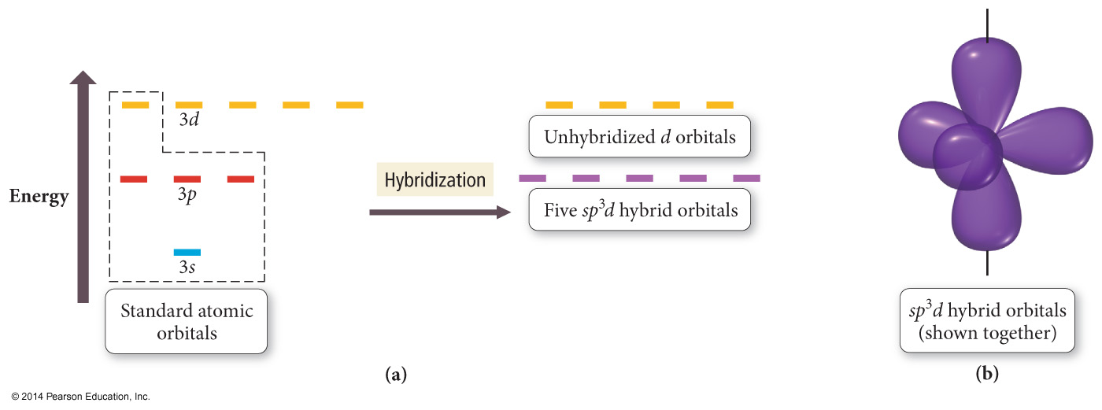

Slide 30
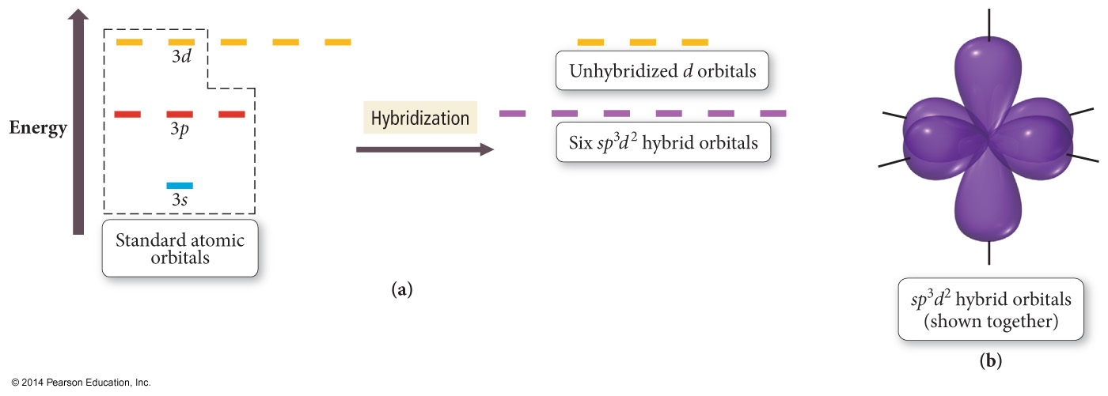

Slide 31
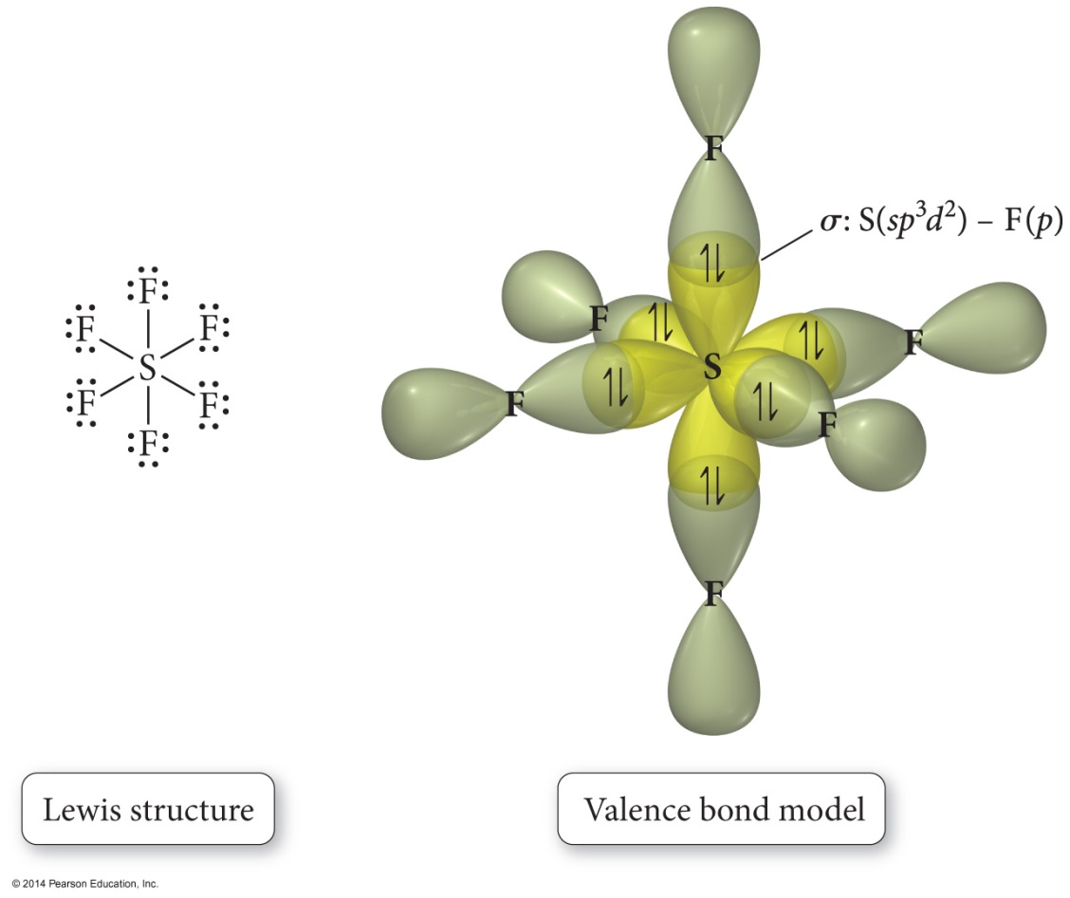
sp³d²
Atom with six electron groups around it
Octahedral electron geometry
Square pyramid, Square planar
90° bond angles
Use empty d orbitals from valence shell to form hybrid
d orbitals – used to make π bonds

Slide 32
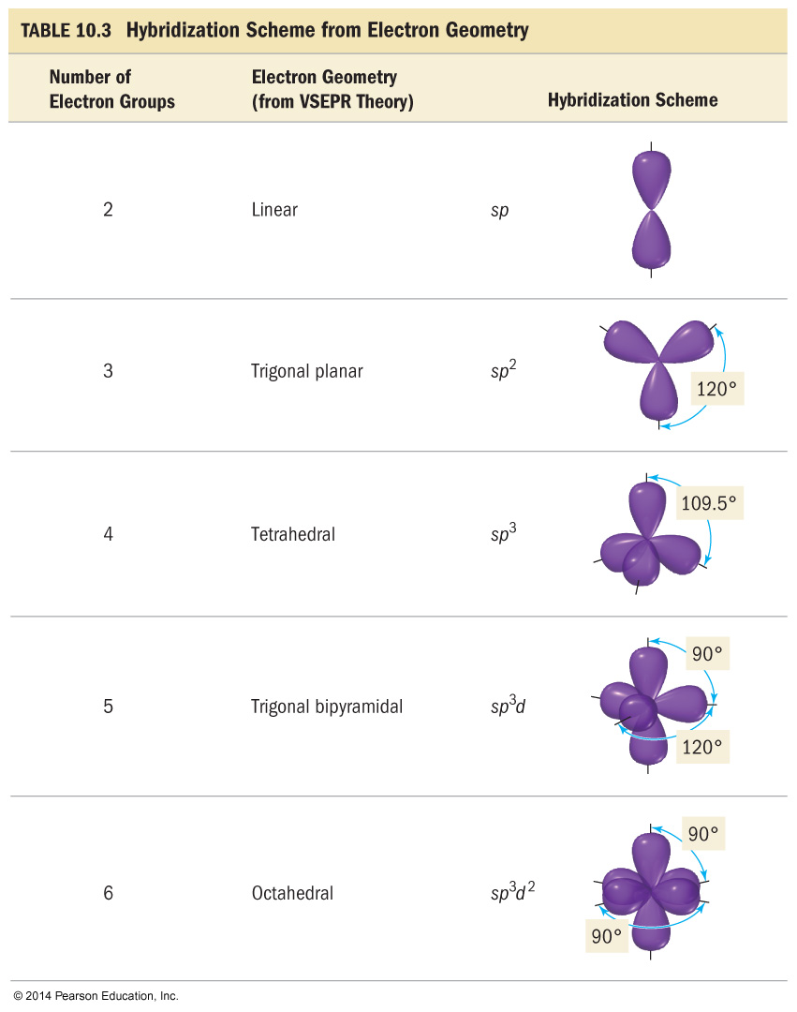

Slide 33
Predicting Hybridization and Bonding Scheme
1. Start by drawing the Lewis structure.
2. Use VSEPR theory to predict the electron group geometry around each central atom.
3. Use Table 10.3 to select the hybridization scheme that matches the electron group geometry.
4. Sketch the atomic and hybrid orbitals on the atoms in the molecule, showing overlap of the appropriate orbitals.
5. Label the bonds as σ or π.

Slide 34
Problems with Valence Bond (VB) Theory
VB theory predicts many properties better than Lewis theory.
Bonding schemes, bond strengths, bond lengths, bond rigidity
However, there are still many properties of molecules it doesn’t predict perfectly.
Magnetic behavior of O₂
In addition, VB theory presumes the electrons are localized in orbitals on the atoms in the molecule—it doesn’t account for delocalization.

Slide 35
Molecular Orbital (MO) Theory
In MO theory, we apply Schrödinger’s wave equation to the molecule to calculate a set of molecular orbitals.
In practice, the equation solution is estimated.
We start with good guesses from our experience as to what the orbital should look like.
Then we test and tweak the estimate until the energy of the orbital is minimized.
In this treatment, the electrons belong to the whole molecule, so the orbitals belong to the whole molecule.
Delocalization

Slide 36
LCAO
The simplest guess starts with the atomic orbitals of the atoms adding together to make molecular orbitals; this is called the linear combination of atomic orbitals (LCAO) method.
Weighted sum
Because the orbitals are wave functions, the waves can combine either constructively or destructively.

Slide 37
Molecular Orbitals
When the wave functions combine constructively, the resulting molecular orbital has less energy than the original atomic orbitals; it is called a bonding molecular orbital.
σ, π
Most of the electron density between the nuclei
When the wave functions combine destructively, the resulting molecular orbital has more energy than the original atomic orbitals; it is called an antibonding molecular orbital.
σ*, π*
Most of the electron density outside the nuclei
Nodes between nuclei

Slide 38
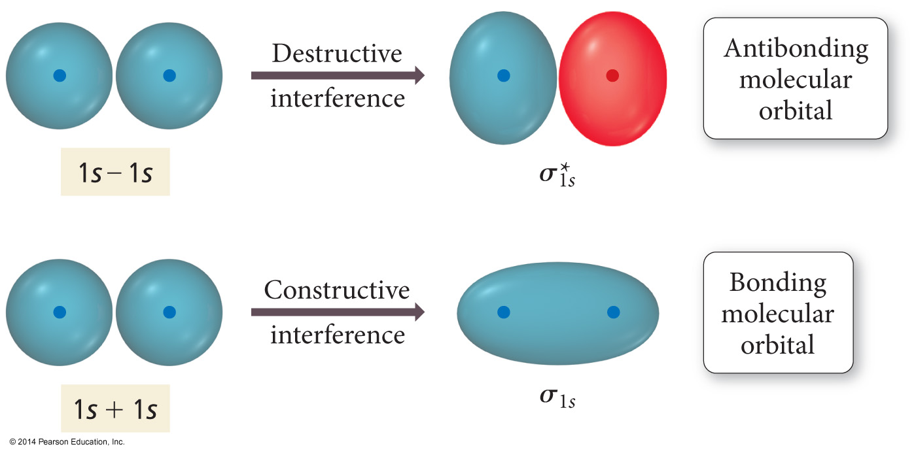
Interaction of 1s Orbitals

Slide 39
Molecular Orbital Theory
Electrons in bonding MOs are stabilizing.
Lower energy than the atomic orbitals
Electrons in antibonding MOs are destabilizing.
Higher in energy than atomic orbitals
Electron density located outside the internuclear axis
Electrons in antibonding orbitals cancel stability gained by electrons in bonding orbitals.

Slide 40
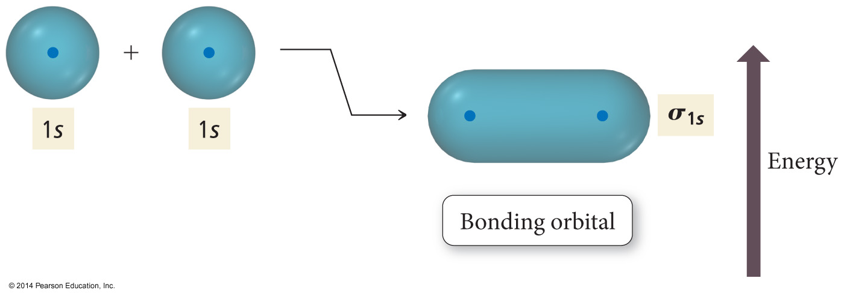
Energy Comparisons of Atomic Orbitals to Molecular Orbitals

Slide 41
MO and Properties
Bond order = difference between number of electrons in bonding and antibonding orbitals
Only need to consider valence electrons
May be a fraction
Higher bond order = stronger and shorter bonds
If bond order = 0, then bond is unstable compared to individual atoms and no bond will form.
A substance will be paramagnetic if its MO diagram has unpaired electrons.
If all electrons paired, it is diamagnetic

Slide 42
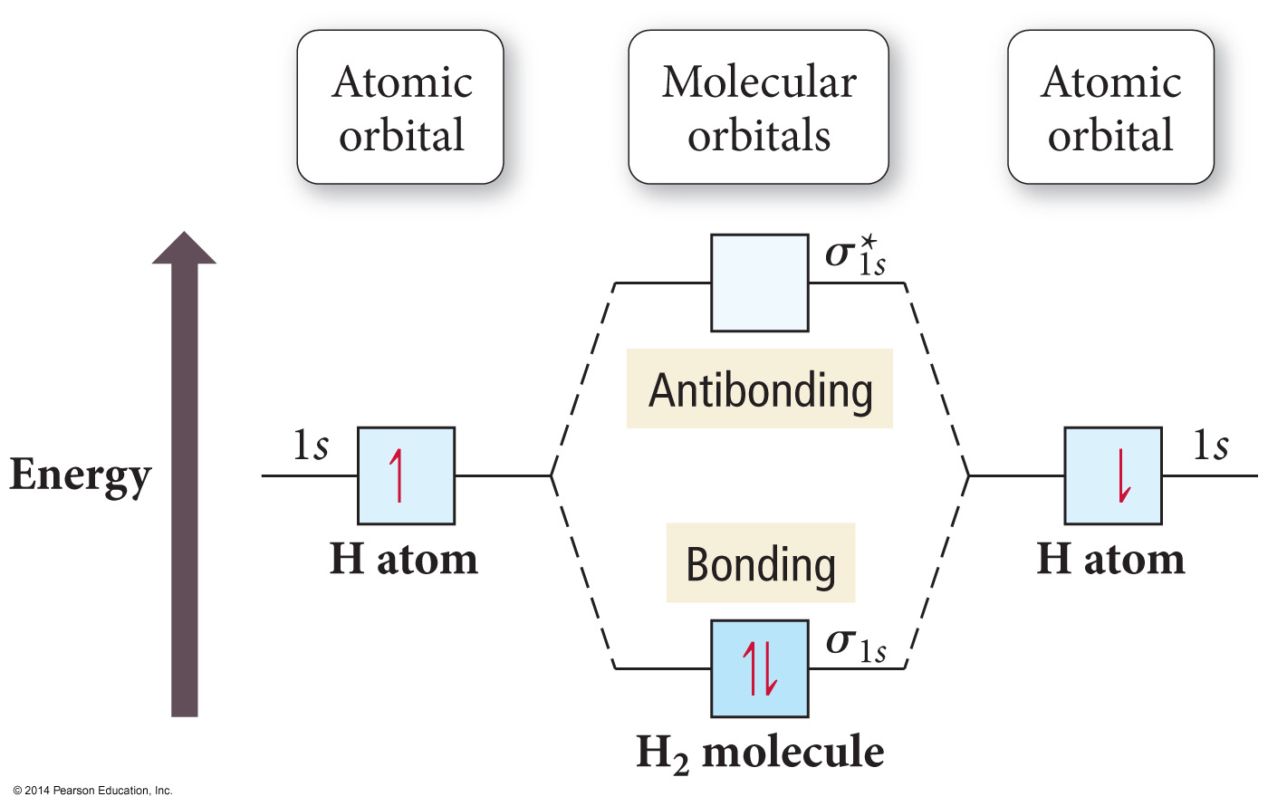

Slide 43
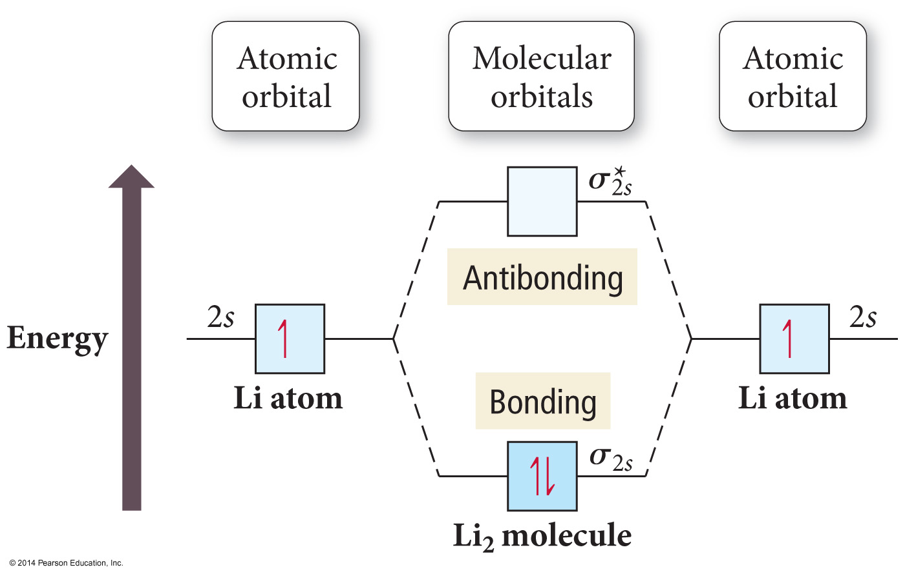
Period Two Homonuclear Diatomic Molecules

Slide 44
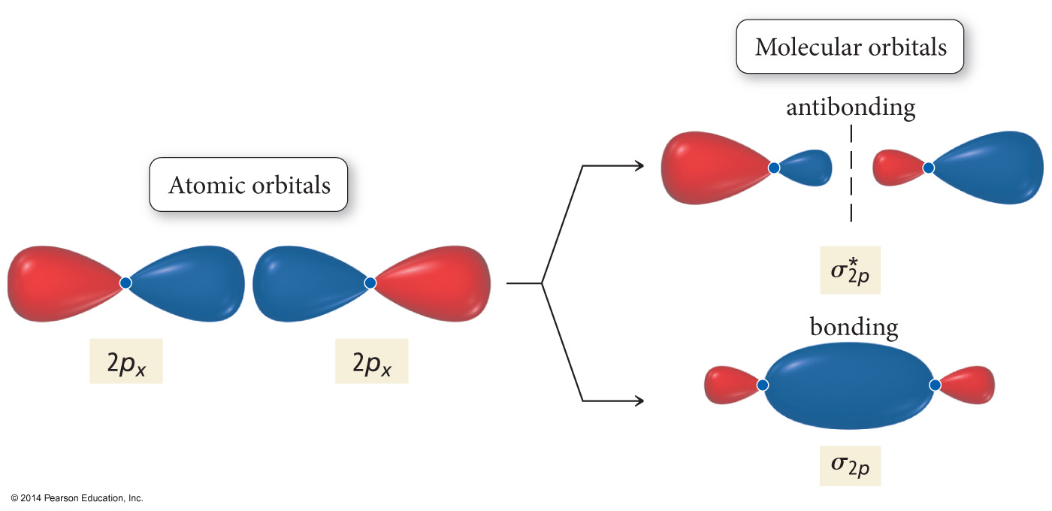
Interaction of p Orbitals

Slide 45
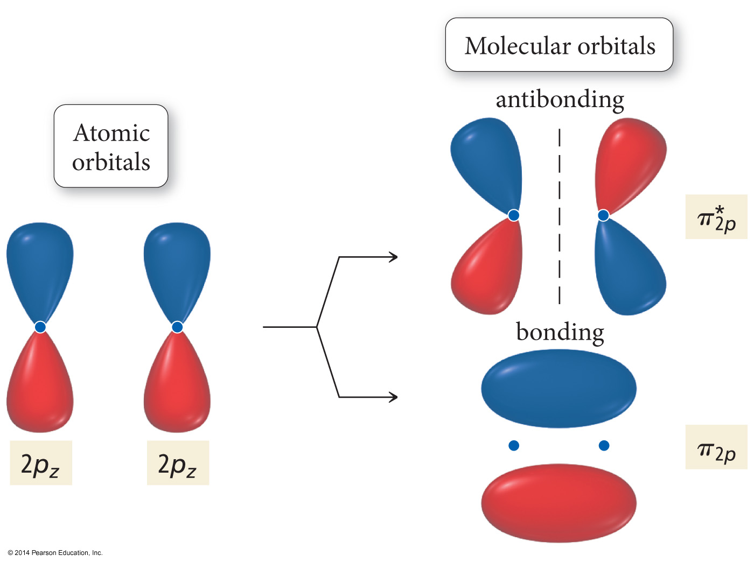
Interaction of p Orbitals

Slide 46
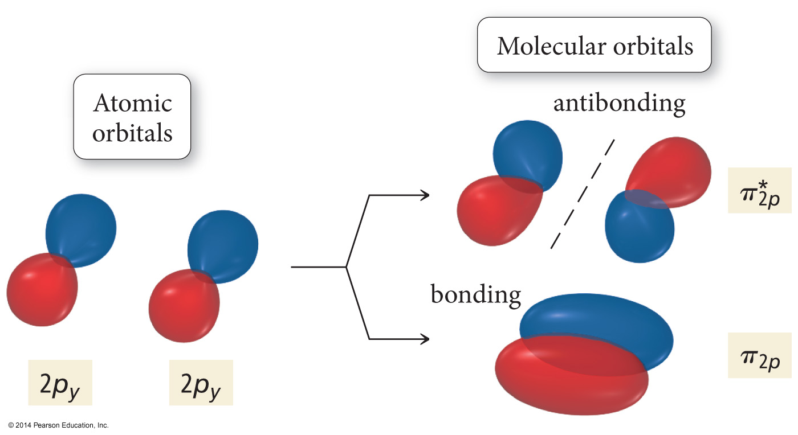
Interaction of p Orbitals

Slide 47
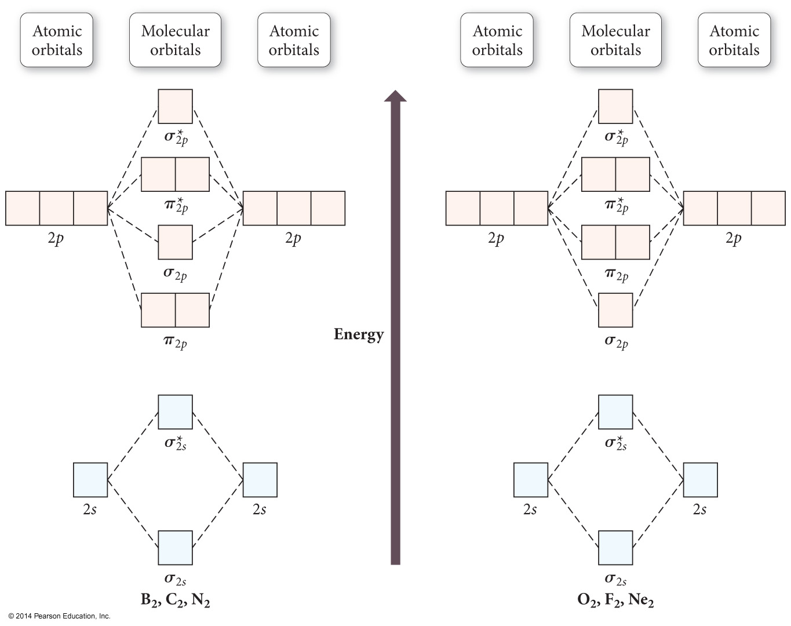

Slide 48
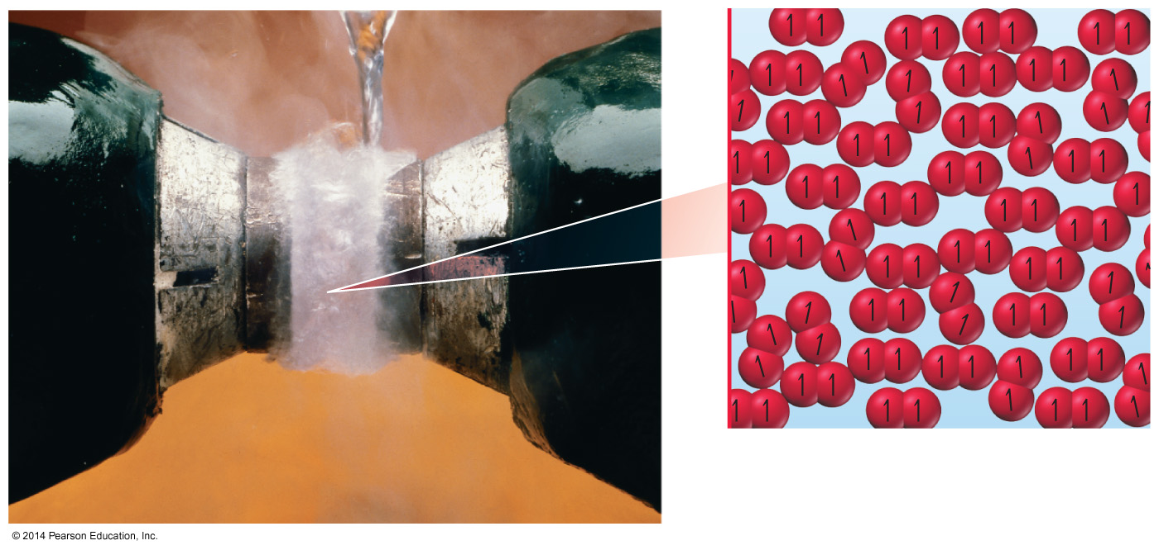
O₂
Dioxygen is paramagnetic.
Paramagnetic material has unpaired electrons.
Neither Lewis theory nor valence bond theory predict this result.

Slide 49
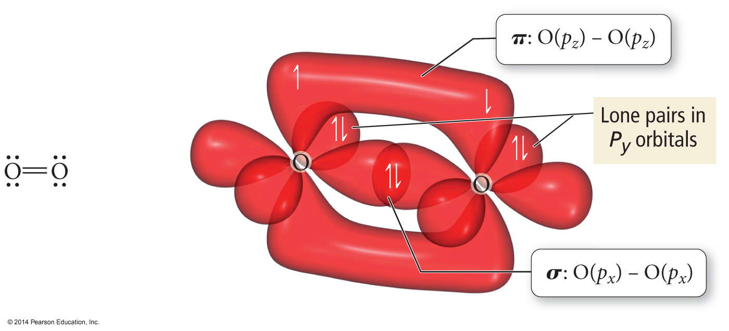
O₂ as Described by Lewis and VB Theory

Slide 50
Heteronuclear Diatomic Molecules and Ions
When the combining atomic orbitals are identical and of equal energy, the contribution of each atomic orbital to the molecular orbital is equal.
When the combining atomic orbitals are different types and energies, the atomic orbital closest in energy to the molecular orbital contributes more to the molecular orbital.

Slide 51
Heteronuclear Diatomic Molecules and Ions
The more electronegative an atom is, the lower in energy are its orbitals.
Lower energy atomic orbitals contribute more to the bonding MOs.
Higher energy atomic orbitals contribute more to the antibonding MOs.
Nonbonding MOs remain localized on the atom donating its atomic orbitals.

Slide 52
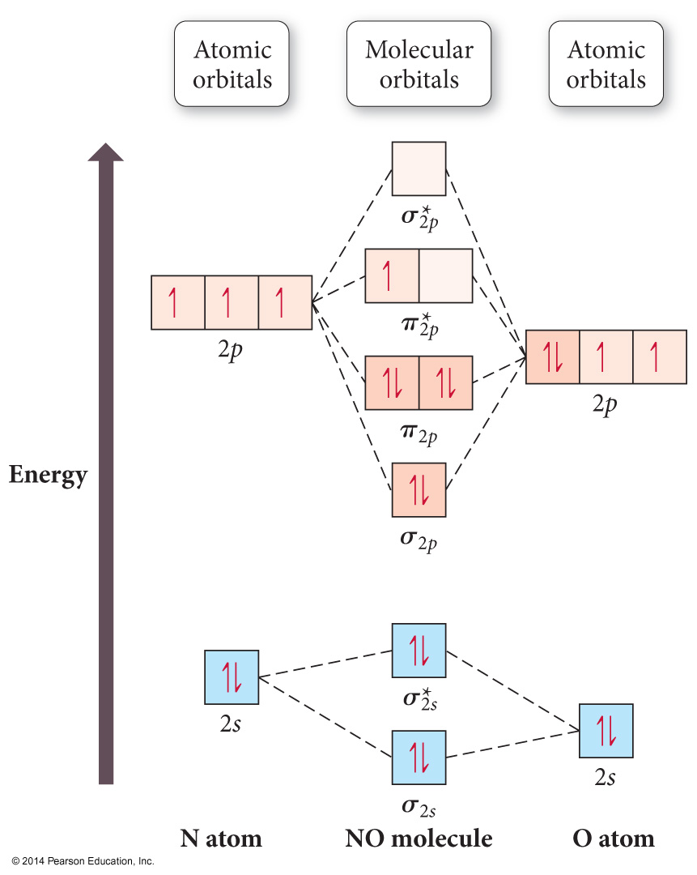
Second-Period Heteronuclear Diatomic Molecules

Slide 53
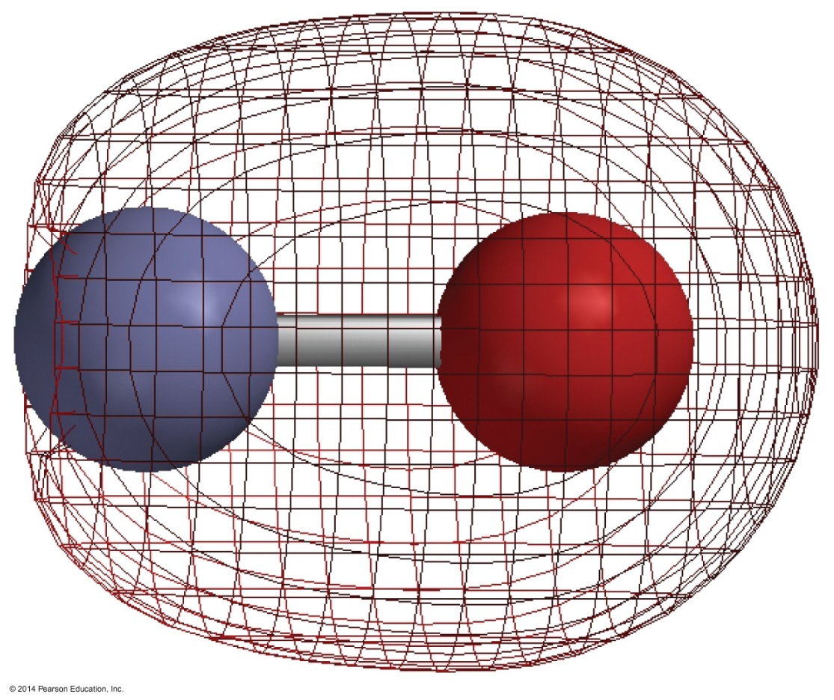
NO
σ_{2s} bonding MO
shows more electron density near O because it is mostly O’s 2s atomic orbital.

Slide 54
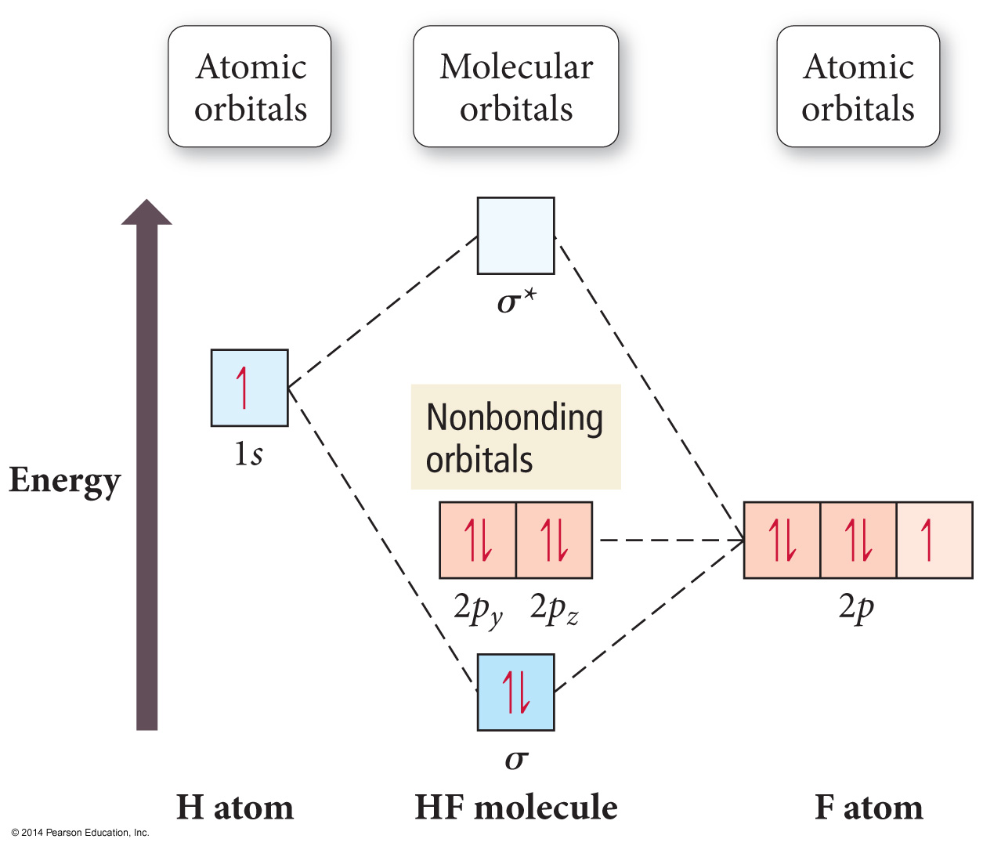
HF

Slide 55
Polyatomic Molecules
When many atoms are combined together, the atomic orbitals of all the atoms are combined to make a set of molecular orbitals, which are delocalized over the entire molecule.
Gives results that better match real molecule properties than either Lewis or valence bond theories.

Slide 56
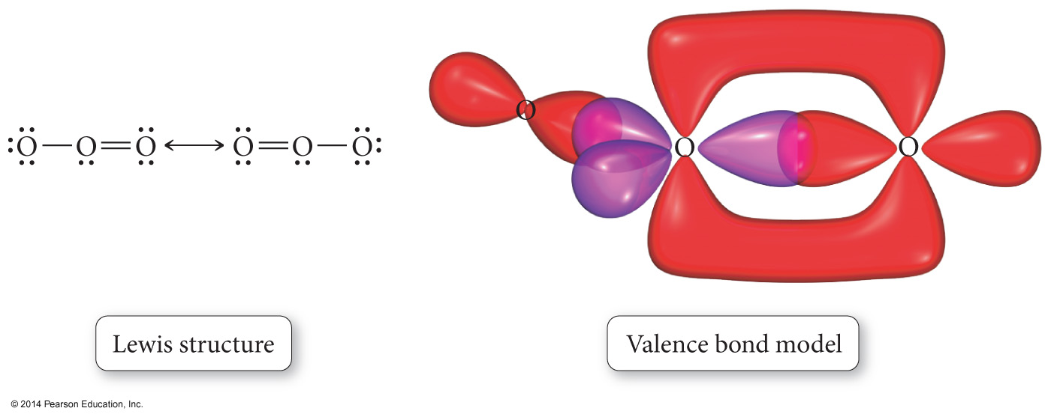
Ozone, O₃

Slide 57
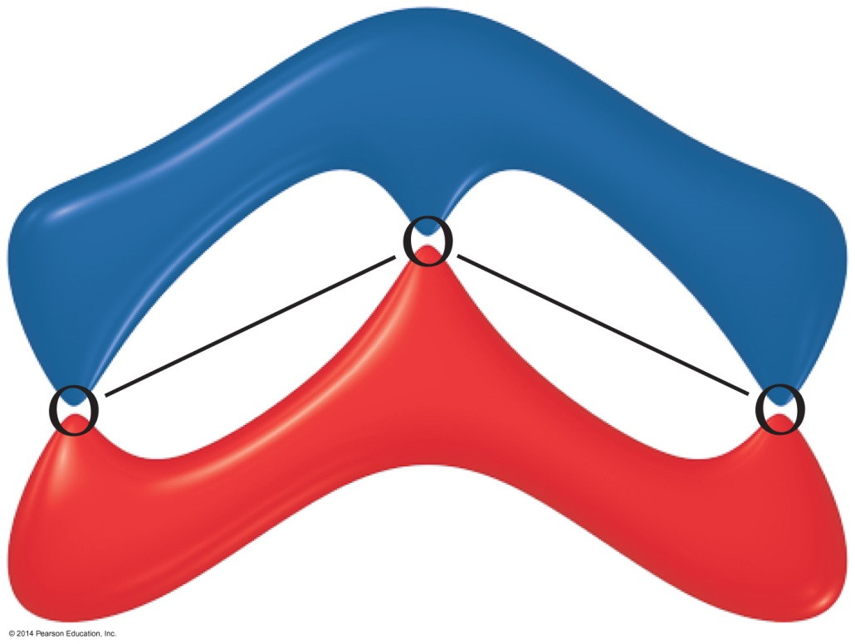
Ozone, O₃

