Slide 1
Solution Concentration: Molarity
Moles of solute per 1 liter of solution
Describes how many molecules of solute in each liter of solution
If a sugar solution concentration is 2.0 M,
1 liter of solution contains 2.0 moles of sugar
2 liters = 4.0 moles sugar
0.5 liters = 1.0 mole sugar

Slide 2
Solution Concentration: Molality, m
Moles of solute per 1 kilogram of solvent
Defined in terms of amount of solvent, not solution
Like the others
Does not vary with temperature
Because based on masses, not volumes

Slide 3
Parts Solute in Parts Solution
Parts can be measured by mass or volume.
Parts are generally measured in the same units.
By mass in grams, kilogram, lbs, etc.
By volume in mL, L, gallons, etc.
Mass and volume combined in grams and mL

Slide 4
Parts Solute in Parts Solution
Percentage = parts of solute in every 100 parts solution
If a solution is 0.9% by mass, then there are 0.9 grams of solute in every 100 grams of solution (or 0.9 kg solute in every 100 kg solution).
Parts per million = parts of solute in every 1 million parts solution
If a solution is 36 ppm by volume, then there are 36 mL of solute in 1 million mL of solution.

Slide 5
PPM
Grams of solute per 1,000,000 g of solution
mg of solute per 1 kg of solution
1 liter of water = 1 kg of water
For aqueous solutions we often approximate the kg of the solution as the kg or L of water.
For dilute solutions, the difference in density between the solution and pure water is usually negligible.

Slide 6
Parts Per Billion Concentration
Notes:
6

Slide 7
Solution Concentrations: Mole Fraction, X_{A}
The mole fraction is the fraction of the moles of one component in the total moles of all the components of the solution.
Total of all the mole fractions in a solution = 1.
Unitless
The mole percentage is the percentage of the moles of one component in the total moles of all the components of the solution.
= mole fraction × 100%

Slide 8
Converting Concentration Units
1. Write the given concentration as a ratio.
2. Separate the numerator and denominator.
Separate into the solute part and solution part
3. Convert the solute part into the required unit.
4. Convert the solution part into the required unit.
5. Use the definitions to calculate the new concentration units.

Slide 9
Colligative Properties
Colligative properties are properties whose value depends only on the number of solute particles, and not on what they are.
Value of the property depends on the concentration of the solution.
The difference in the value of the property between the solution and the pure substance is generally related to the different attractive forces and solute particles occupying solvent molecules positions.
Notes:
9

Slide 10
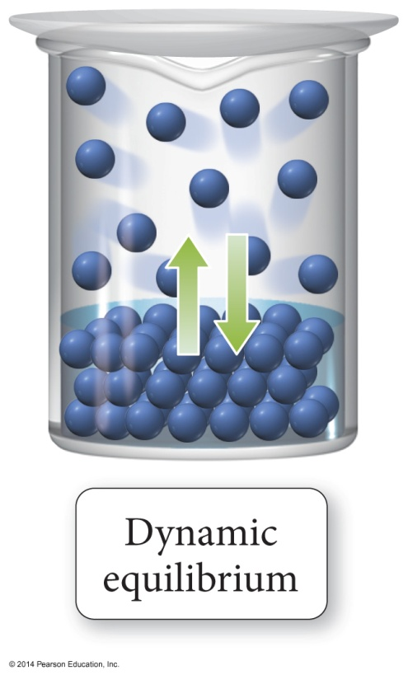
Vapor Pressure of Solutions
The vapor pressure of a solvent above a solution is lower than the vapor pressure of the pure solvent.
The solute particles replace some of the solvent molecules at the surface.
The pure solvent establishes a liquid vapor equilibrium.

Slide 11
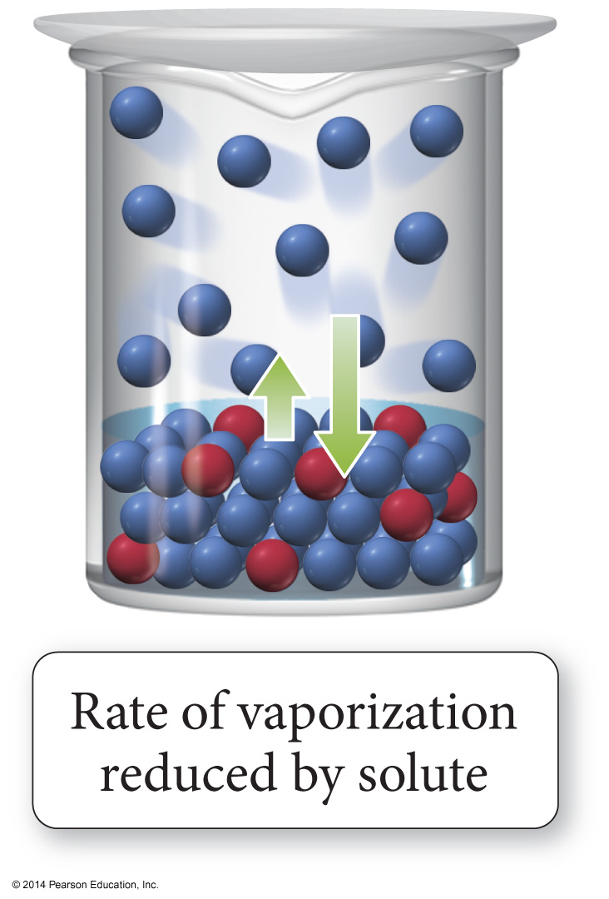
Vapor Pressure of Solutions
Addition of a nonvolatile solute reduces the rate of vaporization, decreasing the amount of vapor.

Slide 12
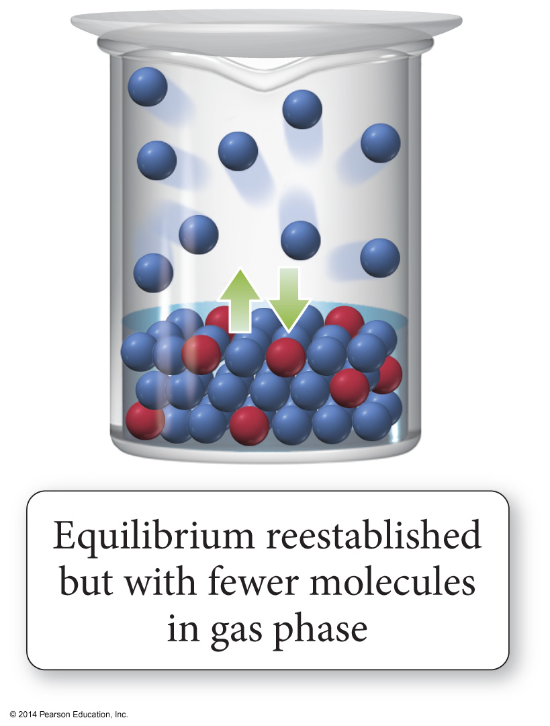
Vapor Pressure of Solutions
Eventually, equilibrium is re-established, but with a smaller number of vapor molecules; therefore, the vapor pressure will be lower.

Slide 13
Thirsty Solutions Revisited
A concentrated solution will draw solvent molecules toward it due to the natural drive for materials in nature to mix.
Similarly, a concentrated solution will draw pure solvent vapor into it due to this tendency to mix.
The result is reduction in vapor pressure.

Slide 14
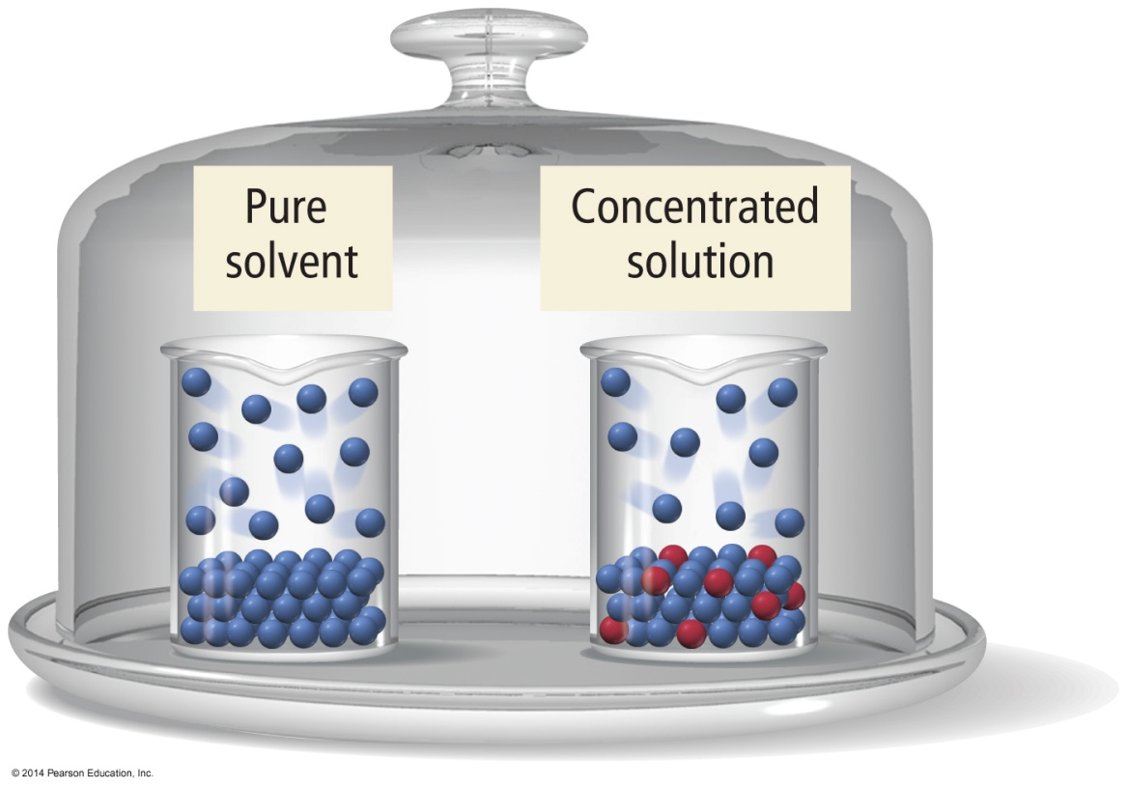
Thirsty Solutions
Beakers with equal liquid levels of pure solvent and a solution are placed in a bell jar. Solvent molecules evaporate from each one and fill the bell jar, establishing an equilibrium with the liquids in the beakers.

Slide 15
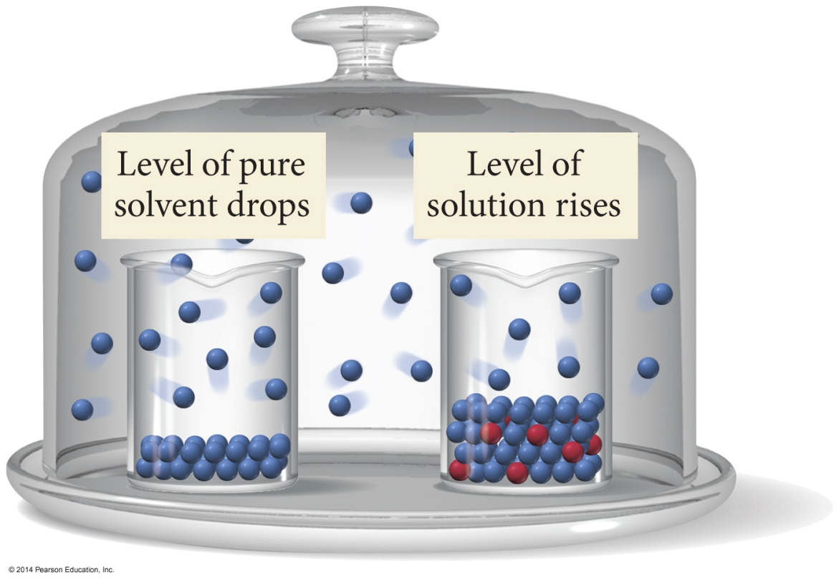
Thirsty Solutions
When equilibrium is established, the liquid level in the solution beaker is higher than the solution level in the pure solvent beaker; the thirsty solution grabs and holds solvent vapor more effectively.

Slide 16
Raoult’s Law
The vapor pressure of a volatile solvent above a solution is equal to its normal vapor pressure, P°, multiplied by its mole fraction in the solution.
P_{solvent in solution} = χ_{solvent}∙P°
Because the mole fraction is always less than 1, the vapor pressure of the solvent in solution will always be less than the vapor pressure of the pure solvent.

Slide 17
Vapor Pressure Lowering
The vapor pressure of a solvent in a solution is always lower than the vapor pressure of the pure solvent.
The vapor pressure of the solution is directly proportional to the amount of the solvent in the solution.
The difference between the vapor pressure of the pure solvent and the vapor pressure of the solvent in solution is called the vapor pressure lowering.
ΔP = P°_{solvent} − P_{solution} = χ_{solute} ∙ P°_{solvent}

Slide 18
Raoult’s Law for Volatile Solute
When both the solvent and the solute can evaporate, both molecules will be found in the vapor phase.
The total vapor pressure above the solution will be the sum of the vapor pressures of the solute and solvent.
For an ideal solution
P_{total} = P_{solute} + P_{solvent}
The solvent decreases the solute vapor pressure in the same way the solute decreased the solvent’s.
P_{solute} = χ_{solute}∙P°_{solute} and P_{solvent} = χ_{solvent} ∙P°_{solvent}

Slide 19
Ideal versus Nonideal Solution
In ideal solutions, the made solute–solvent interactions are equal to the sum of the broken solute–solute and solvent–solvent interactions.
Ideal solutions follow Raoult’s law
Effectively, the solute is diluting the solvent.
If the solute–solvent interactions are stronger or weaker than the broken interactions the solution is nonideal.

Slide 20
Vapor Pressure of a Nonideal Solution
When the solute–solvent interactions are stronger than the solute–solute + solvent–solvent, the total vapor pressure of the solution will be less than predicted by Raoult’s law, because the vapor pressures of the solute and solvent are lower than ideal.
When the solute–solvent interactions are weaker than the solute–solute + solvent–solvent, the total vapor pressure of the solution will be more than predicted by Raoult’s Law.

Slide 21
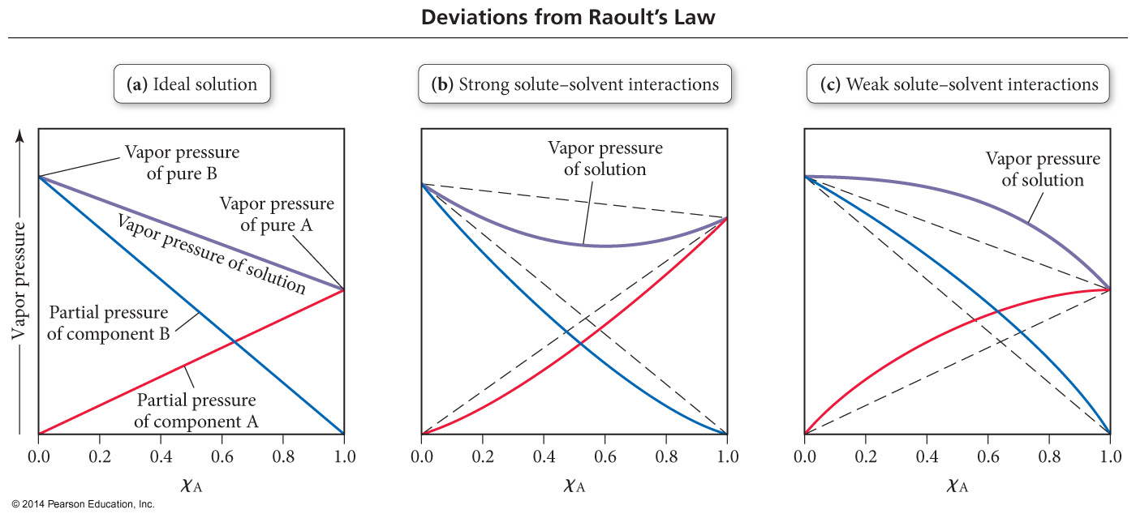
Deviations from Raoult’s Law

Slide 22
Other Colligative Properties Related to Vapor Pressure Lowering
Vapor pressure lowering occurs at all temperatures.
This results in the temperature required to boil the solution being higher than the boiling point of the pure solvent.
This also results in the temperature required to freeze the solution being lower than the freezing point of the pure solvent.

Slide 23
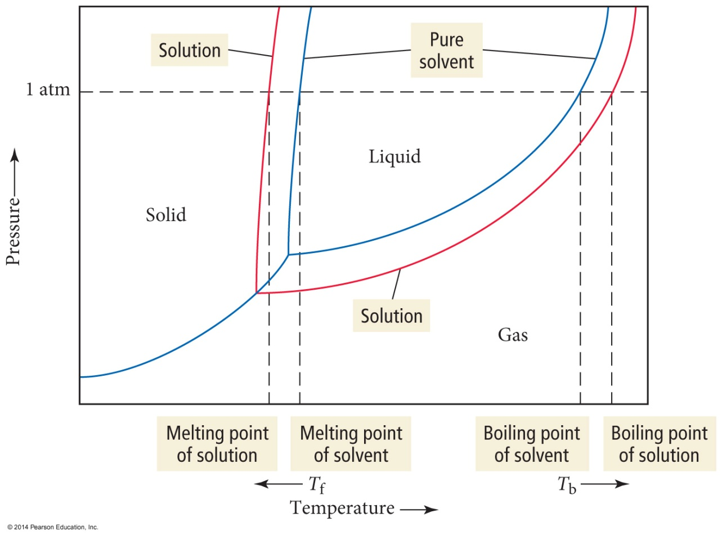
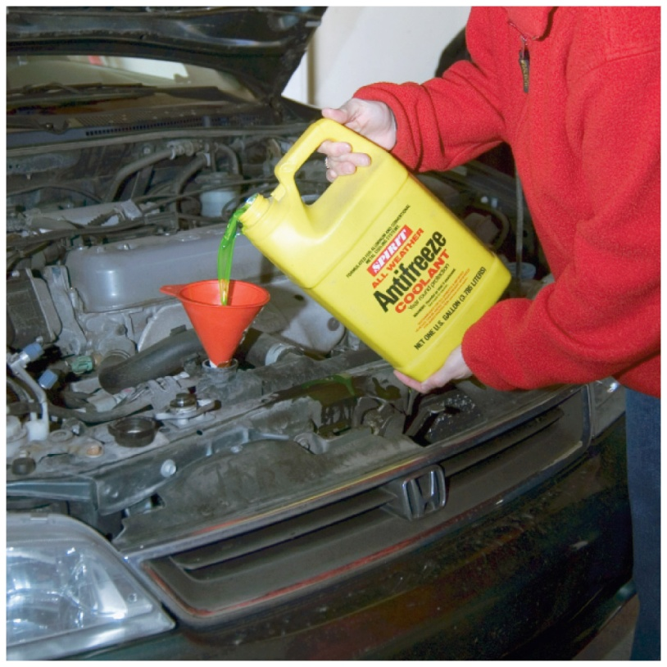
Freezing Point Depression and Boiling Point Elevation

Slide 24
Freezing Salt Water
Pure water freezes at 0 °C. At this temperature, ice and liquid water are in dynamic equilibrium.
Adding salt disrupts the equilibrium. The salt particles dissolve in the water, but do not attach easily to the solid ice.
When an aqueous solution containing a dissolved solid solute freezes slowly, the ice that forms does not normally contain much of the solute.
To return the system to equilibrium, the temperature must be lowered sufficiently to make the water molecules slow down enough so that more can attach themselves to the ice.

Slide 25
Freezing Point Depression
The freezing point of a solution is lower than the freezing point of the pure solvent.
Therefore, the melting point of the solid solution is lower.
The difference between the freezing point of the solution and freezing point of the pure solvent is directly proportional to the molal concentration of solute particles.
(FP_{solvent} – FP_{solution}) = ΔT_{f} = m∙K_{f}
The proportionality constant is called the freezing point depression constant, K_{f}.
The value of K_{f} depends on the solvent.
The units of K_{f} are °C/m.

Slide 26
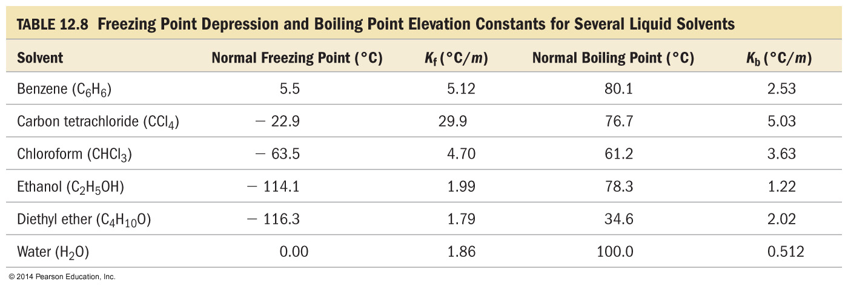
K_{f}

Slide 27
Boiling Point Elevation
The boiling point of a solution is higher than the boiling point of the pure solvent.
For a nonvolatile solute
The difference between the boiling point of the solution and boiling point of the pure solvent is directly proportional to the molal concentration of solute particles.
(BP_{solution} – BP_{solvent}) = ΔT_{b} = m∙K_{b}
The proportionality constant is called the boiling point elevation constant, K_{b}.
The value of K_{b} depends on the solvent.
The units of K_{b} are °C/m.

Slide 28
Osmosis
Osmosis is the flow of solvent from a solution of low concentration into a solution of high concentration.
The solutions may be separated by a semipermeable membrane.
A semipermeable membrane allows solvent to flow through it, but not solute.

Slide 29
Osmotic Pressure
The amount of pressure needed to keep osmotic flow from taking place is called the osmotic pressure.
The osmotic pressure, Π, is directly proportional to the molarity of the solute particles.
R = 0.08206 (atm∙L)/(mol∙K)
Π = MRT
Notes:
29

Slide 30
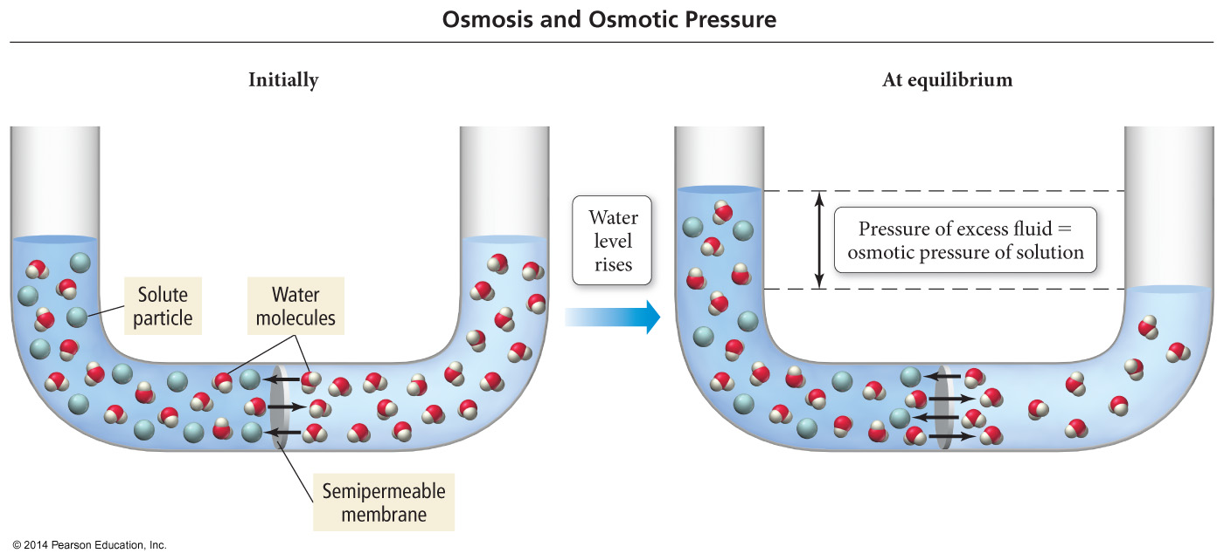
An Osmosis Cell

Slide 31
Van’t Hoff Factors
Ionic compounds produce multiple solute particles for each formula unit.
The theoretical van’t Hoff factor, i, is the ratio of moles of solute particles to moles of formula units dissolved.
The measured van’t Hoff factors are generally less than the theoretical due to ion pairing in solution.
Therefore, the measured van’t Hoff factors often cause the ΔT to be lower than you might expect.

Slide 32
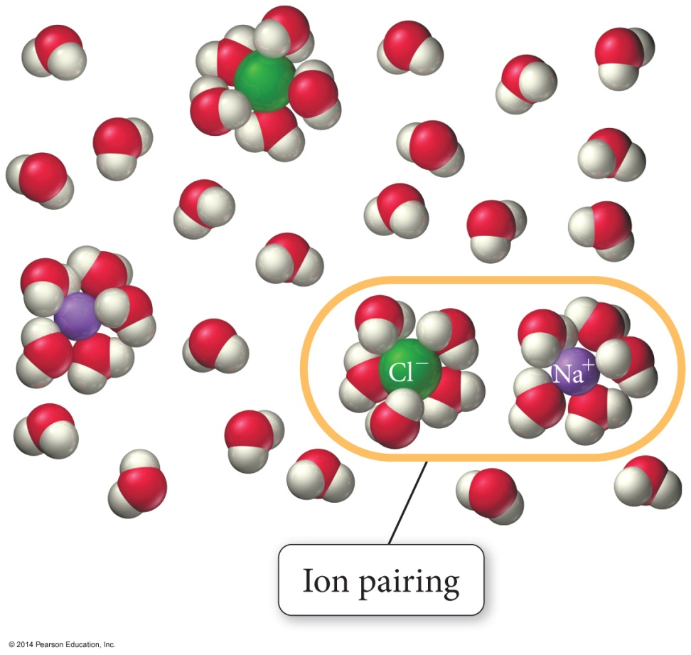
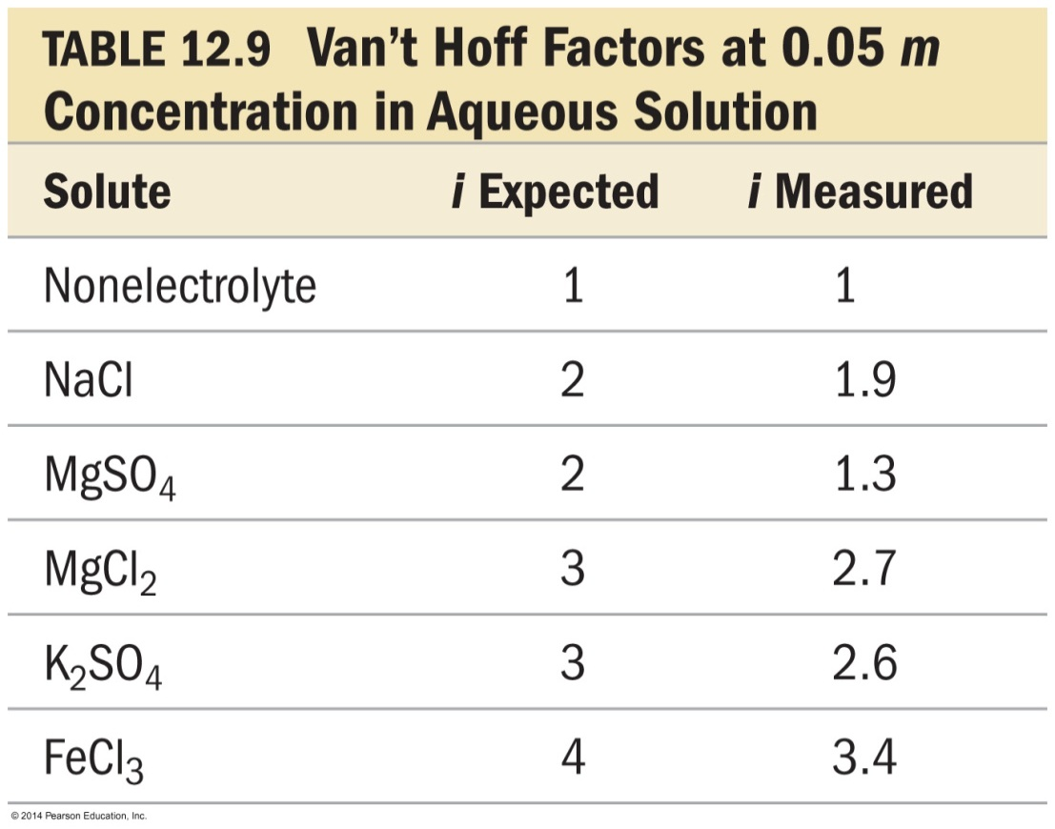
Colligative Properties of Strong Electrolyte Solutions

Slide 33
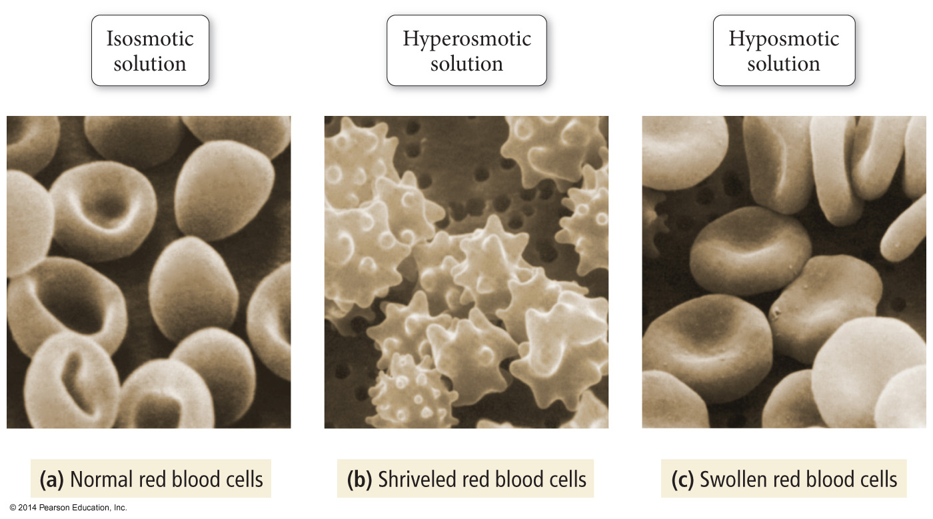
An isosmotic solution has the same osmotic pressure as the solution inside the cell; as a result there is no net flow of water into or out of the cell.

Slide 34
A hyperosmotic solution has a higher osmotic pressure than the solution inside the cell; as a result there is a net flow of water out of the cell, causing it to shrivel.

Slide 35
A hyposmotic solution has a lower osmotic pressure than the solution inside the cell; as a result there is a net flow of water into the cell, causing it to swell.

Slide 36
Mixtures
Solutions = homogeneous
Suspensions = heterogeneous, separate on standing
Colloids = heterogeneous, do not separate on standing
Particles can coagulate
Cannot pass through semipermeable membrane
Hydrophilic
Stabilized by attraction for solvent (water)
Hydrophobic
Stabilized by charged surface repulsions
Show the Tyndall effect and Brownian motion.

Slide 37
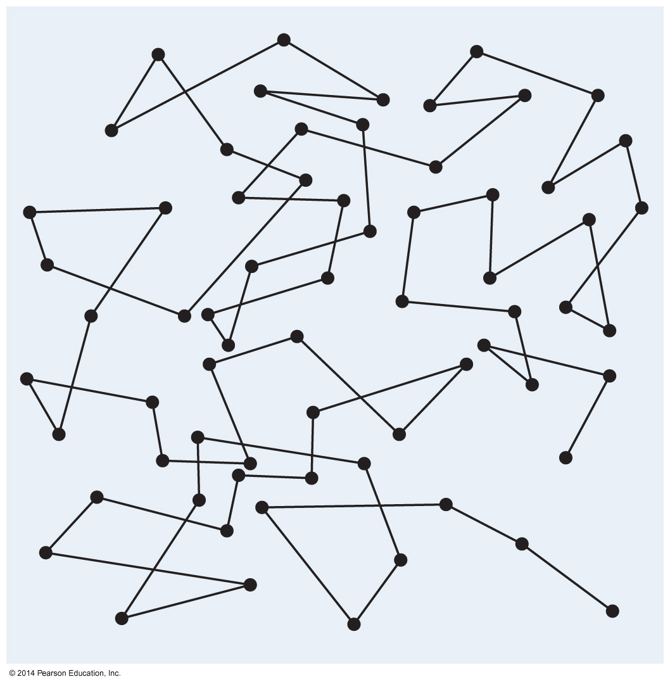
Brownian Motion

Slide 38
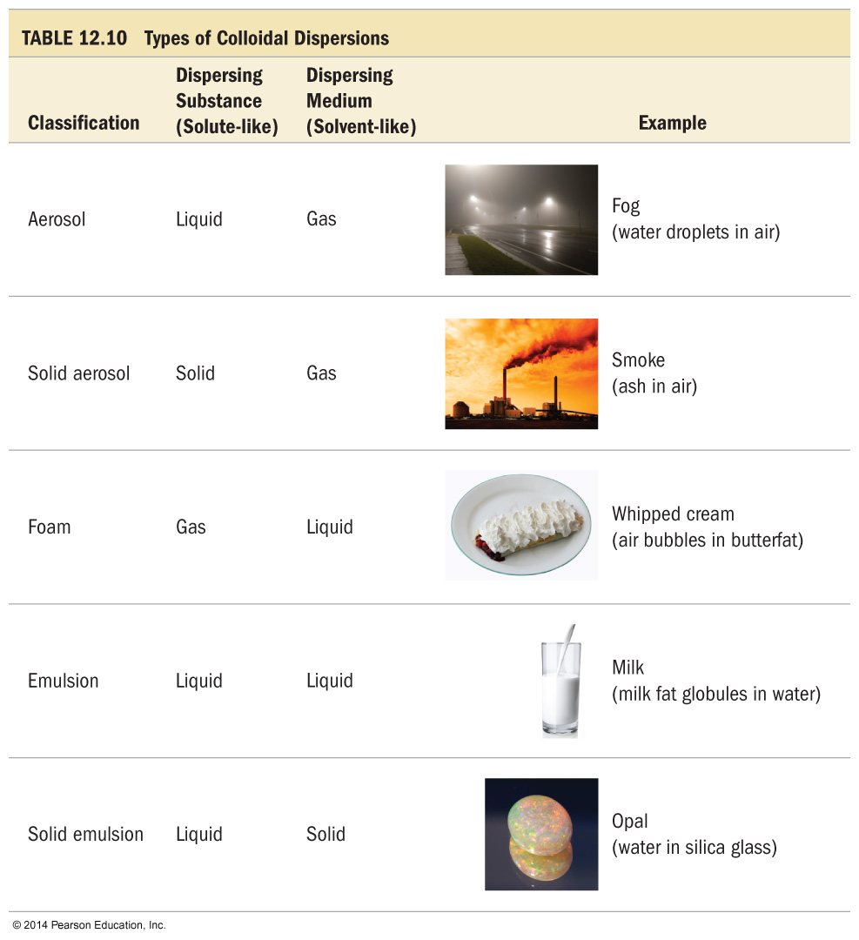
Types of Colloidal Suspensions

Slide 39
Soaps
Triglycerides can be broken down into fatty acid salts and glycerol by treatment with a strong hydroxide solution.
Fatty acid salts have a very polar “head” because it is ionic and a very nonpolar “tail” because it is all C and H.
Hydrophilic head and hydrophobic tail
This unique structure allows the fatty acid salts, called soaps, to help oily substances be attracted to water.
Micelle formation
Emulsification

Slide 40
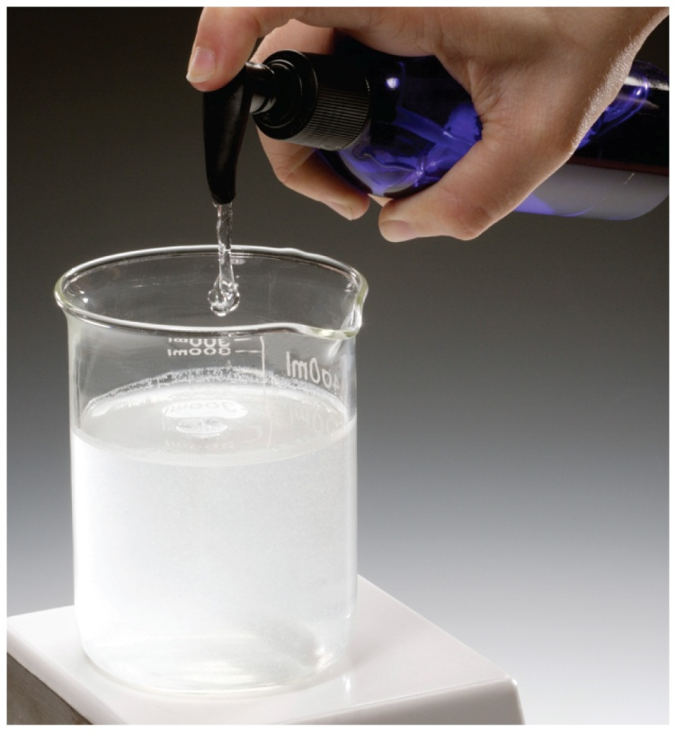
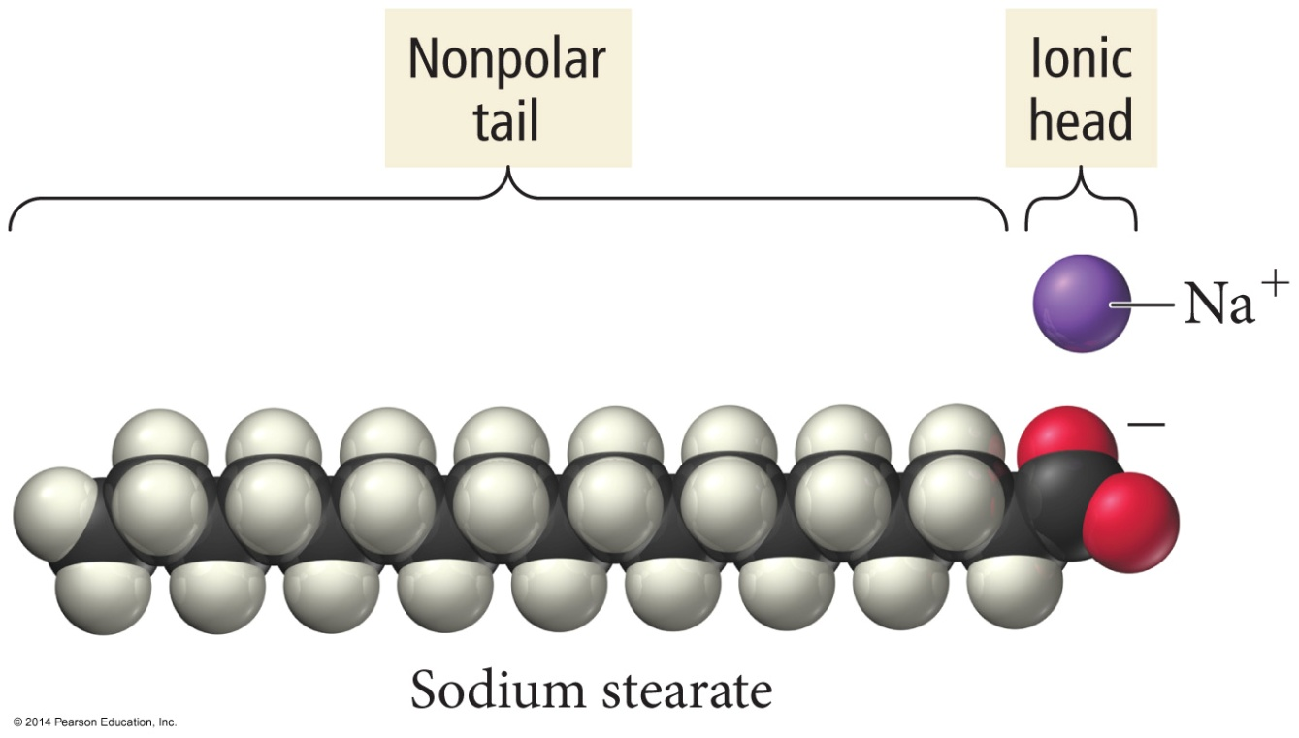
Soap

Slide 41
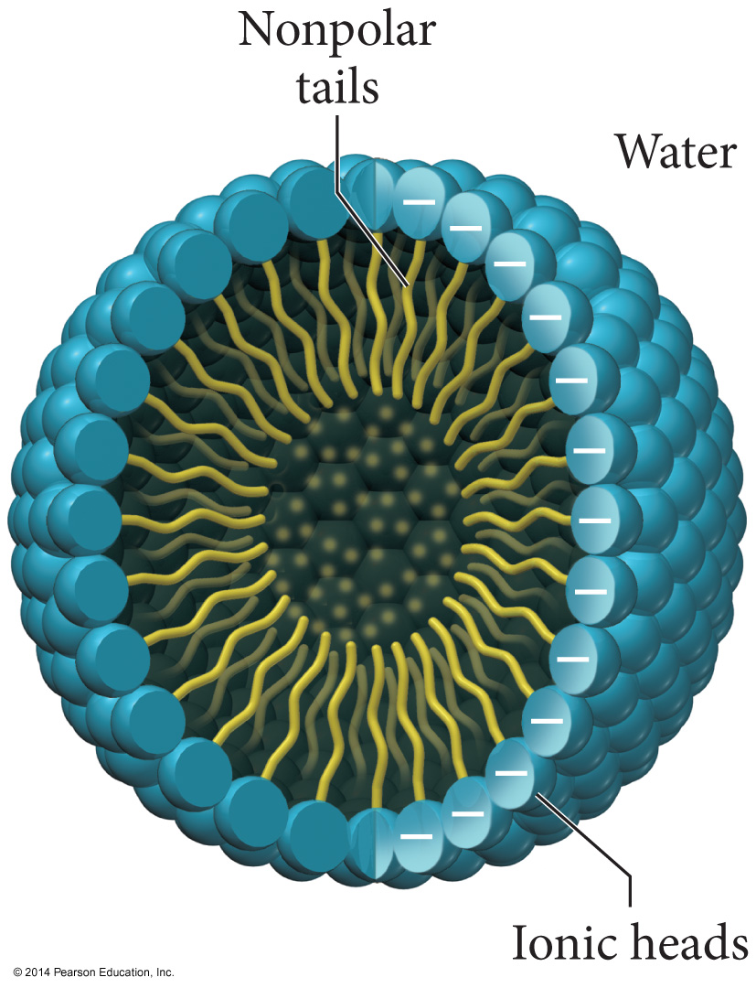
Soap

Slide 42
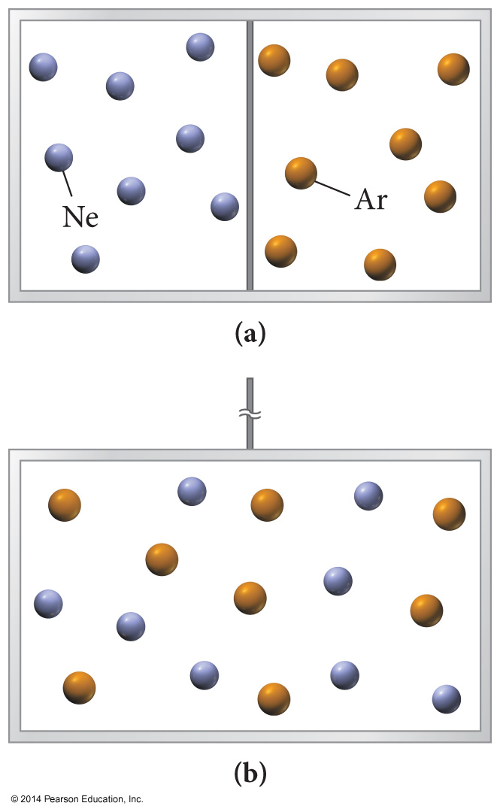
The Tyndall Effect

Slide 43
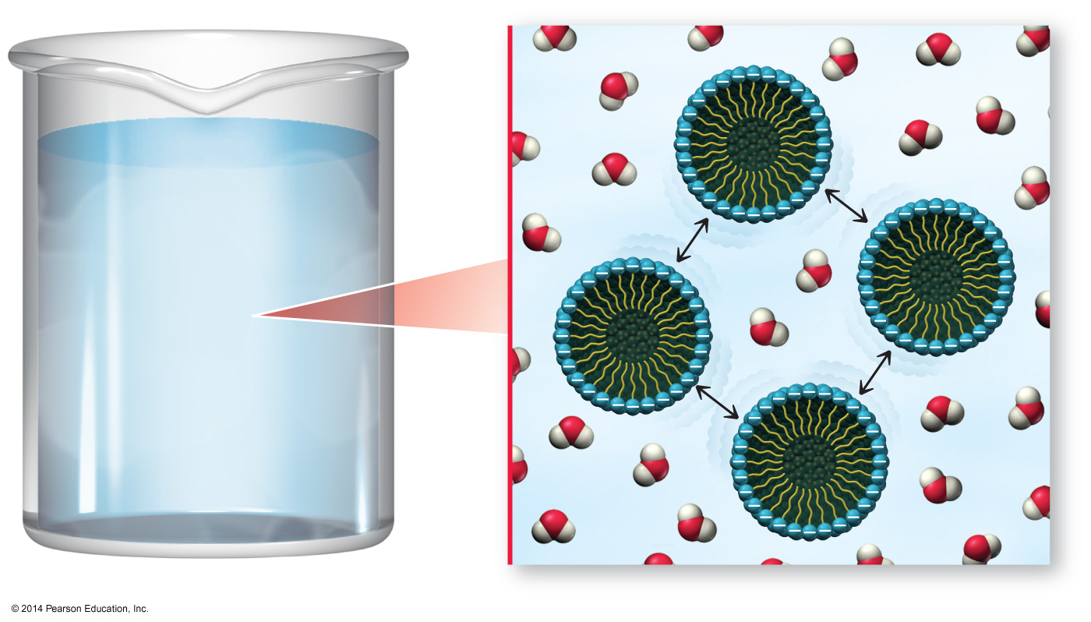
Micelle Repulsions

