Slide 1
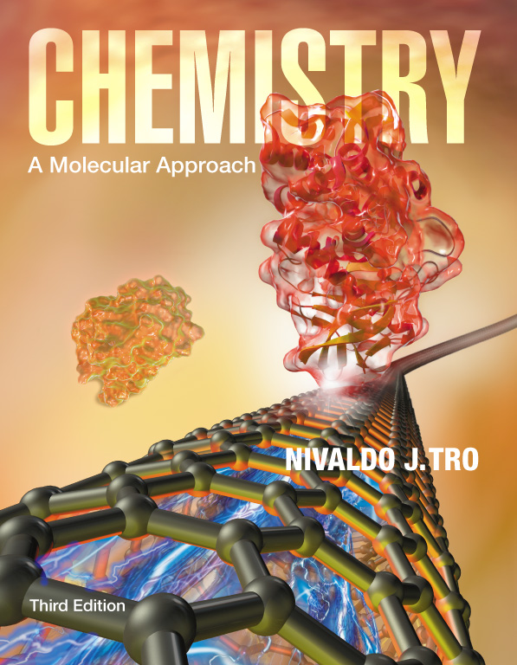
Lecture Presentation
Chapter 11
Liquids, Solids, and Intermolecular Forces
Sherril Soman
Grand Valley State University

Slide 2
Climbing Geckos
Geckos can adhere to almost any surface.
Recent studies indicate that this amazing ability is related to intermolecular attractive forces.
Geckos have millions of tiny hairs on their feet that branch out and flatten out on the end.
Setae = hairs; spatulae = flat ends
This structure allows the gecko to have unusually close contact to the surface, permitting the intermolecular attractive forces to act strongly.

Slide 3
Properties of the Three Phases of Matter
Fixed = keeps shape when placed in a container
Indefinite = takes the shape of the container

Slide 4
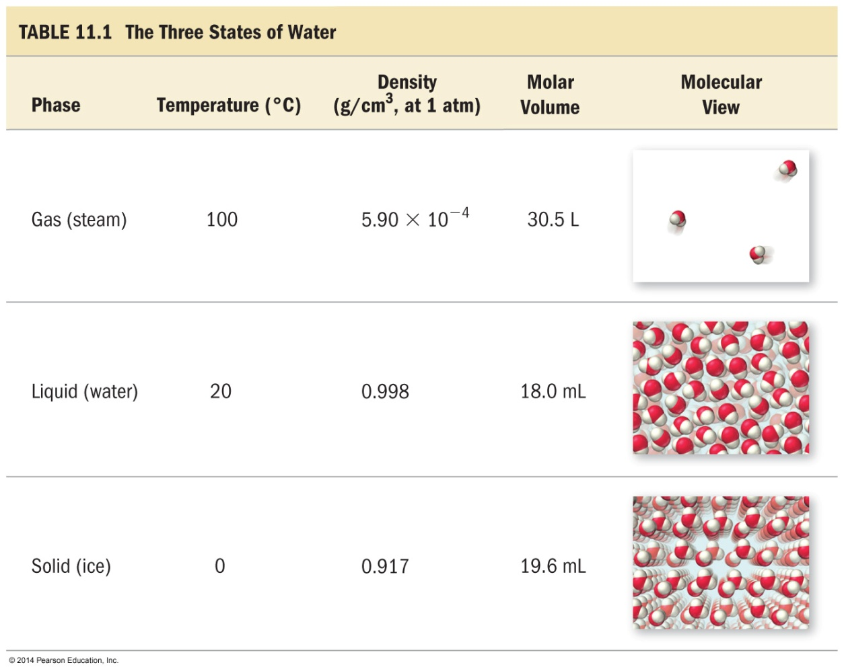
Three Phases of Water
Notice that the densities of ice and liquid water are much larger than the density of steam.
Notice that the densities and molar volumes of ice and liquid water are much closer to each other than to steam.
Notice that the density of ice is larger than the density of liquid water. This is not the norm, but is vital to the development of life as we know it.

Slide 5
Degrees of Freedom
Particles may have one or several types of freedom of motion and various degrees of each type.
Translational freedom is the ability to move from one position in space to another.
Rotational freedom is the ability to reorient the particles direction in space.
Vibrational freedom is the ability to oscillate about a particular point in space.

Slide 6
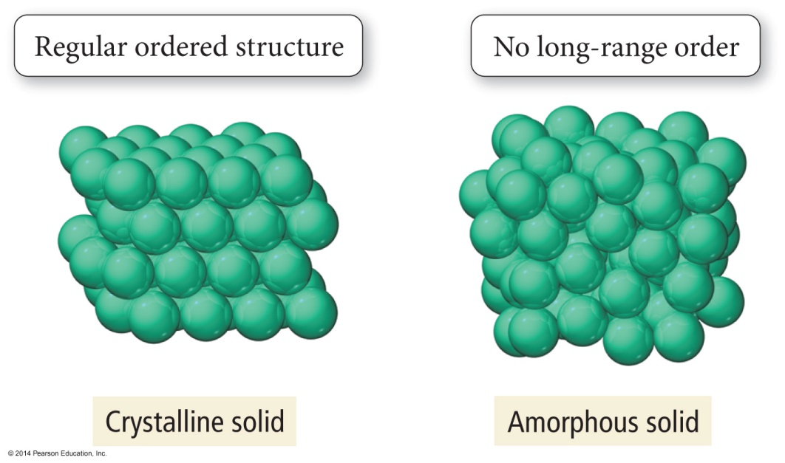
Solids
The particles in a solid are packed close together and are fixed in position though they may vibrate.
The close packing of the particles results in solids being incompressible.
The inability of the particles to move around results in solids retaining their shape and volume when placed in a new container and prevents the solid from flowing.

Slide 7
Solids
Some solids have their particles arranged in an orderly geometric pattern; we call these crystalline solids.
Salt and diamonds
Other solids have particles that do not show a regular geometric pattern over a long range; we call these amorphous solids.
Plastic and glass

Slide 8
Liquids
The particles in a liquid are closely packed, but they have some ability to move around.
The close packing results in liquids being incompressible.
But the ability of the particles to move allows liquids to take the shape of their container and to flow. However, they don’t have enough freedom to escape or expand to fill the container.

Slide 9
Gases
In the gas state, the particles have complete freedom of motion and are not held together.
The particles are constantly flying around, bumping into each other and the container
There is a large amount of space between the particles, compared to the size of the particles.
Therefore, the molar volume of the gas state of a material is much larger than the molar volume of the solid or liquid states.

Slide 10
Gases
Gases are compressible because there is a lot of empty space so the particles can be squeezed closer together.
Because the particles are not held in close contact and are moving freely, gases expand to fill and take the shape of their container.

Slide 11
Compressibility

Slide 12
Kinetic–Molecular Theory
What state a material is in depends largely on two major factors:
1. The amount of kinetic energy the particles possess
2. The strength of attraction between the particles
These two factors are in competition with each other.

Slide 13
States and Degrees of Freedom
The molecules in a gas have complete freedom of motion.
Their kinetic energy overcomes the attractive forces between the molecules.
The molecules in a solid are locked in place; they cannot move around.
Though they do vibrate, they don’t have enough kinetic energy to overcome the attractive forces.
The molecules in a liquid have limited freedom; they can move around a little within the structure of the liquid.
They have enough kinetic energy to overcome some of the attractive forces, but not enough to escape each other.

Slide 14
Kinetic Energy
Increasing kinetic energy increases the motion energy of the particles.
The more motion energy the molecules have, the more freedom they can have.
The average kinetic energy is directly proportional to the temperature.
KE_{avg} = 1.5 kT

Slide 15
Attractive Forces
The particles are attracted to each other by electrostatic forces.
The strength of the attractive forces varies; some are small and some are large.
The strength of the attractive forces depends on the kind(s) of particles.
The stronger the attractive forces between the particles, the more they resist moving.
However, no material completely lacks particle motion.

Slide 16
Kinetic–Molecular Theory of Gases
When the kinetic energy is so large it overcomes the attractions between particles, the material will be a gas.
In an ideal gas, the particles have complete freedom of motion, especially translational.
This allows gas particles to expand to fill their container.
Gases flow
It also leads to there being large spaces between the particles.
Therefore, low density and compressibility

Slide 17
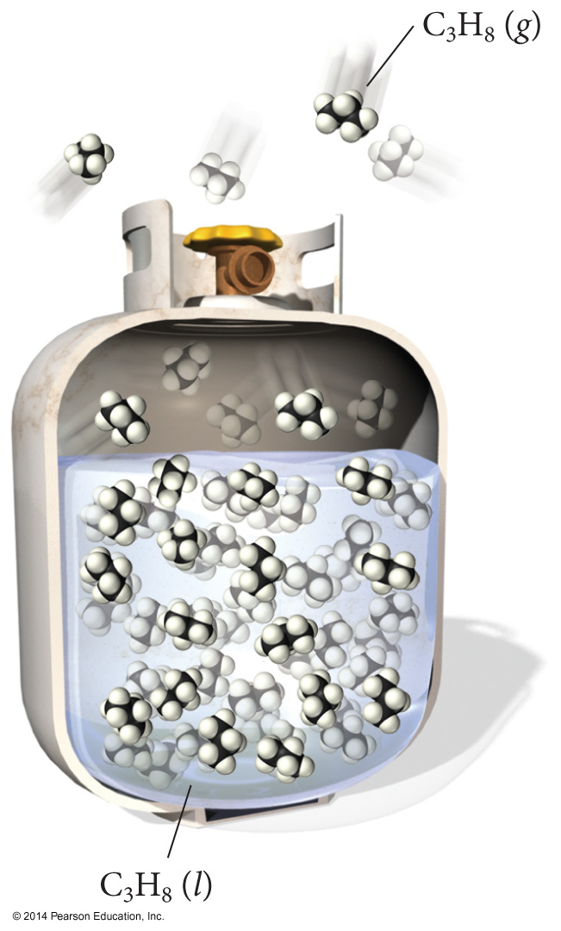
Gas Structure
Gas molecules are rapidly moving in random straight lines, and are free from sticking to each other.

Slide 18
Kinetic–Molecular Theory of Solids
When the attractive forces are strong enough so the kinetic energy cannot overcome it at all, the material will be a solid.
In a solid, the particles are packed together without any translational or rotational motion.
The only freedom they have is vibrational motion.

Slide 19
Kinetic–Molecular Theory of Liquids
When the attractive forces are strong enough so the kinetic energy can only partially overcome them, the material will be a liquid.
In a liquid, the particles are packed together with only very limited translational or rotational freedom.

Slide 20
Explaining the Properties of Liquids
Liquids have higher densities than gases and are incompressible because the particles are in contact.
They have an indefinite shape because the limited translational freedom of the particles allows them to move around enough to get to the container walls.
It also allows them to flow.
But they have a definite volume because the limit on their freedom keeps the particles from escaping each other.

Slide 21
Phase Changes
Because the attractive forces between the molecules are fixed, changing the material’s state requires changing the amount of kinetic energy the particles have, or limiting their freedom.
Solids melt when heated because the particles gain enough kinetic energy to partially overcome the attractive forces.
Liquids boil when heated because the particles gain enough kinetic energy to completely overcome the attractive forces.
The stronger the attractive forces, the higher you will need to raise the temperature.
Gases can be condensed by decreasing the temperature and/or increasing the pressure.
Pressure can be increased by decreasing the gas volume.
Reducing the volume reduces the amount of translational freedom the particles have.

Slide 22
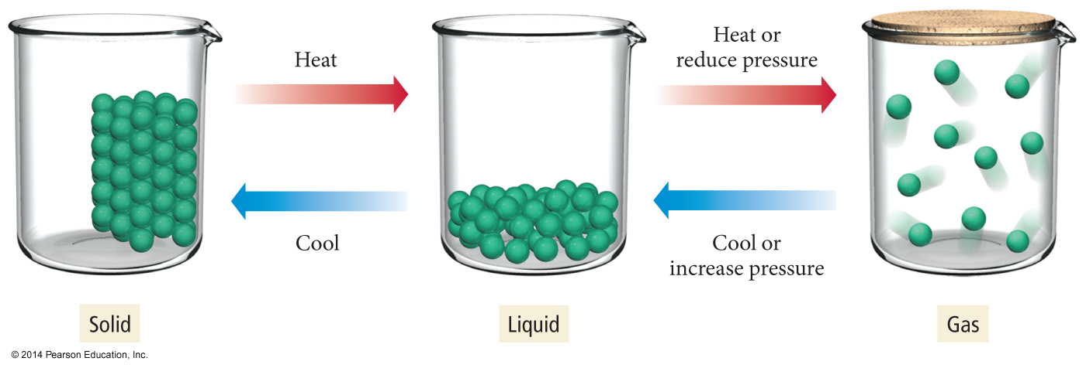
Phase Changes

Slide 23
Intermolecular Attractions
The strength of the attractions between the particles of a substance determines its state.
At room temperature, moderate to strong attractive forces result in materials being solids or liquids.
The stronger the attractive forces are, the higher will be the boiling point of the liquid and the melting point of the solid.
Other factors also influence the melting point.

Slide 24
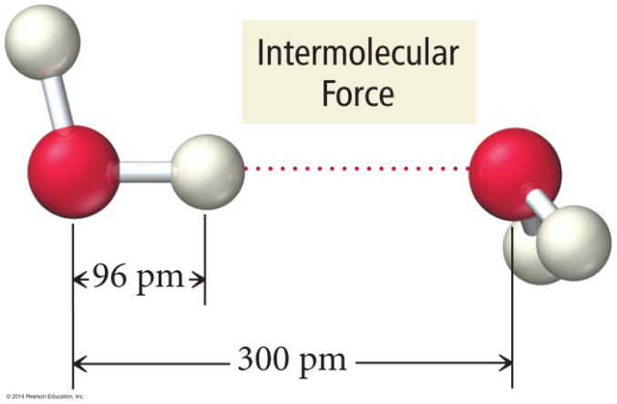
Why Are Molecules Attracted to Each Other?
Intermolecular attractions are due to attractive forces between opposite charges.
+ ion to − ion
+ end of polar molecule to − end of polar molecule
H-bonding especially strong
Even nonpolar molecules will have temporary charges
Larger charge = stronger attraction
Longer distance = weaker attraction
However, these attractive forces are small relative to the bonding forces between atoms.
Generally smaller charges
Generally over much larger distances

Slide 25
Trends in the Strength of Intermolecular Attraction
The stronger the attractions between the atoms or molecules, the more energy it will take to separate them.
Boiling a liquid requires that we add enough energy to overcome all the attractions between the particles.
However, not breaking the covalent bonds
The higher the normal boiling point of the liquid, the stronger the intermolecular attractive forces.

Slide 26
Kinds of Attractive Forces
Temporary polarity in the molecules due to unequal electron distribution leads to attractions called dispersion forces.
Permanent polarity in the molecules due to their structure leads to attractive forces called dipole–dipole attractions.
An especially strong dipole–dipole attraction results when H is attached to an extremely electronegative atom. These are called hydrogen bonds.

Slide 27
Dispersion Forces
Fluctuations in the electron distribution in atoms and molecules result in a temporary dipole.
Region with excess electron density has partial (–) charge
Region with depleted electron density has partial (+) charge
The attractive forces caused by these temporary dipoles are called dispersion forces.
Aka London Forces
All molecules and atoms will have them.
As a temporary dipole is established in one molecule, it induces a dipole in all the surrounding molecules.

Slide 28
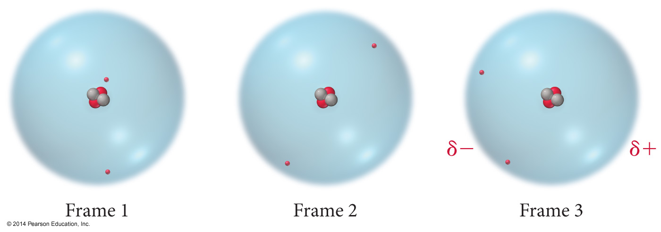
Dispersion Force

Slide 29
Dispersion Force

Slide 30
Size of the Induced Dipole
The magnitude of the induced dipole depends on several factors.
Polarizability of the electrons
Volume of the electron cloud
Larger molar mass = more electrons = larger electron cloud = increased polarizability = stronger attractions
Shape of the molecule
More surface-to-surface contact = larger induced dipole = stronger attraction

Slide 31
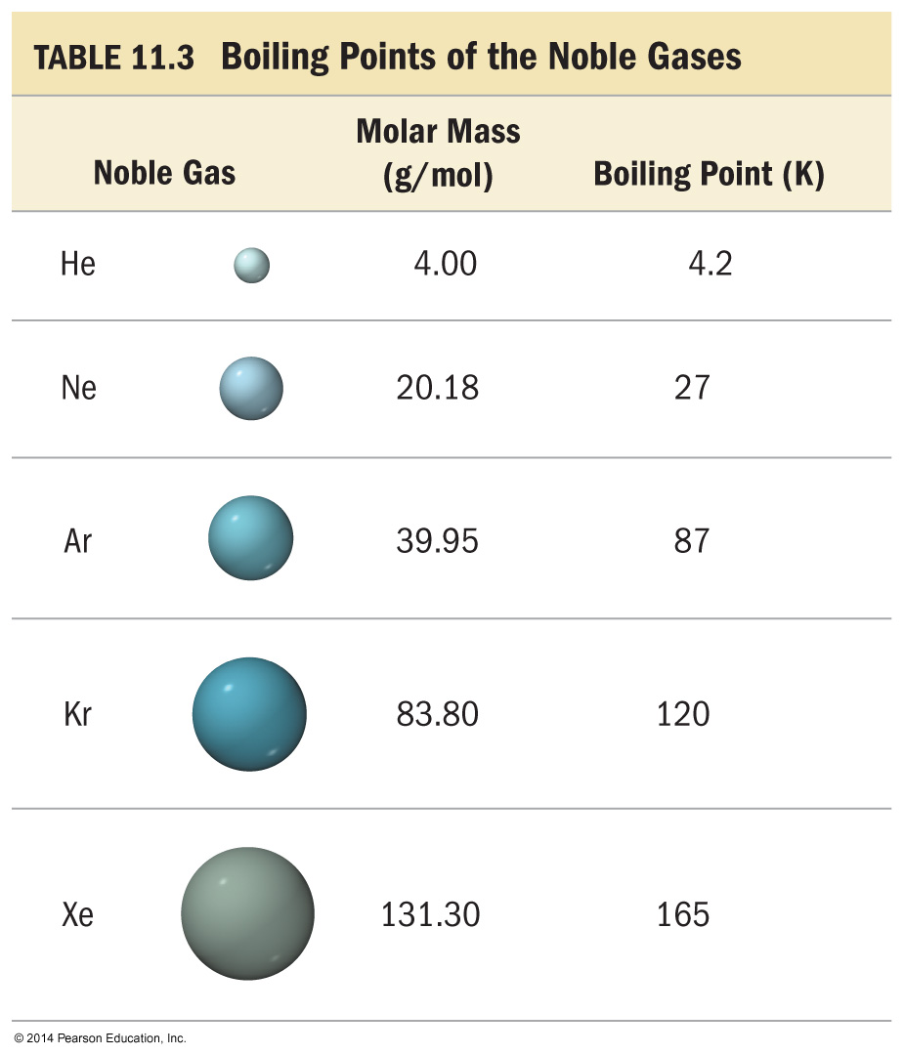
Effect of Molecular Size on Size of Dispersion Force
The Noble gases are all nonpolar atomic elements.
The stronger the attractive forces between the molecules, the higher the boiling point will be.

Slide 32
Effect of Molecular Size on Size of Dispersion Force
As the molar mass increases, the number of electrons increases. Therefore, the strength of the dispersion forces increases.
The stronger the attractive forces between the molecules, the higher the boiling point will be.

Slide 33
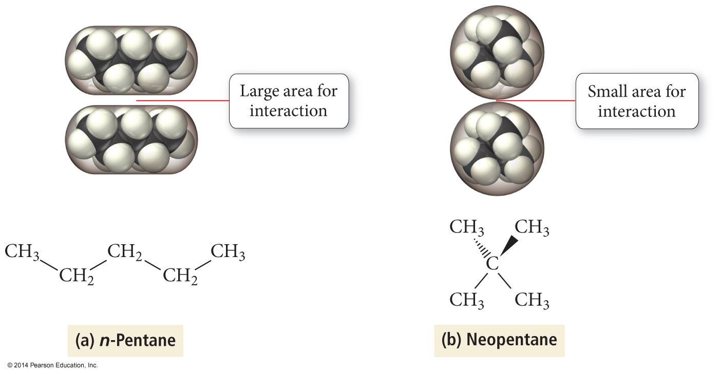
Effect of Molecular Shape on Size of Dispersion Force

Slide 34
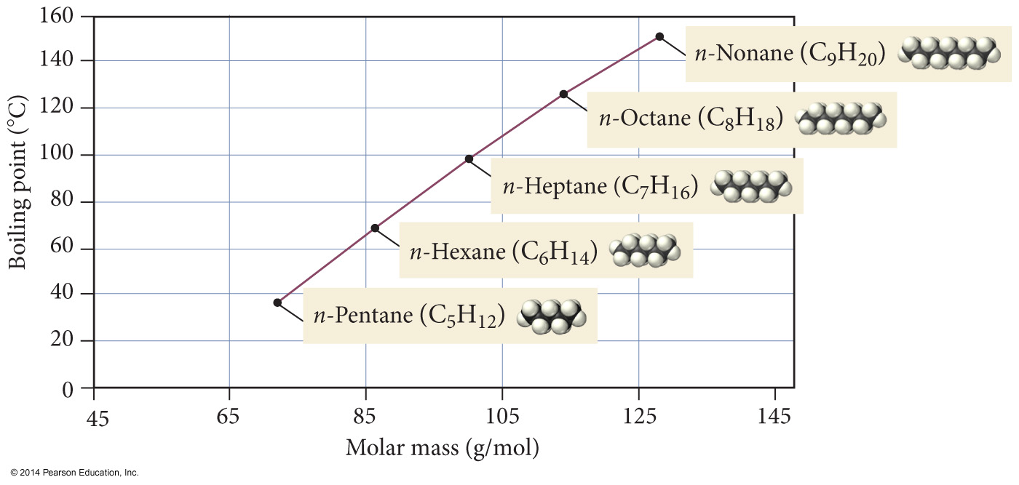
Boiling Points of n-Alkanes

Slide 35
Alkane Boiling Points
Branched chains have lower BPs than straight chains.
The straight chain isomers have more surface-to-surface contact.

Slide 36
Dipole–Dipole Attractions
Polar molecules have a permanent dipole.
Bond polarity and shape
Dipole moment
The always present induced dipole
The permanent dipole adds to the attractive forces between the molecules, raising the boiling and melting points relative to nonpolar molecules of similar size and shape.

Slide 38
Effect of Dipole–Dipole Attraction on Boiling and Melting Points

Slide 39
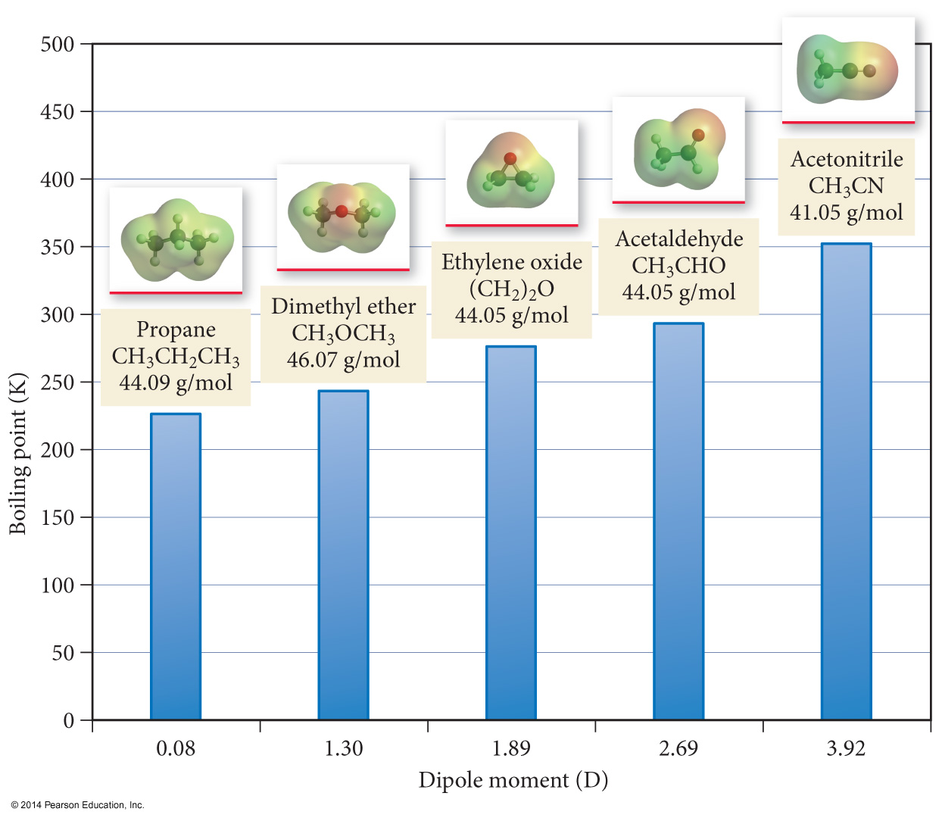
Dipole Movement and Boiling Point

Slide 40
Attractive Forces and Solubility
Solubility depends, in part, on the attractive forces of the solute and solvent molecules.
Like dissolves like
Miscible liquids will always dissolve in each other
Polar substances dissolve in polar solvents.
Hydrophilic groups = OH, CHO, C═O, COOH, NH₂, Cl
Nonpolar molecules dissolve in nonpolar solvents.
Hydrophobic groups = C—H, C—C
Many molecules have both hydrophilic and hydrophobic parts; solubility in water becomes a competition between the attraction of the polar groups for the water and the attraction of the nonpolar groups for their own kind.

Slide 41
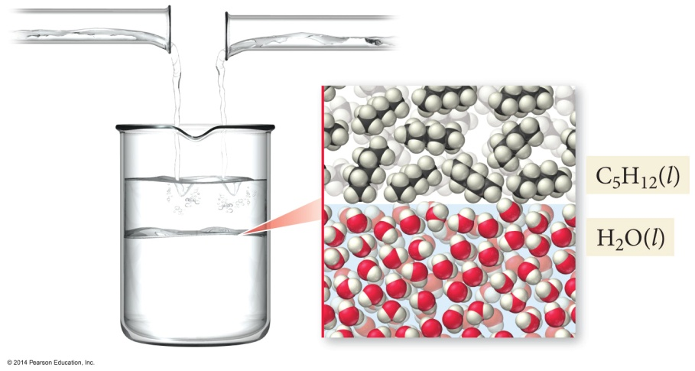
Immiscible Liquids
Pentane, C₅H₁₂ is a nonpolar molecule.
Water is a polar molecule.
The attractive forces between the water molecules is much stronger than their attractions for the pentane molecules. The result is that the liquids are immiscible.

Slide 42
Hydrogen Bonding
When a very electronegative atom is bonded to hydrogen, it strongly pulls the bonding electrons toward it.
O─H, N─H, or F─H
Because hydrogen has no other electrons, when its electron is pulled away, the nucleus becomes de-shielded, exposing the H proton.
The exposed proton acts as a very strong center of positive charge, attracting all the electron clouds from neighboring molecules.

Slide 43
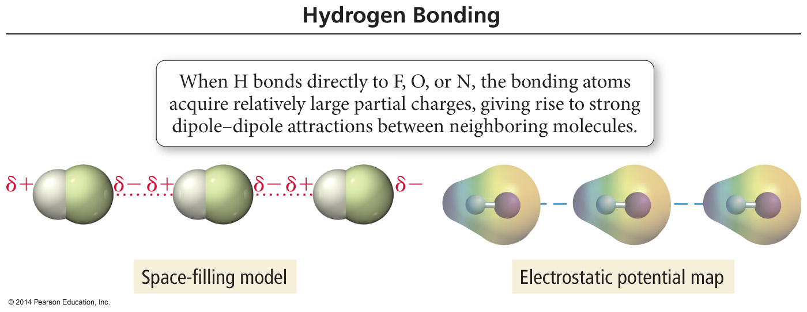
Hydrogen Bonding

Slide 44
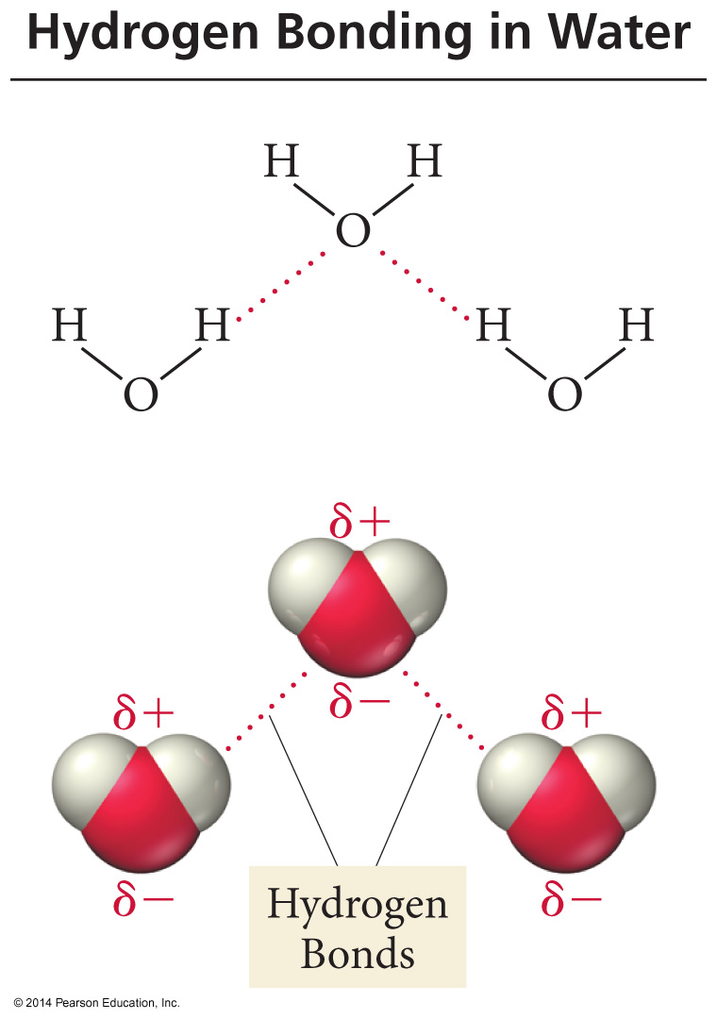
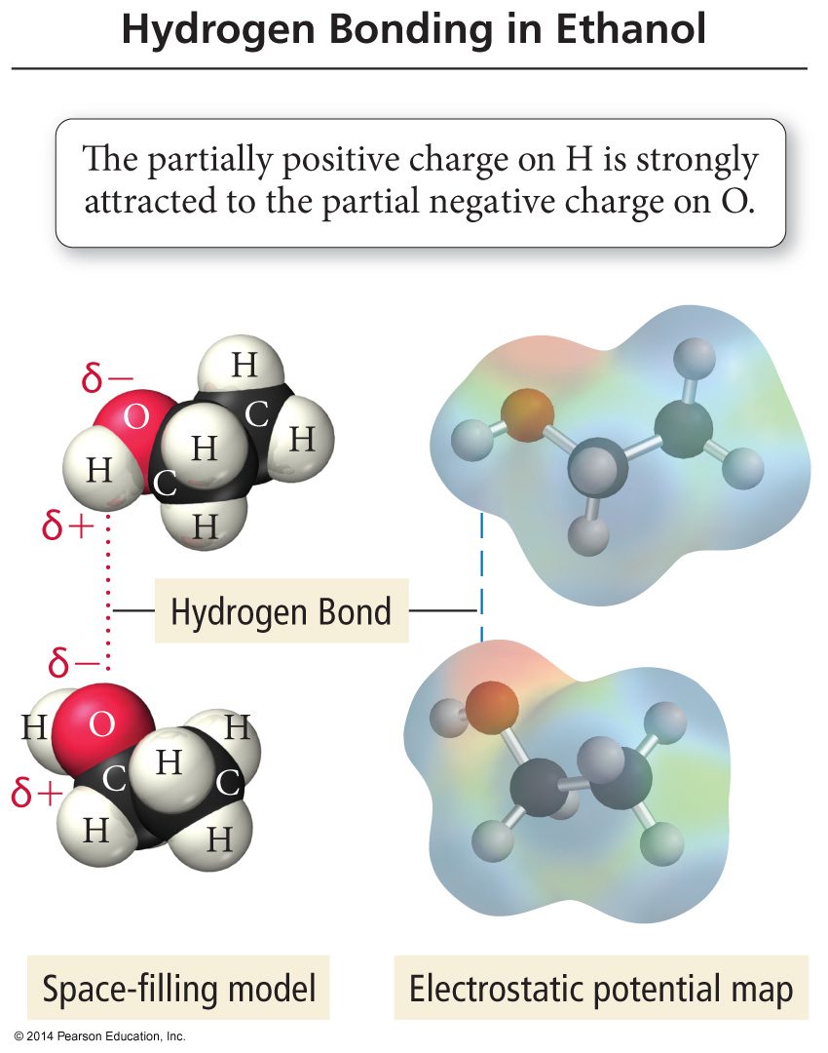
H–Bonding in Water and Ethanol

Slide 45
H–Bonds
Hydrogen bonds are very strong intermolecular attractive forces.
Stronger than dipole–dipole or dispersion forces
Substances that can hydrogen bond will have higher boiling points and melting points than similar substances that cannot.
But hydrogen bonds are not nearly as strong as chemical bonds.
2–5% the strength of covalent bonds

Slide 46
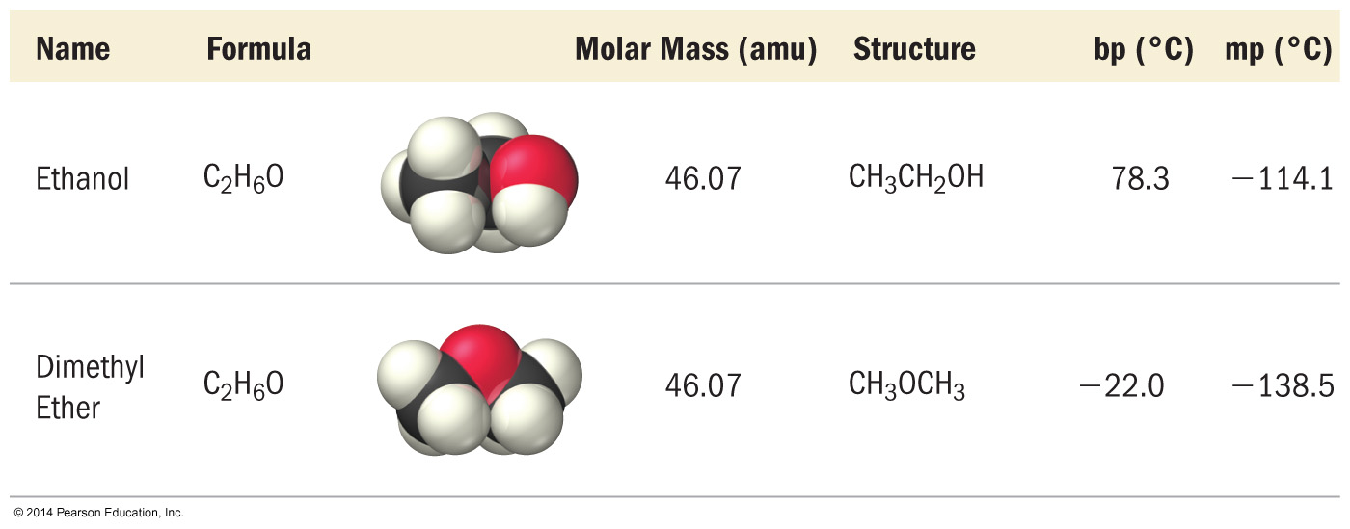
Effect of H–Bonding on Boiling Point

Slide 47
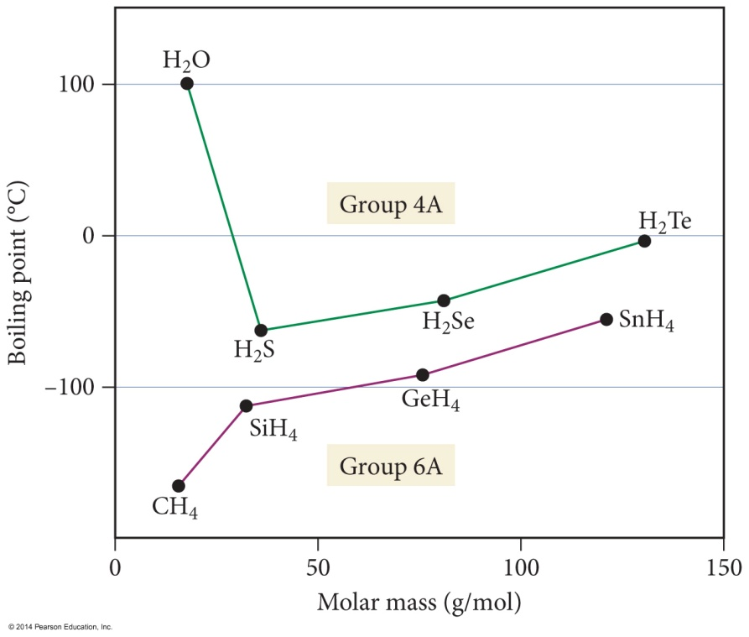
Boiling Points of Group 4A and 6A Compounds
HF, H₂O, and NH₃ have hydrogen bonds. Therefore, they have higher boiling points than would be expected from the general trends.
For nonpolar molecules, such as the hydrides of group 4, the intermolecular attractions are due to dispersion forces. Therefore, they increase down the column, causing the boiling point to increase.
Polar molecules, such as the hydrides of groups 5–7, have both dispersion forces and dipole–dipole attractions. Therefore, they have higher boiling points than the corresponding group 4 molecules.

Slide 48
Ion–Dipole Attraction
In a mixture, ions from an ionic compound are attracted to the dipole of polar molecules.
The strength of the ion–dipole attraction is one of the main factors that determines the solubility of ionic compounds in water.

Slide 49
Summary
Dispersion forces are the weakest of the intermolecular attractions.
Dispersion forces are present in all molecules and atoms.
The magnitude of the dispersion forces increases with molar mass.
Polar molecules also have dipole–dipole attractive forces.

Slide 50
Summary (cont.)
Hydrogen bonds are the strongest of the intermolecular attractive forces a pure substance can have.
Hydrogen bonds will be present when a molecule has H directly bonded to either O, N, or F atoms.
The only example of H bonded to F is HF.
Ion–dipole attractions are present in mixtures of ionic compounds with polar molecules.
Ion–dipole attractions are the strongest intermolecular attraction.
Ion–dipole attractions are especially important in aqueous solutions of ionic compounds.

Slide 51
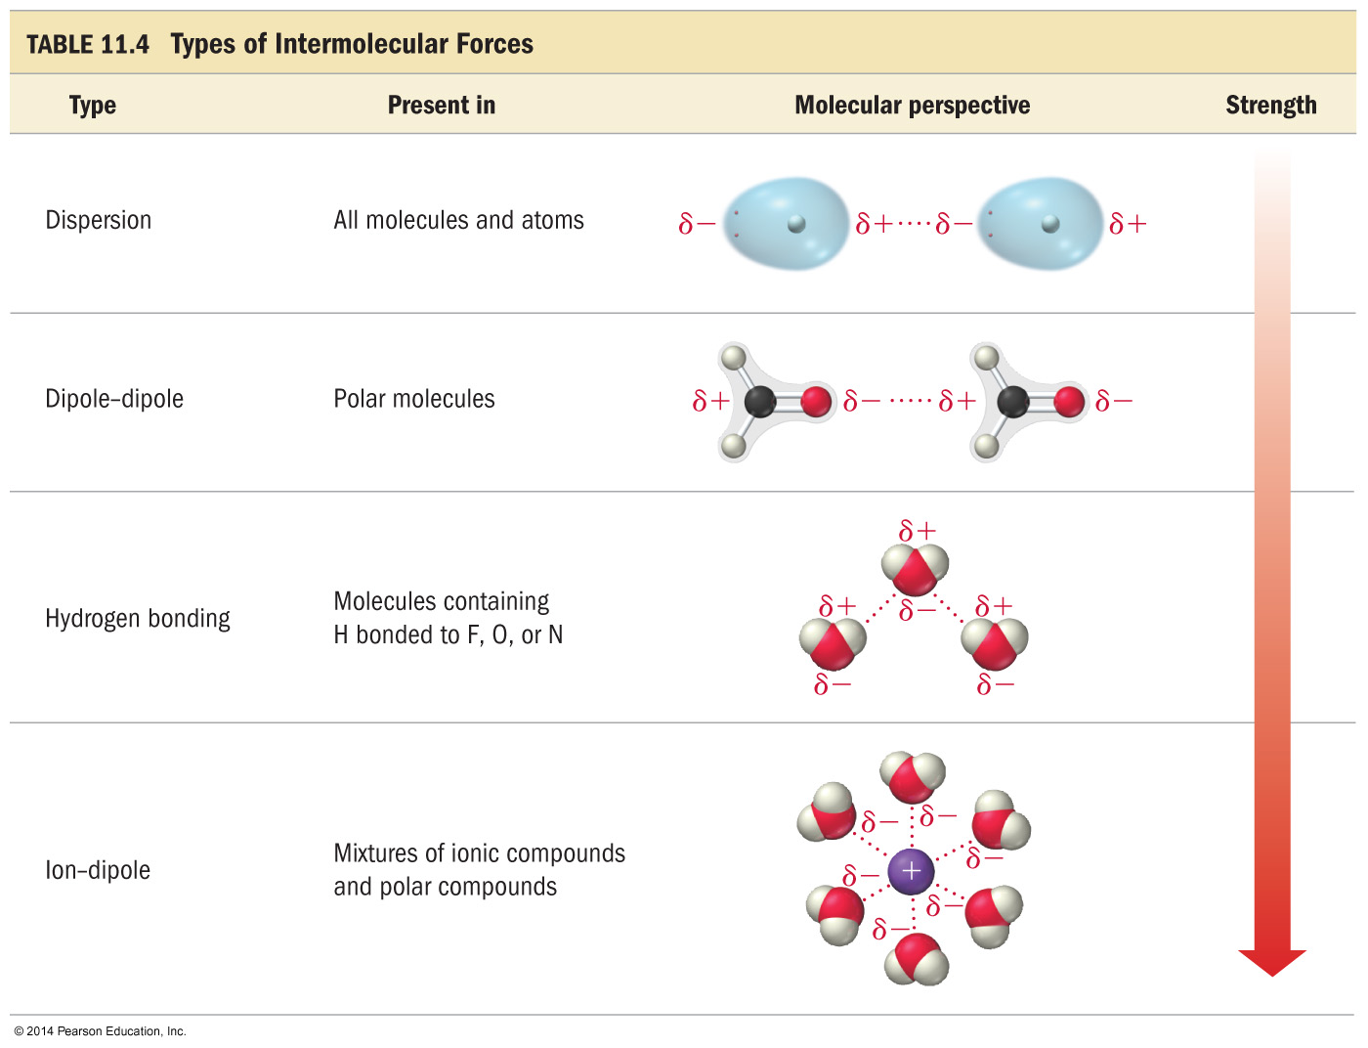

Slide 52
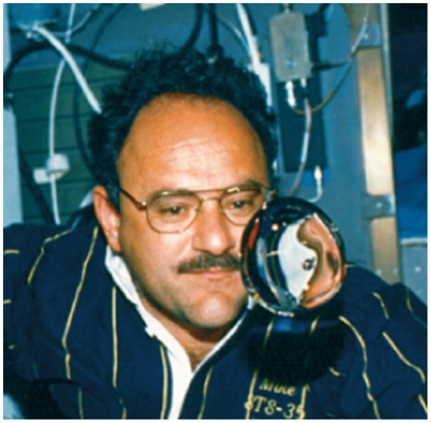
Surface Tension
Surface tension is a property of liquids that results from the tendency of liquids to minimize their surface area.
To minimize their surface area, liquids form drops that are spherical.
As long as there is no gravity

Slide 53
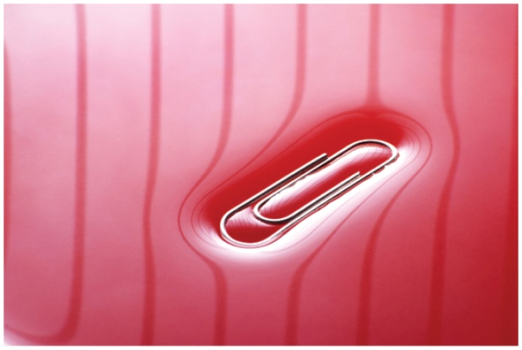
Surface Tension
The layer of molecules on the surface behave differently than the interior, because the cohesive forces on the surface molecules have a net pull into the liquid interior.
The surface layer acts like an elastic skin, allowing you to “float” a paper clip even though steel is denser than water.

Slide 54
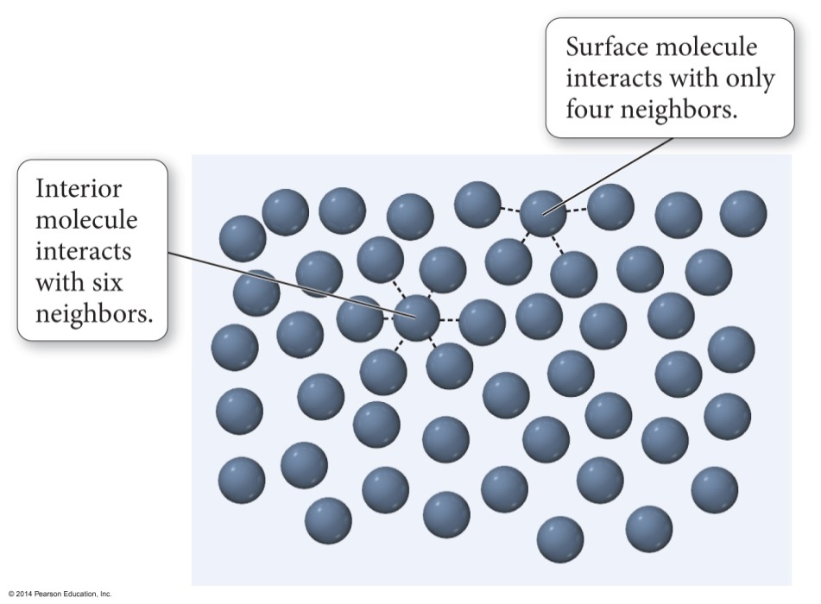
Surface Tension
Because they have fewer neighbors to attract them, the surface molecules are less stable than those in the interior.
Have a higher potential energy
The surface tension of a liquid is the energy required to increase the surface area a given amount.
Surface tension of H₂O = 72.8 mJ/m²
At room temperature
Surface tension of C₆H₆ = 28 mJ/m²

Slide 55
Factors Affecting Surface Tension
The stronger the intermolecular attractive forces, the higher the surface tension will be.
Raising the temperature of a liquid reduces its surface tension.
Raising the temperature of the liquid increases the average kinetic energy of the molecules.
The increased molecular motion makes it easier to stretch the surface.

Slide 56
Viscosity
Viscosity is the resistance of a liquid to flow.
1 poise = 1 P = 1 g/cm ∙ s
Often given in centipoise, cP
H₂O = 1 cP at room temperature
Larger intermolecular attractions = larger viscosity
Notes:
56

Slide 57
Factors Affecting Viscosity
The stronger the intermolecular attractive forces, the higher the liquid’s viscosity will be.
The more spherical the molecular shape, the lower the viscosity will be.
Molecules roll more easily.
Less surface-to-surface contact lowers attractions.

Slide 58
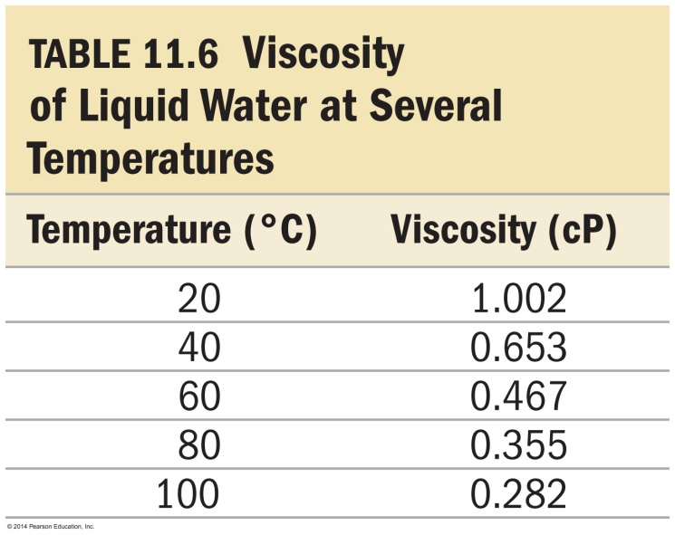
Factors Affecting Viscosity
Raising the temperature of a liquid reduces its viscosity.
Raising the temperature of the liquid increases the average kinetic energy of the molecules.
The increased molecular motion makes it easier to overcome the intermolecular attractions and flow.

Slide 59
Capillary Action
Capillary action is the ability of a liquid to flow up a thin tube against the influence of gravity.
The narrower the tube, the higher the liquid rises.
Capillary action is the result of two forces working in conjunction, the cohesive and adhesive forces.
Cohesive forces hold the liquid molecules together.
Adhesive forces attract the outer liquid molecules to the tube’s surface.

Slide 60
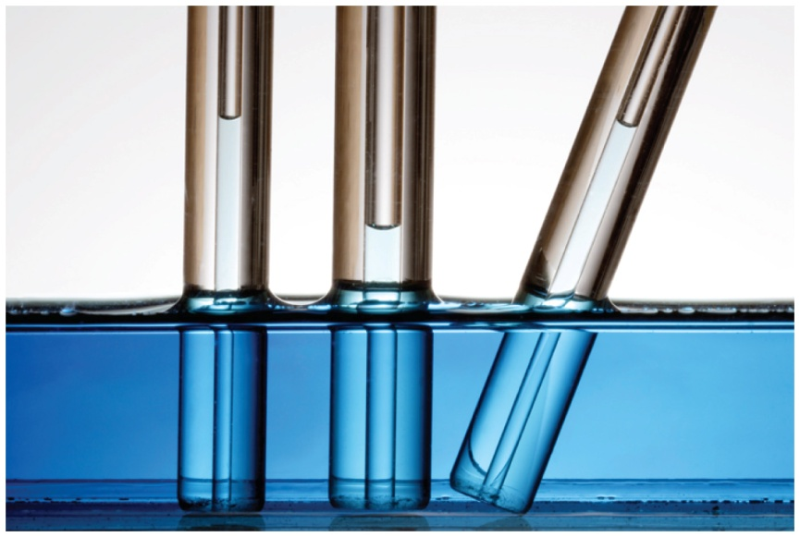
Capillary Action
The adhesive forces pull the surface liquid up the side of the tube, and the cohesive forces pull the interior liquid with it.
The liquid rises up the tube until the force of gravity counteracts the capillary action forces.
The narrower the tube diameter, the higher the liquid will rise up the tube.

Slide 61
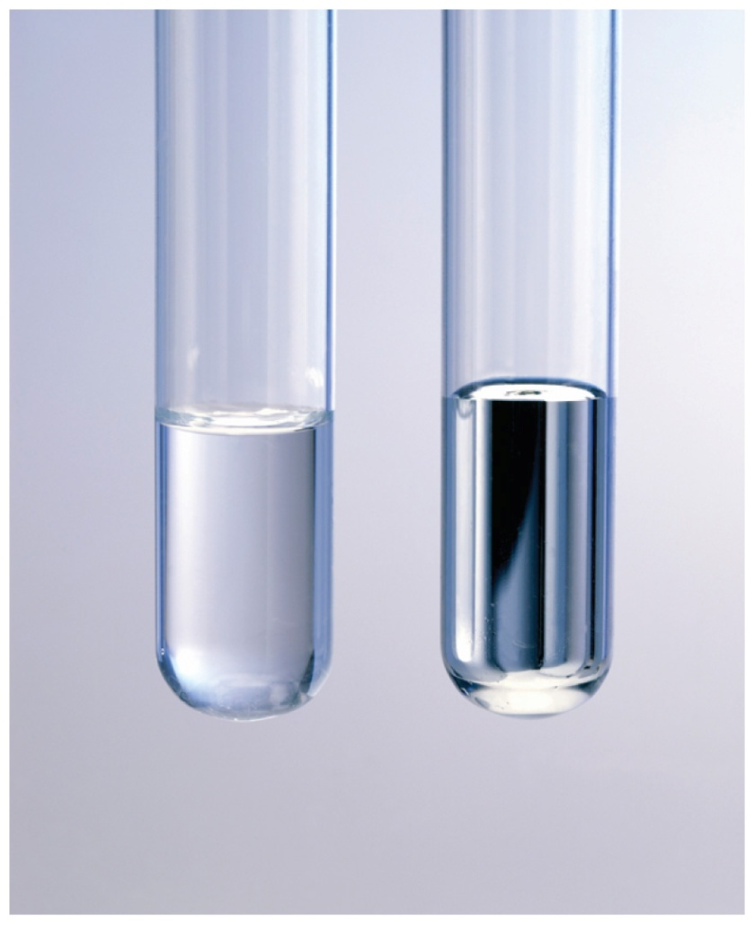
Meniscus
The curving of the liquid surface in a thin tube is due to the competition between adhesive and cohesive forces.
The meniscus of water is concave in a glass tube because its adhesion to the glass is stronger than its cohesion for itself.
The meniscus of mercury is convex in a glass tube because its cohesion for itself is stronger than its adhesion for the glass.
Metallic bonds are stronger than intermolecular attractions.

Slide 62
The Molecular Dance
Molecules in the liquid are constantly in motion.
Vibrational, and limited rotational and translational
The average kinetic energy is proportional to the temperature.
However, some molecules have more kinetic energy than the average, and others have less.

Slide 63
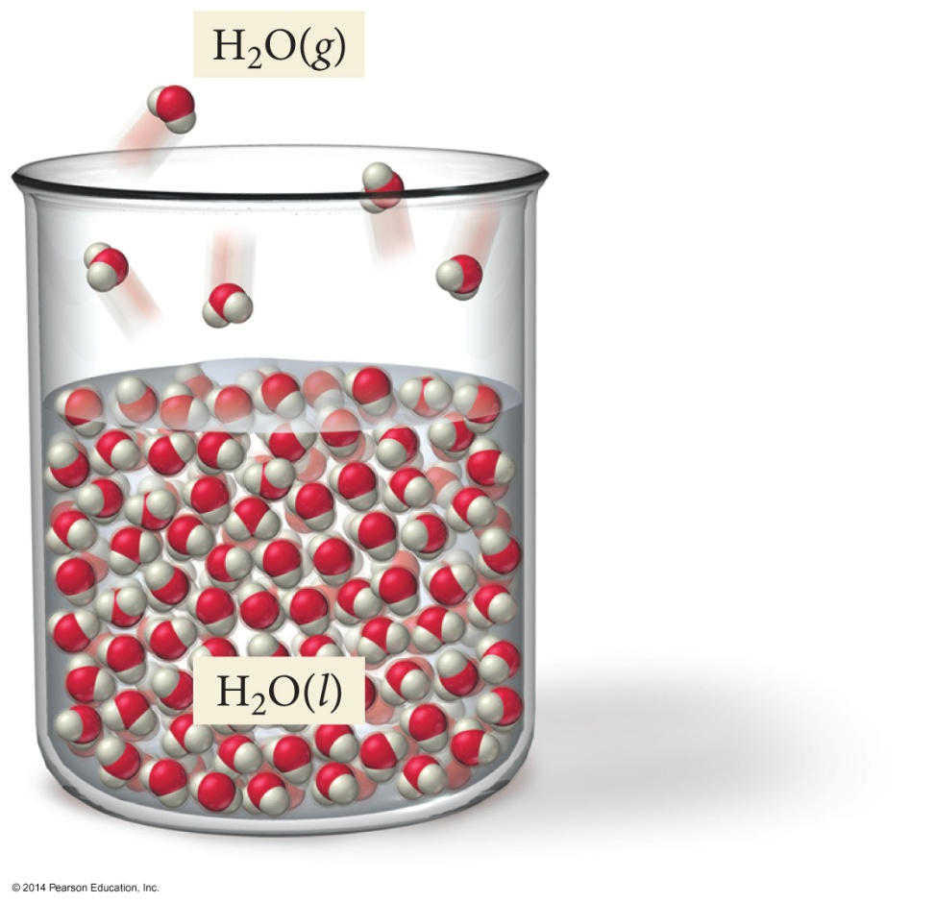
Vaporization
If these high energy molecules are at the surface, they may have enough energy to overcome the attractive forces.
Therefore, the larger the surface area, the faster the rate of evaporation.
This will allow them to escape the liquid and become a vapor.

Slide 64
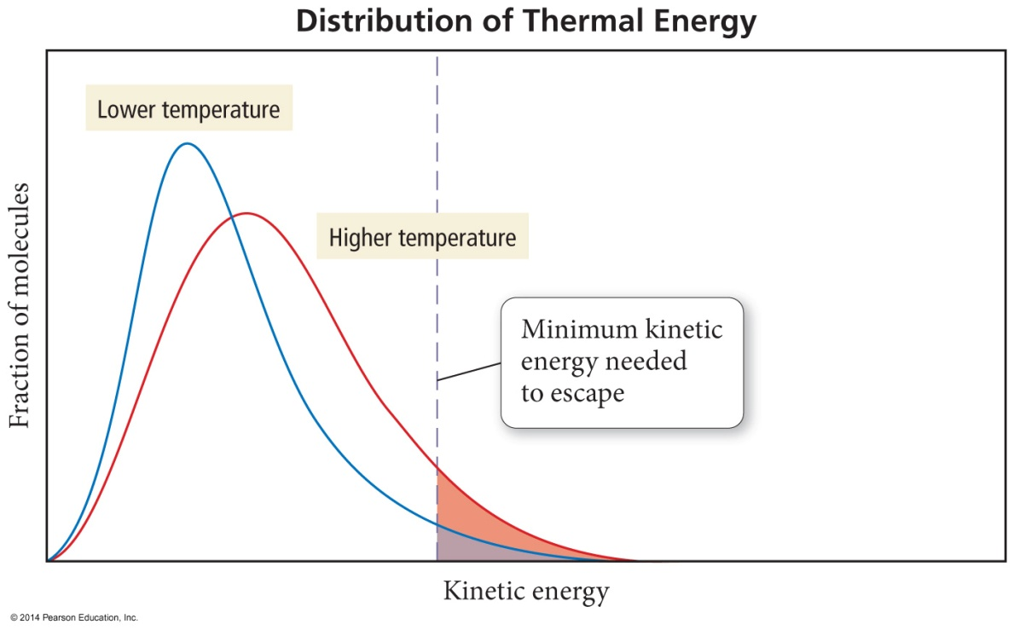
Distribution of Thermal Energy
Only a small fraction of the molecules in a liquid have enough energy to escape.
But, as the temperature increases, the fraction of the molecules with “escape energy” increases.
The higher the temperature, the faster the rate of evaporation.

Slide 65
Condensation
Some molecules of the vapor will lose energy through molecular collisions.
The result will be that some of the molecules will get captured back into the liquid when they collide with it.
Also some may stick and gather together to form droplets of liquid, particularly on surrounding surfaces.
We call this process condensation.

Slide 66
Evaporation versus Condensation
Vaporization and condensation are opposite processes.
In an open container, the vapor molecules generally spread out faster than they can condense.
The net result is that the rate of vaporization is greater than the rate of condensation, and there is a net loss of liquid.
However, in a closed container, the vapor is not allowed to spread out indefinitely.
The net result in a closed container is that at some time the rates of vaporization and condensation will be equal.

Slide 67
Effect of Intermolecular Attraction on Evaporation and Condensation
The weaker the attractive forces between molecules, the less energy they will need to vaporize.
Also, weaker attractive forces means that more energy will need to be removed from the vapor molecules before they can condense.
The net result will be more molecules in the vapor phase, and a liquid that evaporates faster; the weaker the attractive forces, the faster the rate of evaporation.
Liquids that evaporate easily are said to be volatile.
For example, gasoline, fingernail polish remover
Liquids that do not evaporate easily are called nonvolatile.
For example, motor oil

Slide 68
Energetics of Vaporization
When the high energy molecules are lost from the liquid, it lowers the average kinetic energy.
If energy is not drawn back into the liquid, its temperature will decrease; therefore, vaporization is an endothermic process.
Condensation is an exothermic process.
Vaporization requires input of energy to overcome the attractions between molecules.

Slide 69
Heat of Vaporization
The amount of heat energy required to vaporize one mole of the liquid is called the heat of vaporization, ΔH_{vap}.
Sometimes called the enthalpy of vaporization
It is always endothermic; therefore, ΔH_{vap} is +.
It is somewhat temperature dependent.
ΔH_{condensation} = −ΔH_{vaporization}

Slide 70
Dynamic Equilibrium
In a closed container, once the rates of vaporization and condensation are equal, the total amount of vapor and liquid will not change.
Evaporation and condensation are still occurring, but because they are opposite processes, there is no net gain or loss of either vapor or liquid.

Slide 71
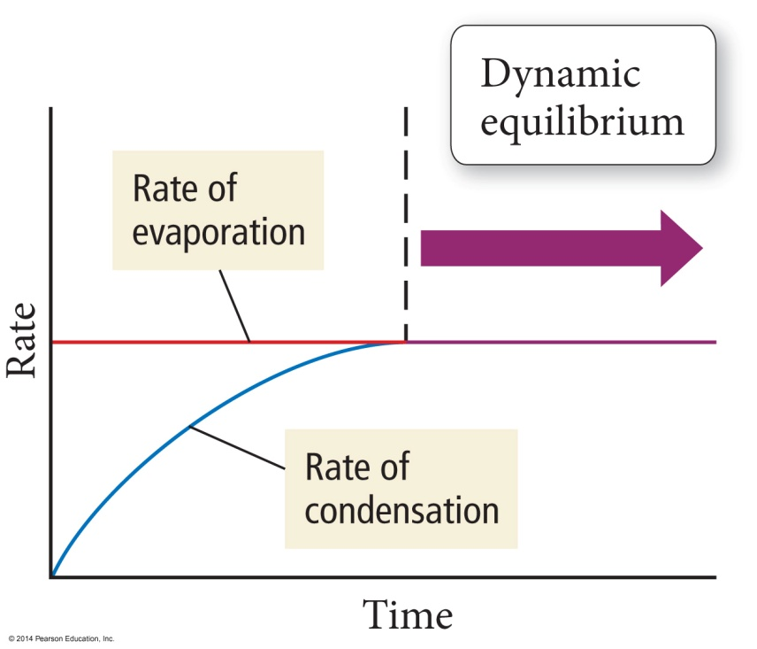
Dynamic Equilibrium
When two opposite processes reach the same rate so that there is no gain or loss of material, we call it a dynamic equilibrium.
This does not mean there are equal amounts of vapor and liquid; it means that they are changing by equal amounts.

Slide 72
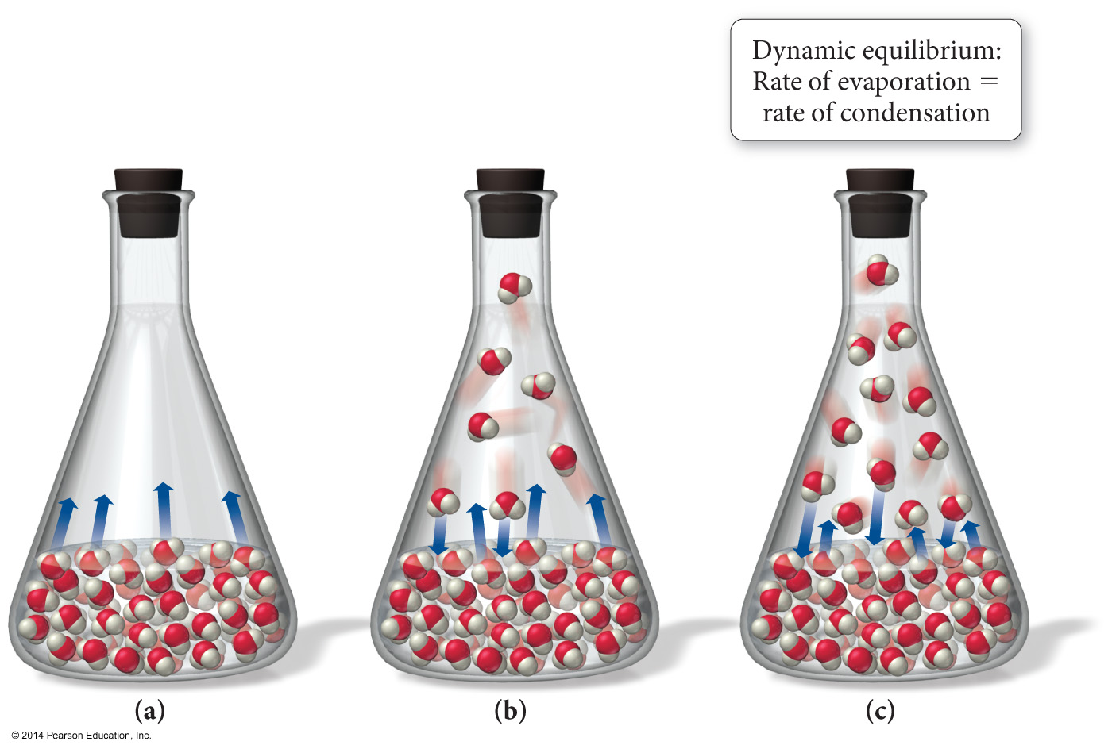
Dynamic Equilibrium

Slide 73
Vapor Pressure
The pressure exerted by the vapor when it is in dynamic equilibrium with its liquid is called the vapor pressure.
Remember using Dalton’s Law of Partial Pressures to account for the pressure of the water vapor when collecting gases by water displacement?
The weaker the attractive forces between the molecules, the more molecules will be in the vapor.
Therefore, the weaker the attractive forces, the higher the vapor pressure.
The higher the vapor pressure, the more volatile the liquid.

Slide 74
Vapor–Liquid Dynamic Equilibrium
If the volume of the chamber is increased, it will decrease the pressure of the vapor inside the chamber.
At that point, there are fewer vapor molecules in a given volume, causing the rate of condensation to slow.
Therefore, for a period of time, the rate of vaporization will be faster than the rate of condensation, and the amount of vapor will increase.
Eventually, enough vapor accumulates so that the rate of the condensation increases to the point where it is once again as fast as evaporation.
Equilibrium is reestablished.
At this point, the vapor pressure will be the same as it was before.

Slide 75
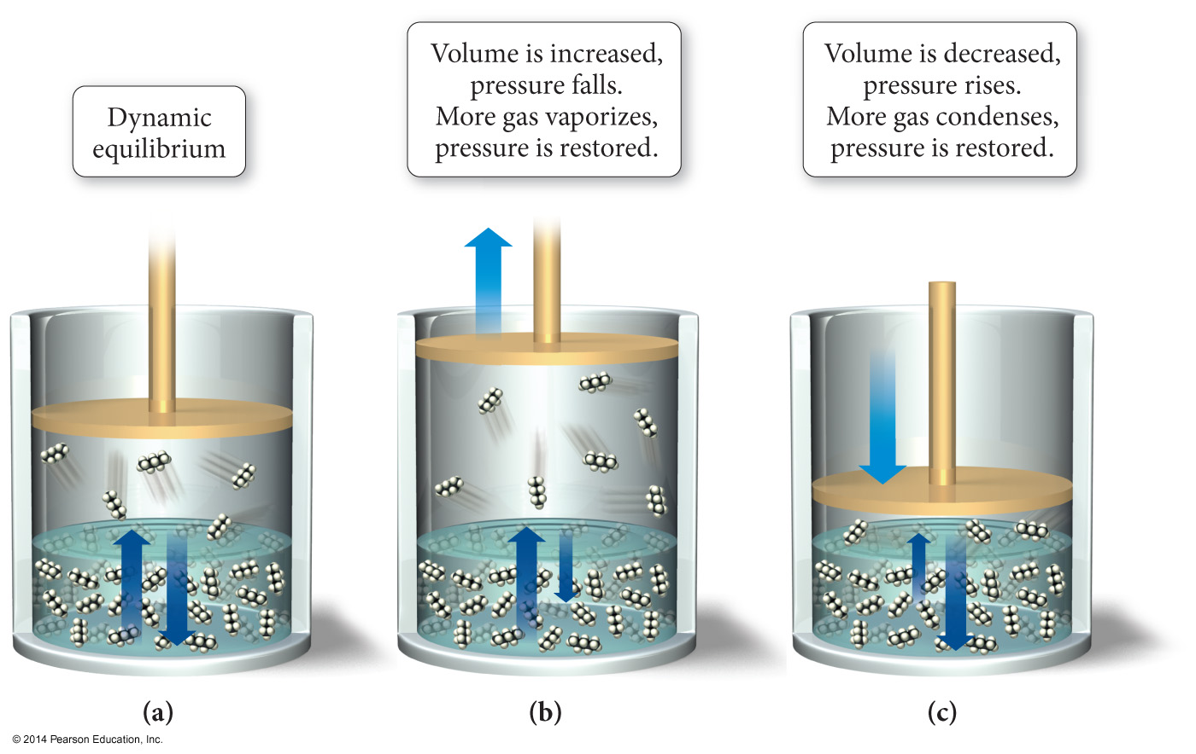
Changing the Container’s Volume Disturbs the Equilibrium
Initially, the rate of vaporization and condensation are equal and the system is in dynamic equilibrium.
When the volume is increased, the rate of vaporization becomes faster than the rate of condensation.
When the volume is decreased, the rate of vaporization becomes slower than the rate of condensation.

Slide 76
Dynamic Equilibrium
A system in dynamic equilibrium can respond to changes in the conditions.
When conditions change, the system shifts its position to relieve or reduce the effects of the change.

